Slide 1
“All Together Now”
Child Bereavement UK Scotland Development Project
Rich Stafford
Director of Bereavement Sector Support - Scotland

Slide 2
Who we are and what we do

Slide 3
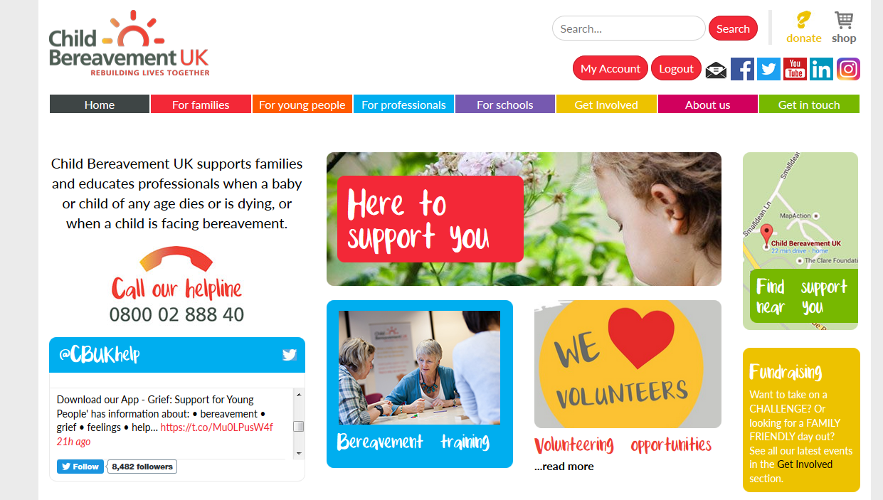
Our website www.childbereavementuk.org

Slide 4

Why Bereavement Support?
Every 22 minutes in the UK a child is bereaved of a parent, making up some 24,000 children a year. www.childhoodbereavementnetwork.org.uk
In Scotland 2,500 parents die each year leaving dependent children This means 4,100 children under 18 are bereaved of a parent each year in Scotland.
(from Mortality Stats 2011).
Many more are bereaved of a grandparent, sibling, school friend or other significant person.

Slide 5
Death is a fact of life...
...and grief is a natural process.
But many people, adults and children, need more support and understanding in their grieving than they receive.
The consequences of unresolved grief can be dire.
Life expectancy is lower in more disadvantaged areas
http://www.yorkpress.co.uk/news/9242248.Grieving_parents_may_die_younger__new_study_shows/

Slide 6
The Evidence Base
Unresolved grief issues have higher incidence in:
Academic Under-Achievement
Challenging Behaviour/ Mental Health Issues
Teenage Pregnancies
Youth Offenders
Prison Populations
www.cbn@ncb.org.uk

Slide 7
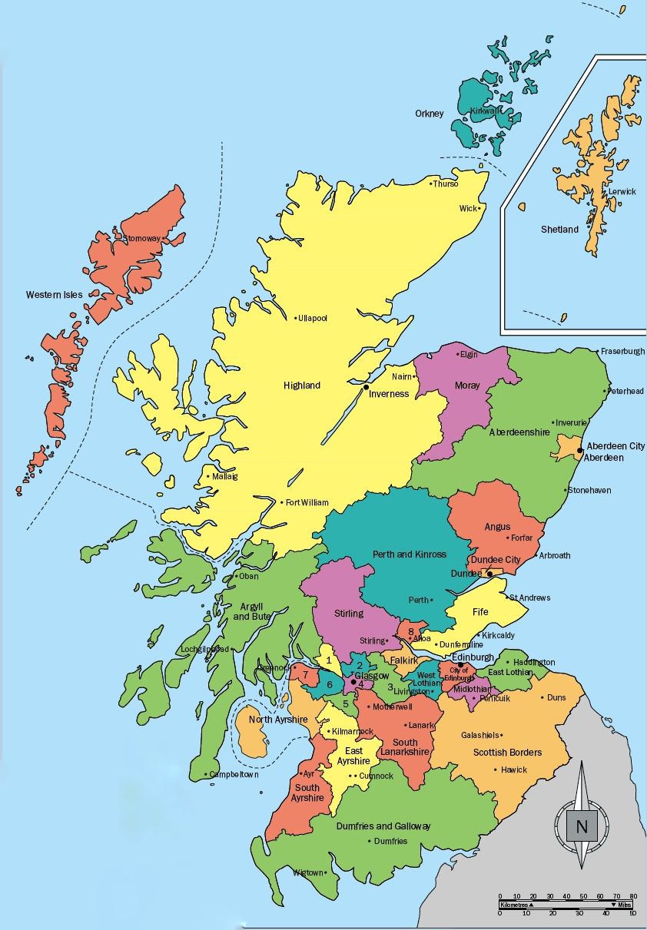
Scotland
Development Project
Glasgow
Edinburgh
West Lothian
Dundee
Aberdeen
North and South Ayrshire
North and South Lanarkshire
Fife
The Highlands
Orkney
Shetland

Slide 8
“The long and winding road…”

Slide 9
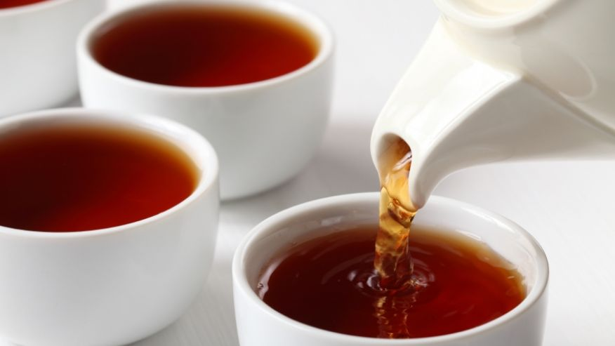

"when are you free to take some tea with me...”
Voluntary Sector Services.
Statutory Services
Other Stakeholders

Slide 10
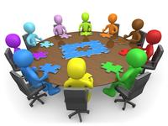
“Come Together”

Slide 11

"...fixing a hole where the rain gets in..."
To reflect the needs of:
  Bereaved young people and families
  Local services providing bereavement support
  Statutory services accessed by bereaved
  children and families

Slide 12
"...fixing a hole where the rain gets in..."
With the intention of:
  Enhancing the profile of local bereavement initiatives.
  Being aware of local and national policies that impact
  bereavement.
  Working collaboratively.

Slide 13

"The sun is up the sky is blue..."
Enhanced Awareness & Confidence For Professionals
Enhanced Support For Families

Slide 14

  "to be here, there and everywhere..."
Glasgow
Edinburgh
West Lothian
Dundee
Aberdeen
Ayrshire
Lanarkshire
Fife
The Highlands
Orkney
Shetland

Slide 15
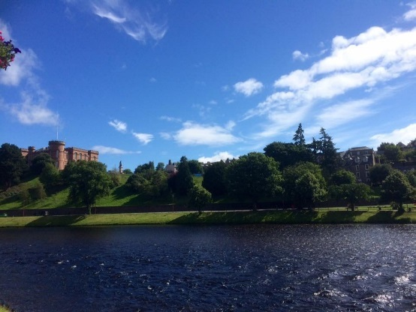
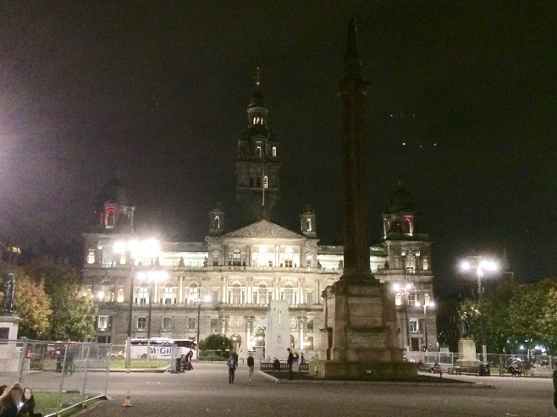
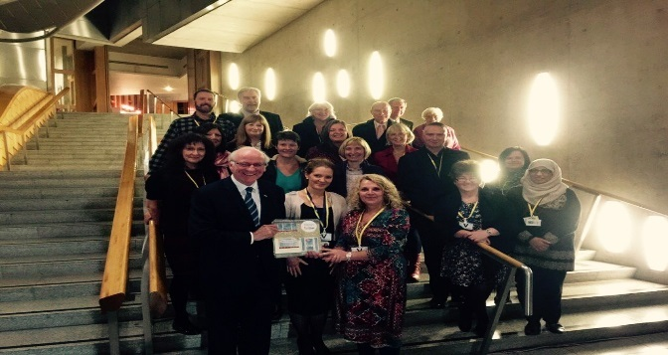
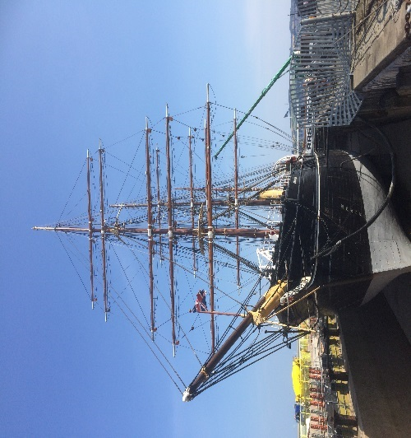

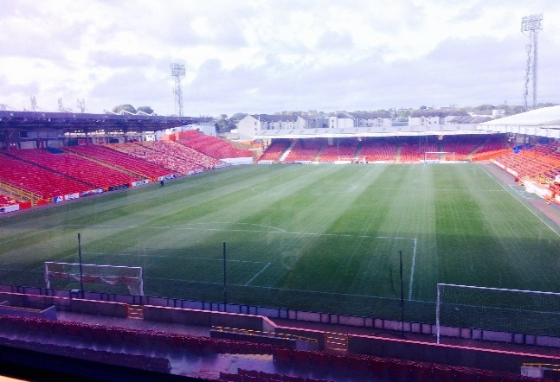
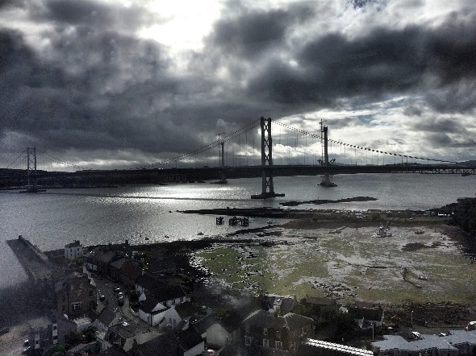
  "to be here, there and everywhere..."

Slide 16
“…to the end of the beginning"
So what have we been doing?

Slide 17

  “It’s been a hard day’s night…”

Slide 18
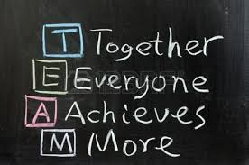
"I know you, you know me..."

Slide 19
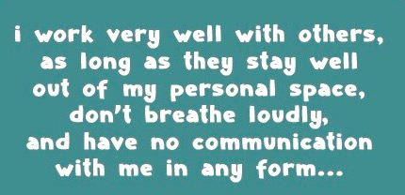
“I know you, you know me..."
Not...

Slide 20

“...there’s a place where I can go..."
Initially - "I wasn’t too sure what the purpose of the advisory group was".
Now – "It’s been really beneficial to bring services together, to understand each other better, and to develop a common voice“

Slide 21

"And don't you know it's gonna last..."
Sustainability

Slide 22
"Say the word and you'll be free..."
LEARNING
COLLABORATION
INFORMATION
PARTNERSHIP
COMMUNICATION
TRUST
AWARENESS & PROFILE RAISING
SIGNPOSTING
RELATIONSHIPS
BREAKING DOWN BARRIERS

Slide 23
If you want to go fast, go alone. If
you want to go far, go with others.
African proverb

Slide 24
"And in the end..."

Slide 25
“There’s nothing you can do that can’t be done...”
John Lennon 1967

