Slide 1
Bereavement in young lives:
the challenges it brings & how to help build resilience
Sacha Richardson
University of Strathclyde – 18th November 2016

Slide 2

Child bereavement statistics
for the UK
Every 22 minutes, a child’s parent dies.
This means that:
111 children a day are bereaved of a parent
41,000 children are newly bereaved each year
480,000 (4% of) children under the age of 18 have experienced the death of a parent or sibling
30% of looked after children under 5 (Cousins 2003)
1 in 29 children have been bereaved of a parent or sibling – that’s around 1 child per class (aged 16)
78% of young people report bereavement of a ‘close’ or ‘significant’ relationship before age of 16 (Harrison and Harrington 2001)

Slide 3
Why does childhood bereavement matter?
We want to alleviate suffering and provide solace and …
Risk factors /associations include:
Low self-esteem
Children becoming ‘Looked After’
Poor school attainment
Being bullied
Greater risk of dying young, including by suicide, even greater if death was by suicide (x3 for suicide death)

Slide 4
Why does childhood bereavement matter?
Strong Link With Teenage pregnancy
Exclusion and Youth Offending
Substance misuse
Low participation in education, employment and training
Mental health difficulties including depression and anxiety in adulthood
Source: A Penny & D Stubbs ‘What do we know in 2015?’
Childhood Bereavement Network

Slide 5
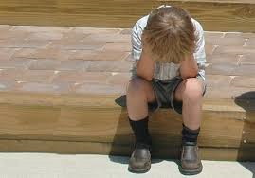
The impact of bereavement in childhood
  Common reactions include:
  Anxiety
  Vivid memories
  Sleep difficulties
  Sadness and longing
  Anger and acting out behaviour
  Guilt, self-reproach and shame
  School problems
  Inability to concentrate
  Physical complaints

Slide 6
“No one ever told me that grief felt so like fear. I am not afraid, but the sensation is like being afraid. The same fluttering in the stomach, the same restlessness, the yawning. I keep on swallowing.”
C.S. Lewis A Grief Observed
Often fear is the dominant emotion especially if you don’t understand what death means or what caused someone to die – it may appear as anger

Slide 7

Sadness
What do we do if someone is sad?
What about if they stay sad?
What about a child who is sad?
Are they sometimes “Forgotten Mourners”?

Slide 8
What do we say?
How it is for us
I am so sorry to hear that your mum died…. I don’t know what else to say….. I am here whenever you need me
How it is sometimes for others (or yourself)
I know people often struggle to concentrate and find it really weird that everyone else carries on as normal, sometimes it feels like it cannot be true.
Sometimes very tentatively (if we have rapport): how it might be, or might not be for them
I wonder if you might be feeling or thinking…. Or maybe I have that wrong and it is not like that at all.

Slide 9
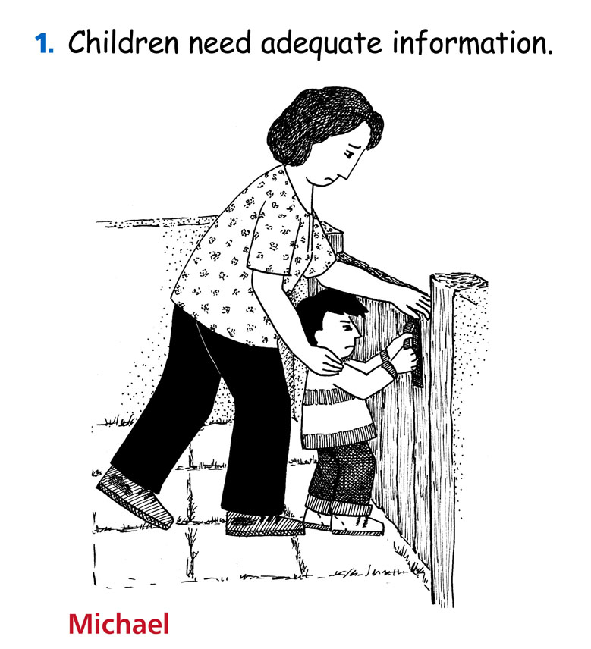
Pictures from Not Too Young to Grieve and Teenage Grief DVDs -
Leeds Animation Workshop

Slide 10
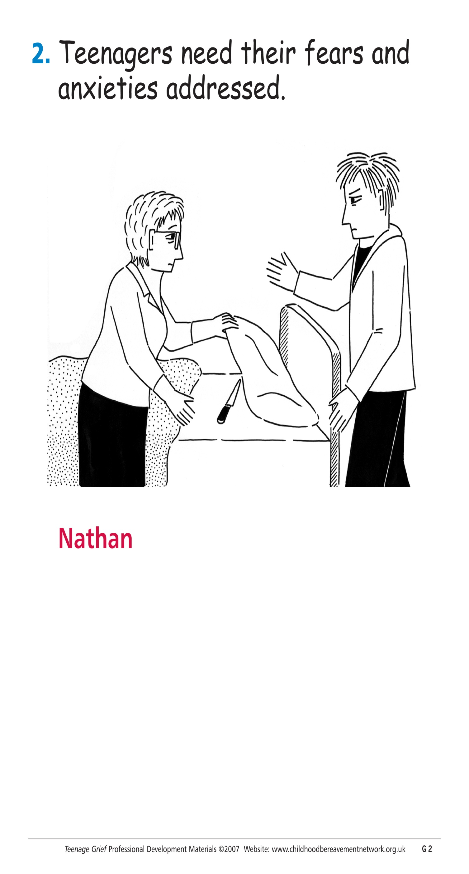

Slide 11
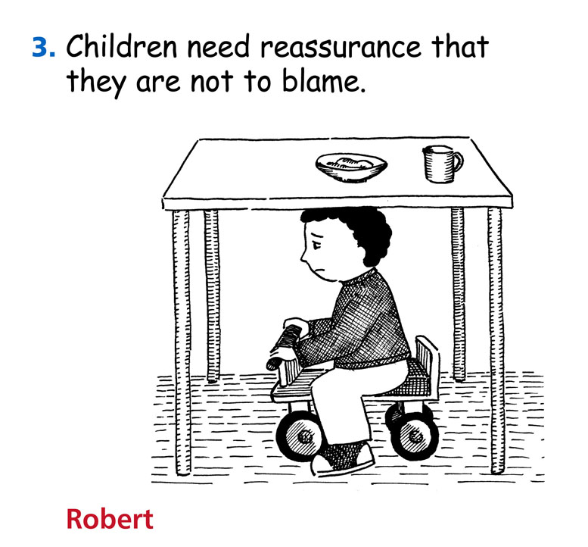

Slide 12
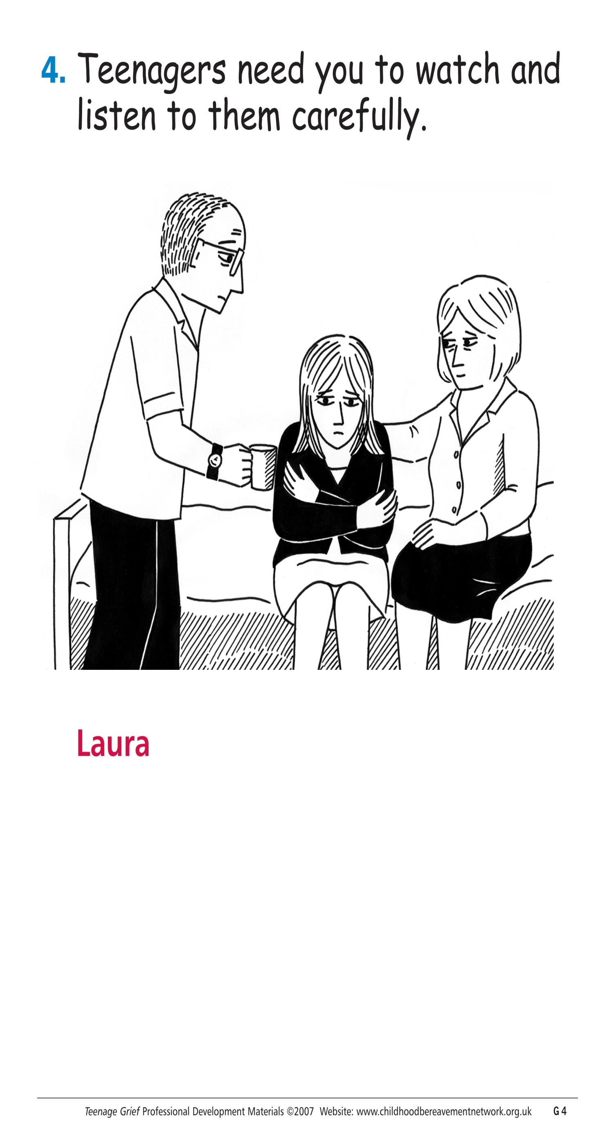

Slide 13
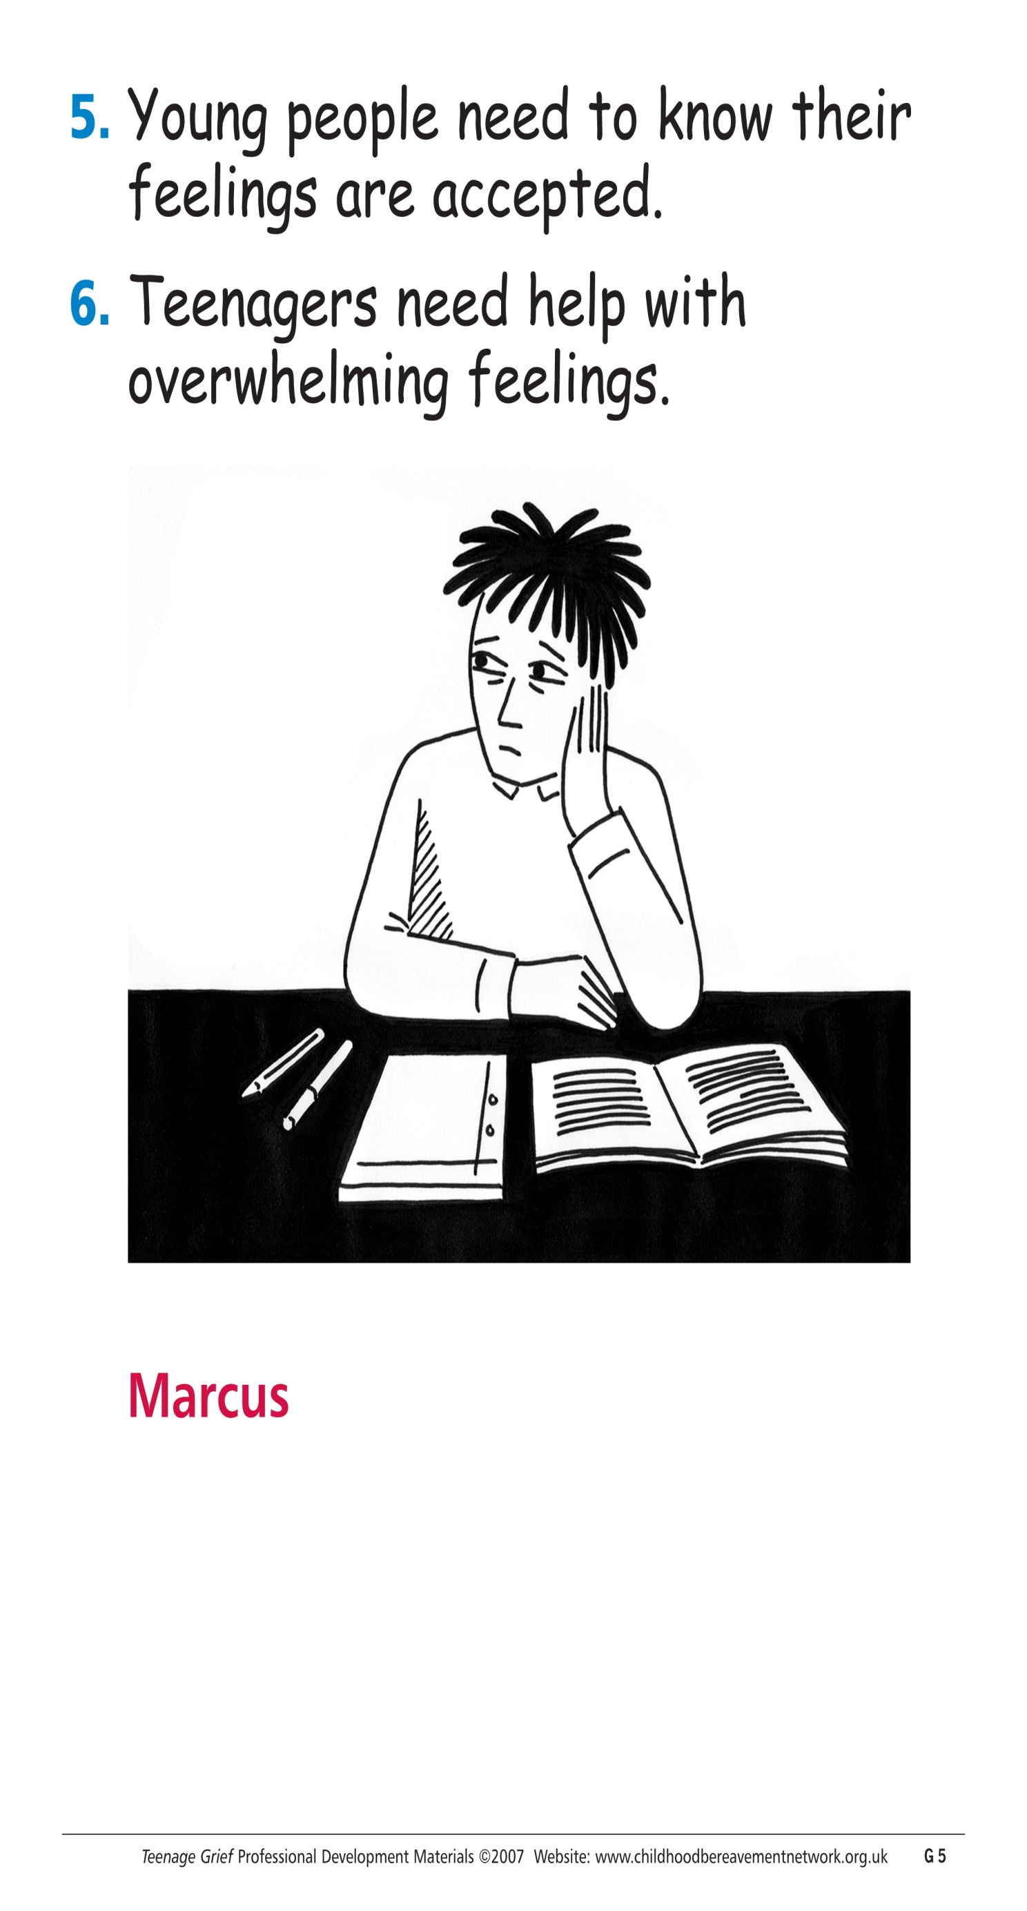

Slide 14
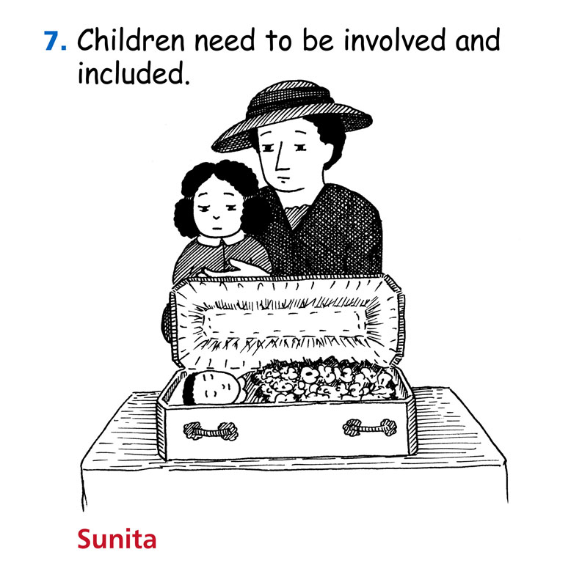

Slide 15
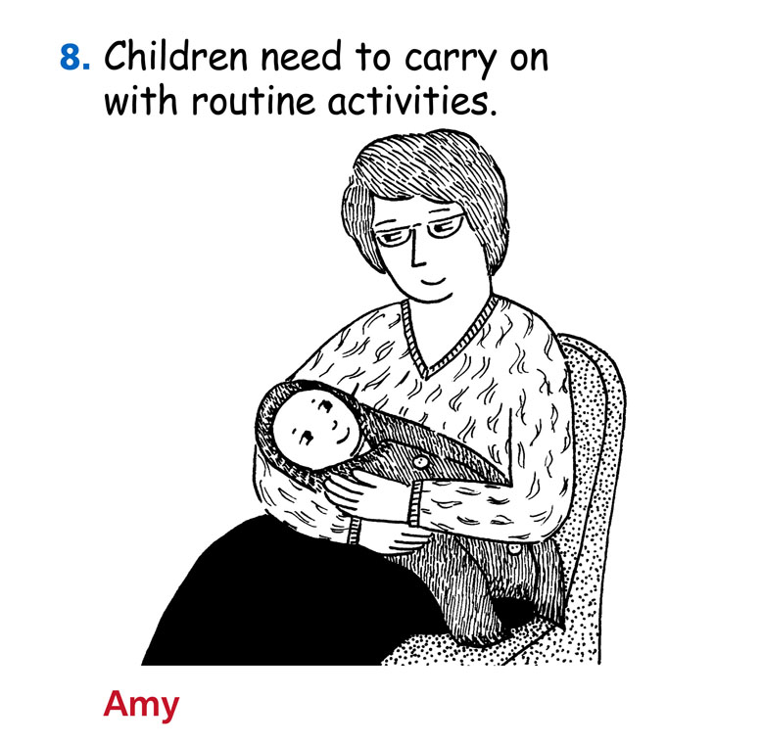

Slide 16
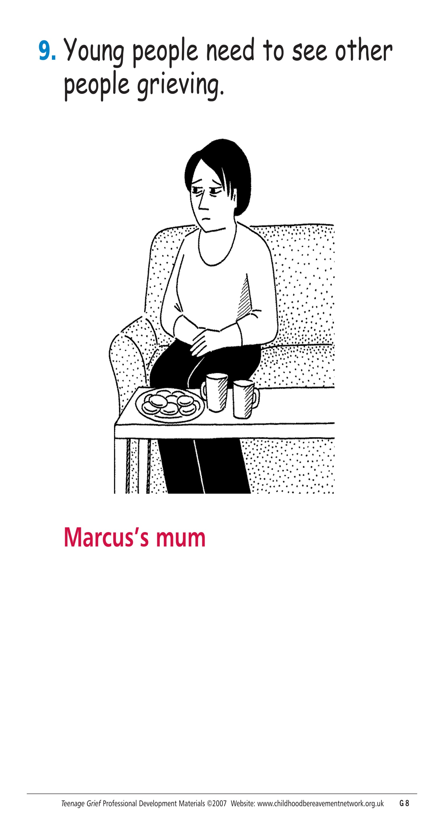

Slide 17
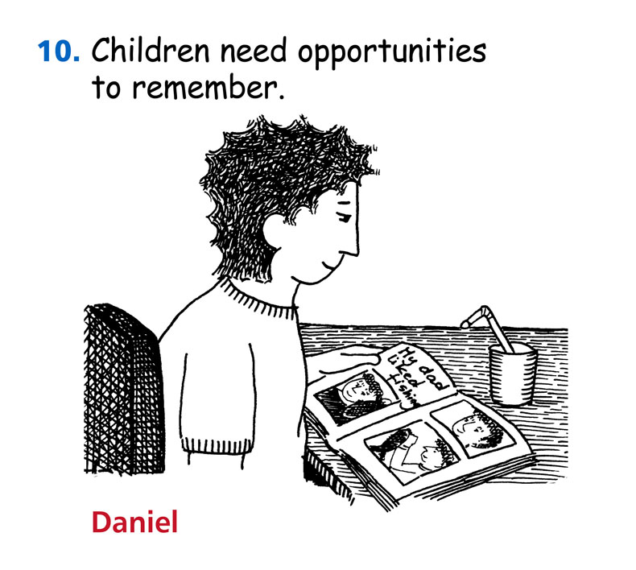

Slide 18

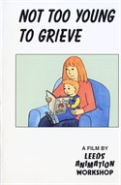

Directory, policy, support for services and resources
Downloadable training packs:
(Training others)
Teenage Grief
www.childhoodbereavementnetwork.org.uk

Slide 19
Narrative Grief Theory
Mourning is a process between people at least as much as within a person
Death impacts ‘self narrative’ of bereaved
Social discourse is vital component of grief
Grief takes place in a cultural context which may suggest a ‘right or wrong way to grieve’
Neimeyer, Klass & Dennis (2014)

Slide 20
“Social constructionist model of grief is a situated interpretive and communicative activity”
SITUATED = social, historical and cultural context
INTERPRETIVE = meaning making processes
COMMUNICATIVE = processes take place in written, spoken and nonverbal exchange
ACTIVITY = grieving and mourning are active not simply to be endured

Slide 21
Cultural context
‘All societies have rules for how the emotions of grief are to be displayed and handled’ (Walter 1999)
Expression/inhibition of emotion
Gender roles e.g. Women cry, men get angry
How / if connect to deceased
What is British or Scottish culture of grief?

Slide 22
Narrative grief theory: children
Ongoing process of understanding the world
May need to learn or understand language
Meaning is experienced in ‘whole communication’ (not just the words)
If given incomplete or dishonest information may have to restart narrative process (turmoil)
Peers may not know how to talk about loss – could impact on status
S. Richardson

Slide 23

Language & Mixed Messages

Slide 24
Narrative grief theory: children (2)
If they are ‘protected’ how can they make sense of event
If people do not share stories about deceased how can they form a back story?
How do they make sense of conflicting stories?
S. Richardson

Slide 25
“The hardest part for me was realising that I couldn’t protect Rachel from the pain of her father’s death. It hurts to watch my child in pain. But then I realised that it isn’t a choice of whether she will hurt or not, but whether I will know about it.”
Christ G. 2000

Slide 26
Every bereaved child is unique
How does this particular cause of death?
Of this particular person?
At this time?
In this family?
Impact on this child?
Within their particular environments (friends, school, community, interests….)?

Slide 27
The SWITCH Programme
To deliver a community outreach intervention to vulnerable children and young people aged 8-14 who have been bereaved and might be experiencing one or more of the following:-
  Truancy, exclusion and risk of exclusion from school.
  Relationship breakdown with family and/or peers.
  Unable to manage behaviour or emotions.
  Socially isolated.
  Based in Gloucestershire initially then West Sussex.
Notes:
27

Slide 28
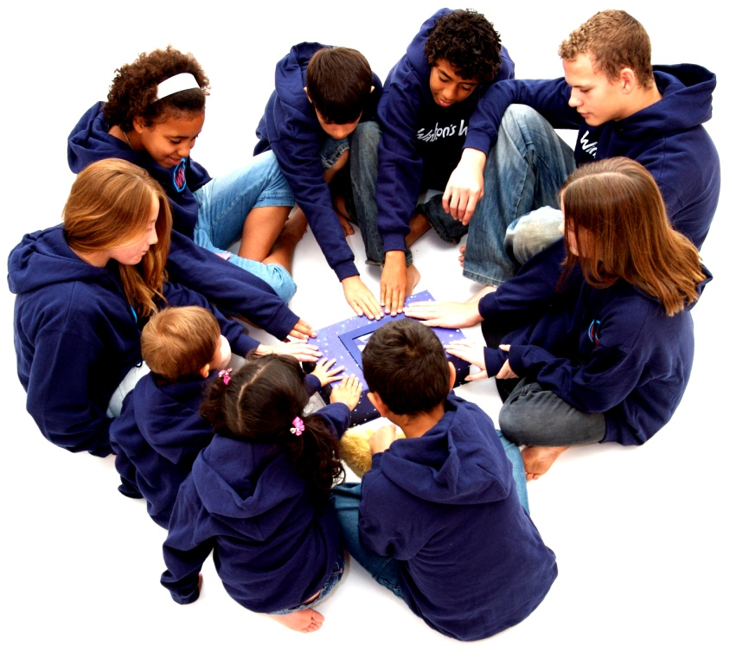
Aims of the SWITCH programme
  Help children and young people understand the impact the death is having on their life and their relationships.
  Recognise and manage difficult feelings and behaviours in relation to their grief.
  Meet others who have been bereaved.
  Learn and share new coping strategies.
  Build confidence, resilience and self esteem.

Slide 29
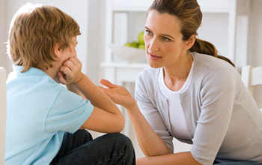
What SWITCH delivers
The Winston’s Wish bereavement intervention using a new delivery method specifically aimed at the target group, including:
2/4 family meetings
4 group sessions for children and young people
(after school - 2 hours)
2 parent groups/ parenting Pack
1 celebration day
1,3,6 & 12 month follow ups

Slide 30
The Long Term Effects
Results from the SDQs
85% of children experienced an improvement*
Risk of developing a mental health problem had reduced by 30%
Overall stress had reduced by 30%
Emotional difficulties had lessoned by 33%
Behavioural difficulties had reduced by 38%
Hyperactivity and concentration had lessoned by 20%
Peer relationship problems had lessoned by 36%
Kalli Selioti
Notes:
30

Slide 31
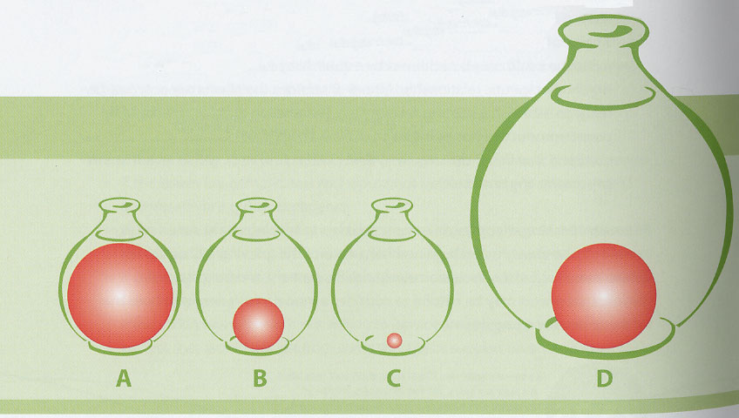
Growing around grief
‘In some ways the pain of grief itself stayed much the same...but as time went on my world expanded so it felt less suffocating’
Tonkin (2006)

Slide 32
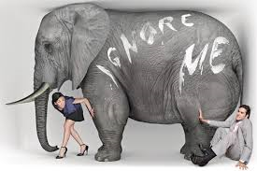
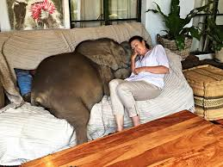
When we talk about what might initially seem difficult and painful things we learn that they can become every day and common place.

