Slide 1
Positive Youth Justice
Children First, Offenders Second
Professor Steve Case, Loughborough

Slide 2
Who am I?

Slide 3
What I’ll cover
PYJ as anti-risk & anti-negative youth justice
The PYJ/CFOS principles
PYJ/CFOS as practised in the Swansea Bureau
The positive turn?
Surrey Youth Support Service & PYJ
Implications for youth justice practice

Slide 4
Positive youth justice:
Children First, Offenders Second
Children First, Offenders Second (CFOS) evolves contemporary youth justice beyond its contemporary risk focus
Promotes a principled, progressive and practical approach to the treatment of children in the Youth Justice System.

Slide 5
CFOS as anti-risk
The measurement, assessment and amelioration of risk drives contemporary youth justice
Risk Factor Prevention Paradigm, Scaled Approach
However, the utility & appropriateness of the risk paradigm has been over-stated
PARTIAL foci, methods, understandings
NEGATIVE-facing & retrospective
No consensus about what approach should or can replace risk as the driver of policy and practice.

Slide 6
Medway Improvement Board report May 2016
“They treat you like an animal and it’s when you need real help.” Young person at Medway STC
“over-controlling and degrading”
“dehumanising”
“control and containment”
“the voice of the children is not being effectively heard”

Slide 7
The Board noted that the use of the term ‘risk assessment’ appears very frequently in all documentation...The Board is concerned that this practice appears more about control and containment than safeguarding vulnerable children
Medway Improvement Board Report May 2016
Notes:
Failure to see children who offend as children but as a basket full of risks to be controlled and pacified.
It is no coincidence that it took 13 years after the passing of the Children Act in 1989 for Justice Mumby to rule that it applied in YOIs. The presumption was that once incarcerated children lost the same rights and protections in law that other children enjoy.
There never has been a golden age for youth justice – there are times when things have been better than others: ironically under Margaret Thatcher – but even then our YOIs were far worse than today

Slide 8
“Children grow to fill the space we create for them, and if it’s big, they grow tall.…I’ve not yet met a child not capable of greatness if given the opportunity and encouragement….The best present we can give our children is the chance to do something great. It’s a gift that will last a lifetime and transform their lives.”
Jonathan Sacks quoted in the Medway Improvement Board report

Slide 9
Positive youth justice:
Children First, Offenders Second
4 principles promoting:
Child friendly - adults’ responsibilities
Promotion, inclusion & desistance
Diversion & systems management
Relationship-based partnerships – inc. participation, engagement, legitimacy

Slide 10
The Bureau Model
Diversionary
Child-first
Partnership – children/family, agencies, pracs
Evidenced based & effective
  reductions in FTEs & reconviction
  higher % of NCDs
  inclusion, participation, engagement, legitimacy

Slide 11
The Positive Turn?
Austerity – we can’t afford negative YJ
Build on success of diversion, restoration
Devolution / public service reform – local areas can drive new agenda
YJ Review – children-first and education-centred agenda
Children-first policing – a positive driver for YJ

Slide 12
Surrey’s Positive Youth Justice – the story so far
Diversion (lowest FTE in the country)
4th lowest user of custody in E&W’s
Integrated – non-siloed (no YOT) within ‘one stop shop’ for a range of vulnerable YP’s – C&F assessment not Assetplus
Restorative – for young person and victim
Relationship-based service, built on ‘what works’ for adolescents
Participative – engaging, accessible, inclusive
Future focused – emphasis on education, skills and employability
Referenced in Taylor Review (interim report) & Laming review of looked after children in the CJS

Slide 13
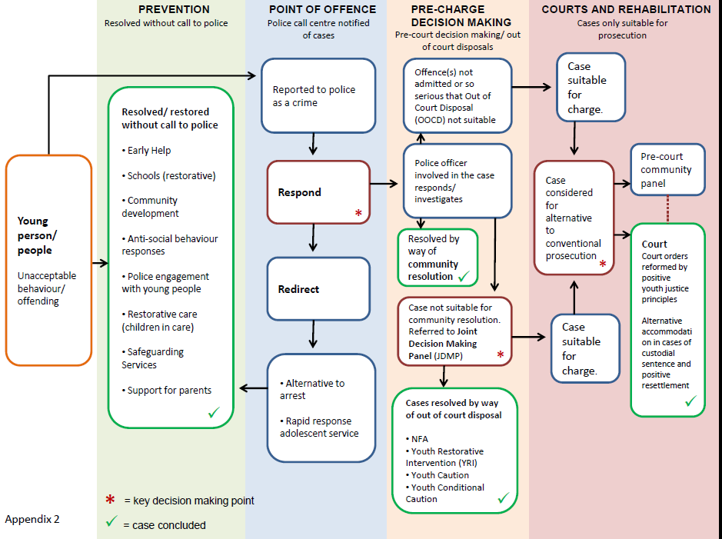

Slide 14
Surrey’s Positive Youth Justice – what next?
Positive policing
Prioritising safeguarding and well-being
Whole family approach
Services designed around CYP – meeting their needs not system’s needs
Evidence based, rights compliant, CYP first
Stop doing the things we know cause harm and don’t work
Whole-system PYJ

Slide 15
Implications for national practice?
Stop doing offender assessments (Asset+) and siloed YJ interventions - Stop being a mini probation service
Integration of YJ into children’s services (with health)
One child - one plan LAC/CP/CiN/YJ/CAMHS/EHCP
Persistent offending as safeguarding: right help at the right time outside of the YJS
Children-first policing
No child prisons
Inspection / regulation: by Ofsted / DfE incorporating HMIP / MoJ expertise and requirements
Raise the age of criminal responsibility
Notes:
Stop starting from the perspective that these children are offenders – stop calling them ‘young offender’, who we work with through youth offending teams, and do offender focused assessments on. It is the wrong starting point which feeds the culture which allows abuses like those at Medway to happen.

Slide 16
Positive youth justice:
Children First, Offenders Second
CFOS is a blueprint for a distinctive, principled, progressive approach to working with children
Can be adopted and adapted by local authority areas throughout the UK, Europe and beyond.
The evolution, trajectory and practical realisation of a CFOS in Wales is discussed and animated with evidence from a twenty-year programme of associated reflective research in the book:

Slide 17
Contact
Email: s.case@lboro.ac.uk
Website: www.profstevecase.com
Facebook Positive Youth Justice group
https://www.facebook.com/groups/853804234630683/
See also: Byrne, B. and Case, S.P. (2016) Towards a positive youth justice. Safer Communities, 15 (2): 69-81.

Slide 18

Haines and Case (2015) Positive Youth Justice: Children First, Offenders Second. Policy Press

Slide 19
Any questions?
www.profstevecase.com

