Slide 1

Pat Branigan & Stuart Allardyce

Slide 2
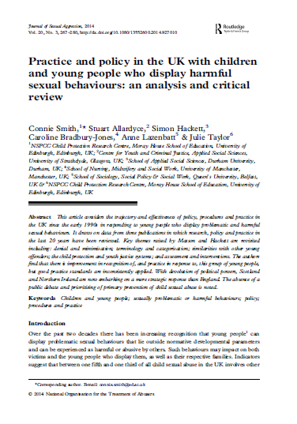
Devolution and Harmful Sexual Behaviour Work

Slide 3
HSB Work in Scotland – a Timeline
Kilbrandon Report (1964)
Establishment of Children’s Hearing System (1971)
NCH Report (1992)
Establishment of HALT project in Glasgow (1994)
Scotland’s Action Programme to Reduce Youth Crime was introduced in response to Audit Scotland’s review of Scotland’s Youth Justice System: ‘Dealing with Offending by Young People’. (2002)
CHIPS Group at CYCJ (2004)
GIRFEC (2004)
Management of Offenders etc. (Scotland) Act (2005)

Slide 4


2005 – Colyn Evans

Slide 5
HSB Work in Scotland - A Timeline
Colyn Evans Inquiry (2005)
First Scottish data set of young people who have displayed HSB (Hutton, Whyte (2006)
Preventing Offending by Young People A framework for action (2007)
Getting it Right for children and young people who present risk of serious harm: Meeting Need, Managing Risk and Achieving Outcomes (2008)
Sexual Offences Scotland (2009) Act
Safer Lives training roll out (2009)
Framework for Risk Assessment and Interventions (2011, updated 2016)
IVY project established (2013)
Preventing Offending: Getting It Right For Children and Young People (2016)
Care and Risk Management Guidance (2016)

Slide 6

Learning From Other Jurisdictions

Slide 7
What we needed and why?
Address definitional issues- including consistency of language/ terminology.
Produce a strong statement of the problem/s we are seeking to address and why (costs, benefits- not just financial).
Identify the values and philosophy that should underpin the framework- to achieve shared approaches across professional groups and systems.
Promote early interventions, effective multiagency information sharing and communication protocols, clear referral routes, address agency ownership issues.
Better highlight the ‘population’ and diverse needs of children and young people displaying HSB.

Slide 8
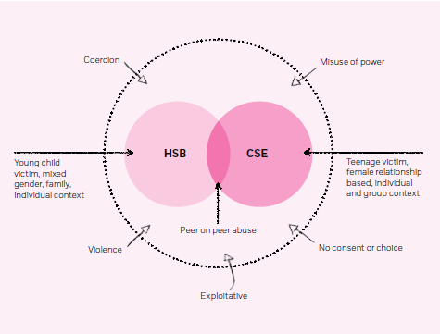
What we needed and why?
Address linkages- plug into other areas of policy and practice (e.g. CSE, parenting).
Concept map

Slide 9
What we needed and why?
Assessment and Intervention models: tiered approaches, co-ordination, promotion of good practice models and approaches, evaluation and monitoring.
Family interventions and approaches.
Training- knowledge and role clarity, address patchiness of professional knowledge, think qualifying curricula not just short course post qualifying training.
Research and improving the evidence base.
Public awareness and education, prevention, tiered policy responses (to accompany practice model), political leverage.

Slide 10
Basically….
Consistency of…
Training and development
CJ and CP responses
Availability and quality of service provision
Response (even if there is provision)
Awareness and knowledge
Policy

Slide 11
Developing an operational framework for HSB
Notes:
Purpose of the framework overview group:
• The vision for this development group is: the development of an operational framework for children and young people who sexually harm, for use by local areas, to help support the delivery of clear policies and procedures as well as any local practice guidelines and assessment tools.
• The draft operational framework and implementation support plan will be developed by the end of December 2014. In early 2015 the work will be piloted by a cohort of local areas and NSPCC teams (linked to HSB service delivery) through the practice working group representatives. A pilot steering group will be established to help monitor and support this next stage.
• Ultimately we would aim for this framework to be adopted and embedded in a coherent cross departmental government(s) strategy on HSB that promotes collaboration across agencies and local authority, police and health boundaries.

Slide 12
Current issues
Responding to Harmful Sexualised Behaviours – feedback from our practice working group
Lack of appropriate training and support for staff across the lead agencies regarding harmful sexualised behaviours in children and young people
Inconsistent responses to allegations regarding harmful sexualised behaviours in children and young people
Poor clarity around communication and sharing of information following an allegation or incident of harmful sexualised behaviour
Service delivery – need for joined up thinking across all of the lead agencies not only for assessment but also intervention and support
Notes:
issues that have been collected and collated drawn from professionals across the country – from the 15 local areas

Slide 13
Development group
NSPCC initiated and co-ordinated. Includes:
Academics, independent experts, authors and research partners on HSB
Large national charities - NSPCC, Action for Children, Lucy Faithfull, Barnados, Brook, Ms Understood Partnership
YJB, Police, CEOP, NOMS/MAPPA, AIM Associates, CAPE, Glebe House
Observers from central government departments – Home Office, DH, CAMHS
Office for the Children’s commissioner, LGA, linking with NICE
14 local areas involved through the practice working group and NSPCC YP Participation group

Slide 14
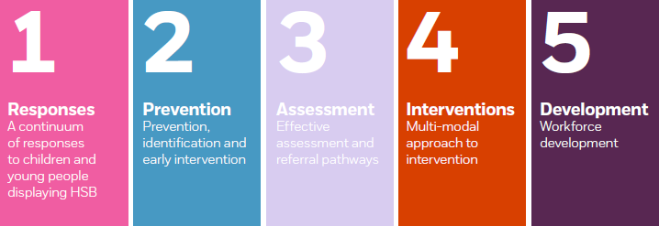
HSB framework covers five core domains:

Slide 15
a summary of the latest evidence to back up practice and local decision making and the key issues being faced
an audit tool to help you assess the current state of your HSB offer and service responses
the key principles to consider when focusing on delivery aligned with the NICE guidelines, with practical examples
A list of available tools and resources can also be found for each domain online at
nspcc.org.uk

Slide 16
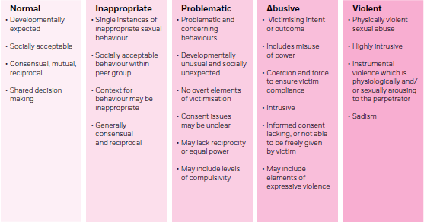
Domain 1
Summary of evidence
A continuum of children and young people’s sexual behaviours (Hackett, (2010)

Slide 17
a summary of the latest evidence to back up practice and local decision making and the key issues being faced
an audit tool to help you assess the current state of your HSB offer and service responses
the key principles to consider when focusing on delivery aligned with the NICE guidelines, with practical examples
A list of available tools and resources can also be found for each domain online at
nspcc.org.uk

Slide 18
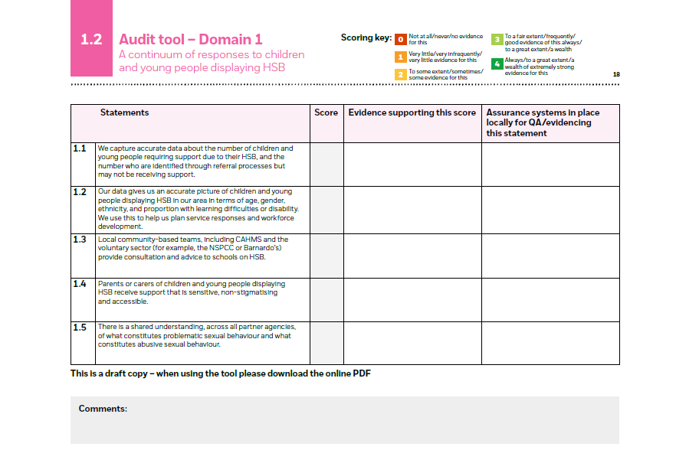

Slide 19
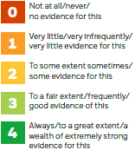
Domain 1
Audit statements
Each domain includes an audit exercise to enable local areas to assess their practice, processes and leadership against the five key areas. These exercises provide statements against which a score between 0 and 4 should be given, as follows:
Notes:
To enable accurate scoring, multi-agency partners will need to work together to reflect and respond to the statements. It may be helpful for the chair of the LSCB to coordinate completion of the audit tool.
The statements are directly linked to research messages, and are deliberately challenging – requiring evidence to underpin each score, for example – and designed to stimulate debate. The audit exercise should be a catalyst for learning and improvement.
If differences across agencies (the quality of data recorded; the approaches to assessment, etc) make it difficult to reach an agreed score, we strongly suggest using the lower score. Similarly, statements that employ subjective terms such as ‘high quality’ or ‘confident’ may highlight differences of opinion between professional groups. Again, we recommend applying the lower score and considering what action would be necessary for all groups to feel confident, or be assured of quality.
We suggest you carry out the audit exercise to establish a baseline, from which scores can be combined to provide an overview of local practice (see the example below in figure 1).
This should enable local areas to focus their efforts on the areas in which improvement is needed most. You can then use the examples and resources provided to draft an action plan that reflects local needs and priorities.

Slide 20
Audit process to action plan

Slide 21

Testing and further development

Slide 22
Formative testing stage
Eight local areas have volunteered to help further develop the framework from July 2015 to December 2015
Cambridgeshire
Cornwall and Isles of Scilly
Leeds
NE Lincs
Nottingham City
Surrey
Waltham Forest
Telford & Wrekin
Notes:
An Expression Of Interest was put out to a purposive sample of local areas who had either been involved so far in the development work or have approached us to volunteer to help with the next stage of development. We had interest from over 15 local areas to take part – with 9 confirmed and signed up
The induction meeting for the 9 confirmed testing areas took place in late May 2015 and work has continued with support provided through an NSPCC facilitated steering groups which met most recently in September 2015. There will be a learning day for the testing areas to feedback their findings in December 2015.

Slide 23
Involving partners is key
Police
Social Care
Fostering
Early Intervention Services
Specialist Services
National Probation Service
Youth Offending Service
CAMHS
School Nurses
Health Services
Managers
LSCBs
Head of Services
CCGs
Education
Voluntary sector

Slide 24
Findings
  Integrated, multi-level, multi-agency approach
  Managers & Practitioners
Persuasive Device
Keen engagement of partners
  Operational Framework
  Refocus agenda link with CSE
  Refresh local practice
  Platform
  Reflective practice
  Strengths / Weaknesses
  Innovation
  Clear policies & procedures
  Recommendations
  Action Plan
  Integrated, multi-level, multi-agency approach
  Managers & Practitioners
  Facilitate Early Intervention
Persuasive Device
Engagement of partners
Notes:
The purpose of the framework was for it to be operational, provide an integrated approach to support local work with children and young people who displayed HSB, facilitate the development of clear policies and procedures, and refresh local practice guidelines and assessment tools.
The feedback from the pilot was very positive and the framework was received well by those who were involved.
Each authority appreciated the operational usefulness of the framework, and welcomed this innovative approach that guided decision making, and refocused the attention on HSB and its links to CSE, as it was recognised as an area lacking in policy and practical guidance.
The framework acted as a platform for discussion and reflection on current policies and practice, through which areas of strengths and weaknesses were identified, improvements not previously considered were highlighted, and clear recommendations and action plans to improve the way local services respond to children and young people with HSB were implemented.
Local authorities welcomed the integrated, multi-level, multi-agency approach towards service provision, and reiterated the importance of early identification, assessment, and intervention of HSB, and recognised the shared responsibility across multiple services and divisions.
The framework also acted as a persuasive device for the local authorities in the pilot, as it helped them to argue for the retention of services, secure funding, and keenly engage partners at multiple levels alongside other current priorities such as tackling CSE.

Slide 25

What progress has been made?
Finally on the agenda with CSE (risk and vulnerability)
Widening scope: HSB, peer on peer, Teen DV and gangs/group sexual violence
Local HSB strategy based on needs assessment
Action plan based on priorities
Training package commissioned by LSCB

Slide 26

“HSB audit has been pivotal in decisions about whether the Gweres Kernow team stays and the news on that score is positive. Furthermore we are now incorporated within the re-drafted CSE strategy.”

Slide 27

Online HSB
Notes:
This is the first Black Mirror episode since the very first to take place in the recognisable present and depend only on technology that’s widely available today: perhaps that’s why it’s so scary.

Slide 28
For more information or to download the HSB framework visit nspcc.org.uk/hsbframework
pat.branigan@nspcc.org.uk

