Slide 1
95%
Graffiti, stealing money from home, underage drinking etc..
Edinburgh Study of Youth Transitions and Crime

Slide 2
5% children
24,000 children
6% of crimes & offences
Scottish Government (2013) Scottish Policing Performance Framework, 2012-13

Slide 3
Trauma, bereavement, loss and abuse

Slide 4
Violent offenders were significantly more likely than non-violent youths to be …
victims of crime and adult harassment
self-harming and para-suicidal behaviour
problematic health risk behaviours
Weak bonds (parent / school)
Personality measures (impulsivity and risk taking)
Bullying others
Family turbulence
socially deprivation
Friends involved in offending (McAra & McVie, 2010)

Slide 5
100 children under 12 referred on offence grounds
For those children whose offence referral was part of a pattern of behaviour:
81% of these children had parents who presented risks to them
43% had mental health difficulties
70% educational problems
30% had been the victims of physical or sexual abuse.
(Henderson et al, 2016)

Slide 6
Children most likely to harm other children
Where victims were identified – 67 instances.
81% victims were children
(Henderson et al, 2016)

Slide 7
IVY - background
Over 80% input from social work services and looked after status
76% exposed to domestic violence
88% experienced some other form of maltreatment
Mean of 4 psychological/mental disorders

Slide 8
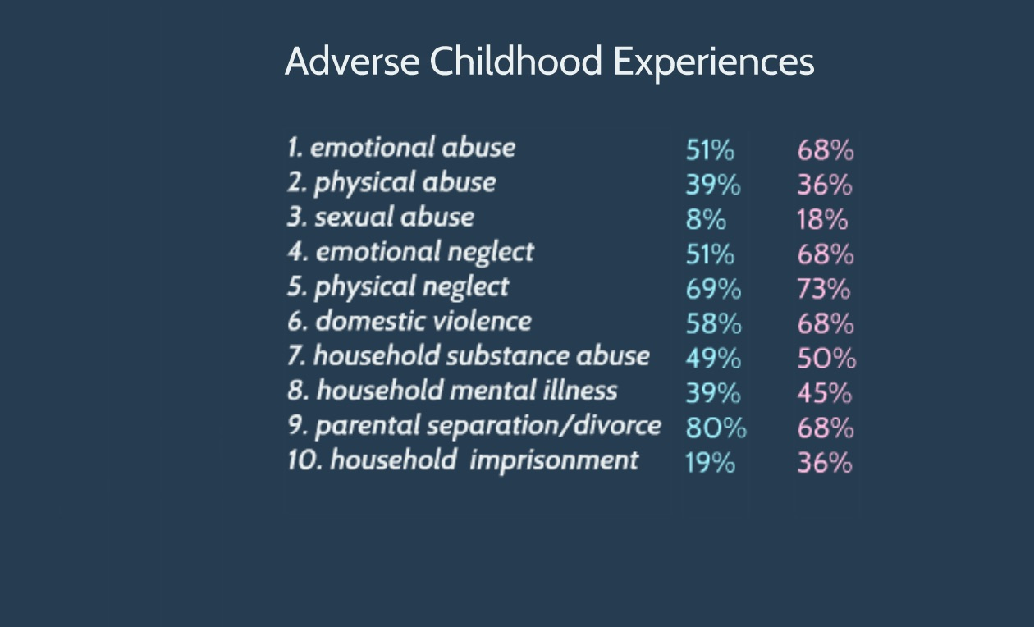
Boys - 34% 6 or more ACE
Girls – 50% 6 or more ACE (Johnson, 2016)

Slide 9
On admission to secure care over 50% had PTSD symptoms

Slide 10
Bereavement & loss in Polmont YOI
Over three-quarters experienced traumatic bereavements (murder, suicide etc)
Two-thirds suffering from substantial bereavements (four or more)
(Vaswani, 2014)

Slide 11
Speech, language & communication needs
50-60% children involved in youth justice services (UK wide)
See: A guide to Youth Justice in Scotland, http://www.cycj.org.uk/resource/youth-justice-in-scotland-guide

Slide 12
School Exclusion
80% of the young men in Polmont had experienced exclusion from school
High levels of school exclusions at primary school age
CYCJ (2014) Young Men in Custody, http://www.cycj.org.uk/resource/young-men-in-custody-a-report-on-the-pathways-into-and-out-of-prison-of-young-men-aged-16-and-17/

Slide 13
Retrospective NOT predictive
Serious offending
Children who experience trauma
DO NOT OFFEND
Children who seriously offend
EXPERIENCED TRAUMA
No experience of trauma
Notes:
Make link to ACEs in general population rate which gives us some indication of the number of children who experience trauma. Research in England showed across the general population almost 50% experienced at least 1 ACE (most commonly parental separation – 22%), 8% had experienced 4 or more ACEs.
Bellis MA, Hughes K, Leckenby N, et al. Measuring mortality and the burden of adult disease associated with Adverse Childhood Experiences in England: a national survey. Journal of Public Health 2014b; doi: 10.1093/pubmed/fdu065.
Bellis MA, Lowey H, Leckenby N, et al. Adverse childhood experiences: retrospective study to determine their impact on adult health behaviours and health outcomes in a UK population. Journal of Public Health 2014c; 36: 81-91
http://jpubhealth.oxfordjournals.org/content/early/2014/08/30/pubmed.fdu065.full#T1

Slide 14
References
CYCJ (2014) Young Men in Custody, http://www.cycj.org.uk/resource/young-men-in-custody-a-report-on-the-pathways-into-and-out-of-prison-of-young-men-aged-16-and-17/
CYCJ (2015) A Guide to Youth Justice in Scotland, http://www.cycj.org.uk/resource/youth-justice-in-scotland-guide/
Henderson, G. et al. (2016) Backgrounds and outcomes for children aged 8 to 11 years old who have been referred to the Children’s Reporter for offending, http://www.scra.gov.uk/wp-content/uploads/2016/03/Backgrounds-and-outcomes-for-children-aged-8-11-years-old-who-have-been-referred-for-offending.pdf
Johnson, D. (2016) How does trauma affect young people?, https://prezi.com/9h6tpxzbl8qv/new-5-how-does-trauma-affect-young-people/
McAra, L. and McVie, S. (2010) Youth crime and Justice: Key Messages from the Edinburgh Study of Youth Transitions and Crime, www.research.ed.ac.uk/portal/files/8195355/Youth_crime_and_justice_Key_messages_from_the_Edinburgh_Study_of_Youth_Transitions_and_Crime_Criminology_and_Criminal_Justice.pdf
Mental Health Difficulties in the Youth Justice Population: Learning from the first six months of the IVY project, www.cycj.org.uk/wp-content/uploads/2014/07/Briefing-Paper-5-final.pdf
Scottish Government (2013) Scottish Policing Performance Framework, 2012-13.
Vaswani, N. (2014) The Ripples of Death: Exploring the Bereavement Experiences and Mental Health of Young Men in Custody, http://onlinelibrary.wiley.com/doi/10.1111/hojo.12064/full

