Slide 1
Youth Justice and Mental Health Interventions for Vulnerable Youth (IVY)
Fiona Dyer, Strategic Manager CYCJ/IVY
Leanne Gregory, Principal Clinical Psychologist, IVY
Social Services Expo & Conference
18th March 2014
Edinburgh International Conference Centre

Slide 2
The work of the CYCJ
What is IVY
Rationale for IVY
IVY Model
Client Demographics
Client Mental Health
Client Risk and vulnerabilities

Slide 3
CYCJ
Practice Development
Managing High Risk
Early and Effective Intervention
Knowledge Exchange
Funding by the Scottish Government
Hosted by University of Strathclyde
Research
Girls
Transitions and Reintegration
Notes:
Focus of Practice development work – champions groups.
EEI – writing standards for consistency across Scotland
Managing High Risk – recently written Care and Risk management guidelines
Vulnerable girls and young women – developing training resource
Reintegration & transitions – improving practice for y/p leaving secure care and custody – circular etc….. Research
Research Team: Polmont, safer lives, stakeholder survey, systemic family work, multi dimensional foster treatment
Knowledge exchange – events/conferences, practice guidance, national training strategy, e bulletins etc

Slide 4
CYCJ Policy Perspective
Early and Effective Intervention
FRAME
Supporting YP in Court
Reintegration and Transitions
Mental Health
Alternatives to Secure Care and Custody
Diversion from Prosecution
Engaging with YP
Transitions from YJ to Adult Justice
Notes:
Government priorities – WSA
Practitioners priorities – stakeholder survey
Joint – mental health

Slide 5
IVY
Multidisciplinary
Tiered Approach
Risk Assessment
Psychological Assessment
Notes:
? .5 WTE Social work
1 WTE Psychology, soon 1.8; .2 WTE Clinical and Forensic Psychology
.4 WTE Admin
.3 assistant psychologist soon

Slide 6
The rest of IVY
Heather Irving Stuart Allardyce Dr Lorraine Johnstone
Notes:
Does including this seriously effect my popularity?!

Slide 7
Map of Scotland provided courtesy of FreeVectorMaps.com
Notes:
FCAMHS limited availability
Nationwide Specialist provision
Funding from 2nd September for one year

Slide 8
Why are we funded?
Youth who perpetrate acts of serious violence are among the most marginalised and vulnerable in society.
Backgrounds of adversity and abuse.
Do not have equitable access to services equipped to assist them.
At risk of poor outcomes and harm to others
Notes:
This is the state of play and young minds produced a reported detailing the obstacles, albeit English context
The Government in response to this unmet need, funded our project

Slide 9
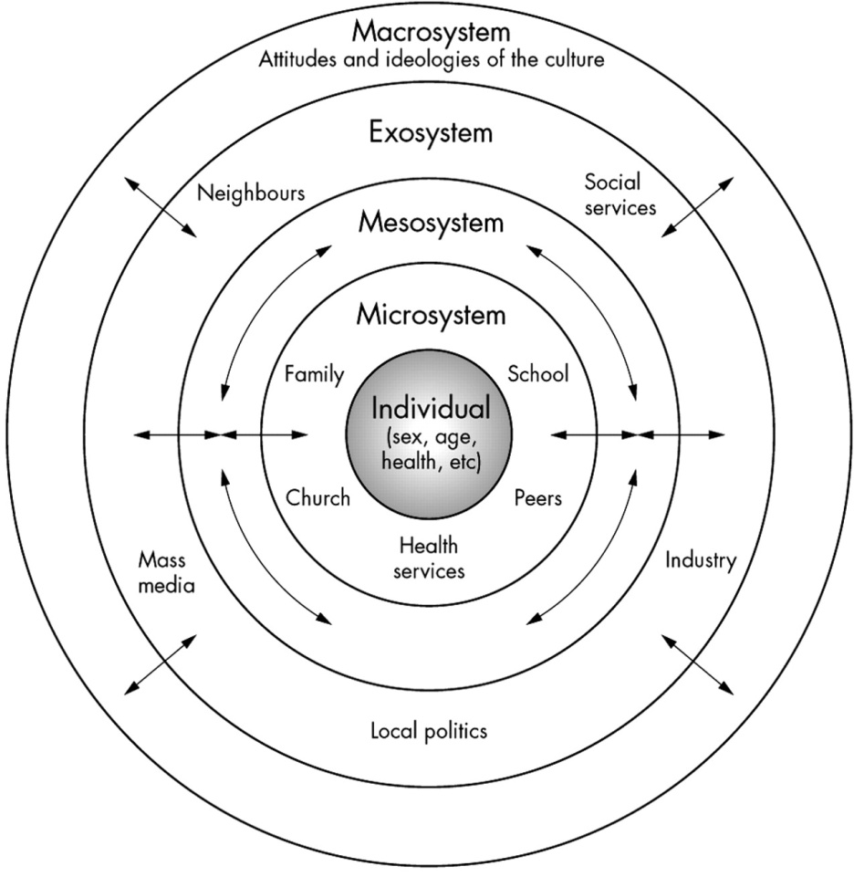
Our Aims
Individual
Improved mental health
Macrosystem
Greater understanding of antecedents of crime
Economical benefits – diversion from secure care
Microsystem
Exosystem
Reduced risk of offending behaviour
Reduced risk of harm to significant others
Improved family functioning / stabilised placement
Engagement with education/occupation
Improved peer relationships
Decreased anxiety in wider system
Shared understanding
Reduced risk of harm to community
Increased mental health capacity of wider network
?Redirection to community
Sense of service provision and met need
Reduced rates of crime
Notes:
Our aims, in conjunction with the rest of the system.

Slide 10
The Model
LEVEL ONE – CONSULTATION – IVY meet with involved professionals to discuss a young person. A SPJ risk assessment opinion incorporating risk factor ratings, a risk formulation, risk scenarios and recommendations for risk assessment/management
LEVEL TWO – ASSESSMENT - Builds on the data available at level 1 but includes direct specialist assessments of mental health, psychological or offending needs necessary for a more complete formulation.
LEVEL THREE – TREATMENT – Is offered where treatment needs are identified and cannot be met by local services. It is a formulation-led and eclectic approach to intervention.

Slide 11
Structured Professional Judgement
Risk Factors
Formulation
Scenarios
Management
Background
Communication
Notes:
When we say risk assessment, this is what we mean.

Slide 12
Who is referring?
26 referrals
1 police
5 health 19 social work
Notes:
Accepted referrala 02.09.13 – 02.03.14

Slide 13
LOCALITY/BOARD | Number
East Dumbartonshire | 1
East Lothian | 1
Dumfries and Galloway | 4
Falkirk | 2
Fife | 2
Glasgow | 2
Highlands | 1
Inverclyde | 1
Lanarkshire | 5
Moray | 2
North Ayrshire | 1
Renfrewshire | 3
1
2
1
2
1
2
2
1
3
5
1
4
Map of Scotland provided courtesy of FreeVectorMaps.com

Slide 14
Demographics – Age & Sex
N= 25
Mean age = 15.5
Mode = 16
Range 12-17
Male = 19
Female = 6

Slide 15
Accommodation

Slide 16
Diagnosed or Suspected Difficulty | Number
Anger | 7
Anxiety | 1
Autism Spectrum Disorder | 6
Attachment Disorder | 5
Attention Deficit Hyperactivity Disorder | 6
Communication Disorder | 1
Complex Post Traumatic Stress | 6
Deliberate Self-Harm | 7
Dissociation | 2
Eating Difficulties | 2
Emotional Dysregulation | 6
Learning Disability | 2
Low Mood | 2
Oppositional Defiant/Conduct Disorder | 2
Psychosis | 2
Sleep Difficulties | 2
Substance Misuse Difficulties (Alcohol/Drugs) | 7
Suicidal Ideation/Action | 6
Unusual perceptual experiences | 3
MEAN = 4.4

Slide 17
Domestic Violence

Slide 18
Other Maltreatment

Slide 19
Firesetting
Violent Extremism
Victimisation
Suicide /DSH
PRIMARY RISK
N = 17
Interpersonal Violence
Nature of Risk | n = Primary Risk
Fire-setting | 1
Interpersonal Violence | 10
Self-harm/Suicidality | 3
Sexual offences (contact) | 5
Sexual offences (non-contact) | 1
Victimisation | 1
Violent Extremism | 1
Sexual offence - contact
Sexual offences non-contact

Slide 20
Sexual offences non-contact
Firesetting
Suicide /DSH
SECONDARY RISK
Victimisation
Nature of Risk | n = Secondary Risk
Fire-setting | 1
Interpersonal Violence | 3
Self-harm/Suicidality | 3
Sexual offences (contact) | 0
Sexual offences (non-contact) | 1
Victimisation | 5
Violent Extremism | 0
Interpersonal violence

Slide 21
Comorbid Risks
64%

Slide 22
Level 2
10 offered 9 accepted
Risk Assessment Learning Disability
Personality
Mental Health Diagnostic Review

Slide 23
Emerging Themes
Transition
LAAC
Rejection
?Attachment Difficulties*
?ADHD
?Autistic Spectrum
Vulnerability victimisation
Unmet treatment need
Difficulties with engagement*

Slide 24
FYI

