Slide 1
Interventions for Vulnerable Youth (IVY)
DR LORRAINE JOHNSTONE
Consultant Clinical and Forensic Psychologist, Senior Research Fellow and Project Lead
FIONA DYER
Team Manager and Co-Lead
DR LEANNE GREGORY
Clinical Psychologist and Project Manager
STUART ALLARDYCE
Consultant Social Worker
HEATHER IRVING
Consultant Social Worker (RMA)
With thanks to
The Scottish Government
The Centre for Youth and Criminal Justice, Strathclyde University

Slide 2
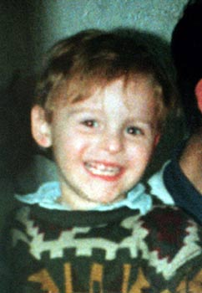
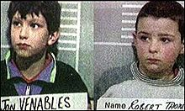
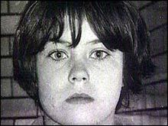
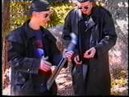
Youth Violence: Nature and Scope
Interpersonal
Sexual
Familial
Intimate partner
Fire-raising
Extremist
Stalking
Notes:
Few groups are more marginalised, vulnerable or misunderstood than children and adolescents who perpetrate acts of serious violence on others. They are typically of a profile that reflects issues of deprivation, neglect, trauma and abandonment, exposure to antisocial role modelling, lack of social support, placement breakdown and instability (REF). They can manifest a range of emotional and behavioural difficulties and they typically show early precursors of mental disorders known to place them at risk of persistent offending (REF). Indeed, early initiation and history of violent offending is a significant prognostic indicator of poor long-term outcomes (Douglas et al., 2013). Of course, the construct of violence refers to highly complex behaviour and while some people will be ‘exclusive’ in terms of the risk they pose, others will present a diverse risk (REF). Violence profiles may take one or more types illustrated in figure 1 below and victims can include peers, parents, siblings, strangers, professionals, intimate partners, vulnerable others, etc..

Slide 3
Scotland’s Response A Whole Systems Approach to Getting it Right for Every Child
Early and Effective Intervention (EEI) 8-15
Diversion from prosecution
Address risks and needs
Alternatives to secure care
Supporting YP if the do go to court, aid decision makers
Risk Management by multiagency partners
Support reintegration after secure care
Use supervision requirements as legal status
The Children’s Hearing system
Notes:
The Children’s Hearings System is Scotland’s unique care and justice system for children and young people. It aims to ensure the safety and wellbeing of vulnerable children and young people through a decision making lay tribunal called the Children’s Panel.
A number of different agencies work together within the Children’s Hearings System to deliver care, protection and support services to the children and young people involved. These include social work, police, education, the Scottish Children’s Reporter Administration (SCRA) and Children’s Hearings Scotland (CHS).
One of the fundamental principles of the Children’s Hearings System is that children and young people who commit offences, and children and young people who need care and protection, are dealt with in the same system – as they are often the same children and young people.
In 2012/13, 22,561 children and young people were referred to SCRA. Of those:
20,308 were referred on non-offence (care and protection) grounds
3,636 were referred on offence grounds
During the same period, 38,316 children’s hearings were held (down from 40,708 in 2011/12

Slide 4
Youth Violence: Developmental Risk Factors
Youth Violence
Family Factors
Community Factors
Individual Factors
Peer Factors
Developmental
Factors
Notes:
Past delinquency/aggression
Early age of onset
Low levels of serotonin
Low salivary cortisol
Low levels of arousal & reactivity
Prefrontal dysfunction
Prenatal complications
Delivery complications
Cognitive abilities
Academic failure
Deficits in executive functioning
Attributional biases
Witnessed family violence
Experienced maltreatment
Early disruptions with caregivers
Low parental involvement and attachment
Parental criminality
High crime area
Substance use
Poor housing and poverty
Housing problems
Racial discrimination
ADHD
Substance use
Post-traumatic stress disorder
Affective Disorders
Pre-psychotic disorders
Neurodevelopmental dysfunction
Autistic Spectrum Disorders and Learning Disability
Personality Disorder

Slide 5
But, challenges from espoused theory to routine practice…and a major challenge getting psychological and mental health opinions and input
WHY?
Conduct Disorder is an exclusion criteria in CAMHS
Early indicators of forensic psychopathology might not be identified or understood in terms of risk (e.g., paraphilias, violent extremism, etc.)
Competencies required to assess MH and risk – FMHA not routinely available in the workforce
Approaches to risk assessment not appropriate
Only a small proportion of youth present with severe and enduring violence risk…demand?
AND SO,
Agencies often outsourcing expert assessments at significant cost and for Tier 5 cases, refer to England…only for admission…
not getting at root cause and not addressing local service provision

Slide 6
IVY: A Pilot Project

Slide 7
IVY Aims
To provide an expert, evidence-based, efficient and accessible service;
Open to all local authorities, Police Scotland, and Health Boards;
Awarded >£100K to fund the project for 12 months;

Slide 8
IVY Model
Level 3:
Formulation-led, eclectic treatment
Level 2:
Specialist Assessment
Level 1:
Consultation
Notes:
LEVEL ONE – CONSULTATION – IVY meet with involved professionals to discuss a young person. A SPJ risk assessment opinion incorporating risk factor ratings, a risk formulation, risk scenarios and recommendations for risk assessment/management
LEVEL TWO – ASSESSMENT - Builds on the data available at level 1 but includes direct specialist assessments of mental health, psychological or offending needs necessary for a more complete formulation.
LEVEL THREE – TREATMENT – Is offered where treatment needs are identified and cannot be met by local services. It is a formulation-led and eclectic approach to interven

Slide 9
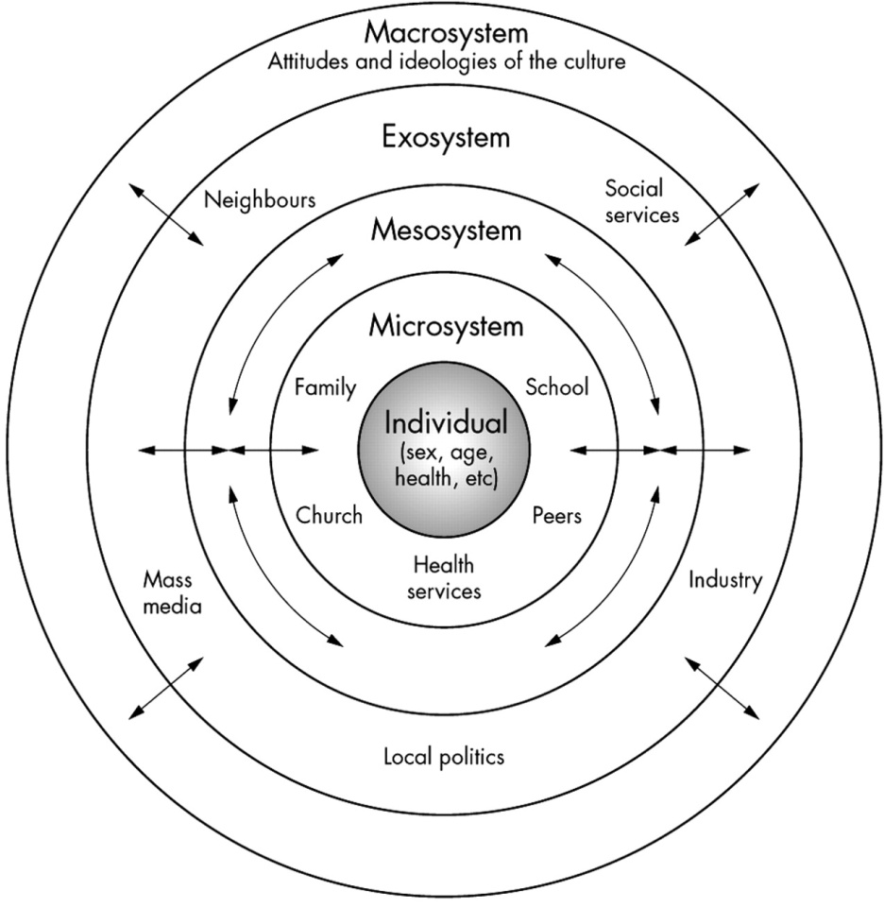
Direct and Indirect Outputs
Individual
Improved mental and psychological health
Macrosystem
Greater understanding of antecedents of crime
E Economical benefits – diversion from secure care
Microsystem
Exosystem
Reduced risk by understanding risk
Reduced risk of harm to significant others
Improved family functioning / stabilised placement
Engagement with education/occupation
Improved relationships
Decreased anxiety in wider system
Shared understanding
Reduced risk of harm to community
Increased capacity of wider network
S Sense of service provision and met need
Reduced rates of crime
Maintaining in the community
Notes:
Our aims, in conjunction with the rest of the system.

Slide 10
IVY: The Team
Four Consultants
Consultant Clinical and Forensic Psychologist/Research Fellow (Project Lead 0.2 WTE)
Clinical Psychologist with Formal Training in Forensic Psychology(1.8WTE)
Social Work Consultant with expertise in SHB (0.2 WTE)
Social Work Consultant with expertise in Violence Risk Assessment (0.2 WTE)
Total years working with vulnerable youth/offenders = +60 years
Notes:
The Team: One consultant clinical forensic psychologist/resercher, a clinical psychologist with competencies in forensic psychology, two social work consultants with expertise in sexually harmful behaviour and violence risk (total years qualified = approx. 50+)

Slide 11
Level 1 and 2: Paradigm
Scenarios
Formulation
e.g., SAVRY, RSVP, START, SAM, Northgate, I-AIM, VERA, Suicide, literature
Structured Professional Judgement
Risk Factors
Management
Document
Background
Notes:
Violence risk assessment in forensic mental health settings includes the process of gathering information for use in making clinical/forensic decisions. A detailed assessment can involve many different modalities and methods of information collecting and may include, for example, interviews with the service user, interviews with family members, employers, friends, victims, administration of specialist tests such as personality disorder and intellectual assessments, a review of health, social work, police, prison, education, employer records etc. A violence risk assessment is the process of gathering information in order to:
Background: Ensure a detailed and comprehensive knowledge of the person’s background. This ensure that all potential risks (not just the index offence type) are identified and assessed. It also is essential to producing a detailed formulation as it is only through the process of examining the person’s background that factors that help us explain the behaviours can become apparent.
Risk Factors: Ensure a thorough analysis of the risk factors shown in the research and clinical literatures as being relevant to the types of risk posed
Risk Formulation:
Produce a risk formulation (narrative) of the nature of the person’s risk (4Ps model). This is the process whereby the evaluator pulls all the relevant information together to produce a coherent explanation or narrative of the person’s history, their risk factors and how and when these risks function in order to increase the likelihood of the risk.
Risk Scenarios: Make a projection about the likelihood of this risk in given circumstances (scenarios)
Identify areas in need of intervention and inform the timing and context of these interventions
Risk Management: To assist in the selection of other risk management interventions and to determine the level of input required to manage the risk. The content and comprehensiveness of a risk management plan will be dependent on the quality of risk assessment information.
In some circumstances the right recommendation will be simply to gather more information.
In other circumstances you might be in a position to make recommendations about treatment, monitoring, supervision and victim safety planning.
Irrespective of what, the policy should make it clear that all patients should have a risk management plan.
Communication. It is futile to spend time completing a detailed risk assessment and risk management if it is not communicated. From a policy perspective, it is also impossible to audit or govern practice if it is not written down. A policy statement should therefore state clearly that a key purpose of violence risk assessment is to communicate and document risk.
By explicitly stating this definition in the policy document, the problems associated with people using only self-report are reduced e.g. Distorted information, failure to recognise a potential risk, etc.
Each of these steps in the violence risk assessment process could be, and perhaps should be, defined as a standard.

Slide 12
Level 1: Consultation
Who:
All referrals – this is the minimum standard
Referral Form is submitted which provides relevant information on risk, background, mental health, placements, etc.
As long as there is active risk of harm to others, a consultation is offered
Format:
Consultants, who are specialists, assist the consultee(s) to assist with the case; consultants are active agents to achieving solutions (understanding) and strengthening the consultee’s competencies to address similar issues in the future
2 hours per case
Report provided to lead professional within 2 weeks of consultation
Content: All aspects of the SPJ Paradigm
Notes:
Three main X determined the model of service delivery.
According to Caplan, mental health consultation/psychological refers to “A process of interaction between two [or more] professional persons – the consultant, who is a specialist, and the consultee, who invokes the consultant’s help in regard to a current work problem with which he [or she] is having difficulty and which he [or she] has decided is within the other’s area of specialized competence.” However, Wallace and Halle (1996) noted that mental health/psychological consultation has additional outputs including that it “involves a broad helping approach in which qualified psychological consultants help consultees (1) resolve work-related issues pertaining to individuals, clients, or programs that they are responsible for, (2) become active agents in achieving solutions to problems, or (3) strengthen consultees’ work-related competencies to address similar issues in the future.” Thus, there are multiple direct and indirect effects of consultation models. As such, this was the preferred model of service delivery.
In order to ensure that referrers had access to requisite skills and expertise, the project team included two highly experienced social workers (one male, one female), a dual trained consultant grade psychologist (forensic and clinical) and a highly specialist clinical psychologist (both females). The mean number of years experience was X (ranging from X to Y) mean = X). The project was hosted by the Centre for Youth and Criminal Justice Department at Strathclyde University. This was selected as it offered an easily accessible base for all local authorities via road, rail and/or air travel where necessary. Funding was from the Scottish Government and the university is paid to provide the necessary physical, administrative and educational infrastructure and support of an academic and learning institution.
Firstly, the project was explicitly designed according to an established model of consultation in mental health practice (Brown, Pryzwansky & Schulte; Caplin, 1970). Secondly, a fundamental was that the risk assessment process would reflect best-practice as outlined in the Structured Professional Judgement Paradigm for assessing risk. Third, drawing on the principles of stepped care and the provision of psychological therapies to complex cases, the treatment interventions were delivered in accordance with the principles espoused in the forensic and psychology matrices (REFS).

Slide 13
Level 2: Specialist Assessment
Who:
Where there are significant information gaps
Where specialist psychological/mental health assessments are needed such as cognitive, attachment, trauma, diagnostic, personality, psychosexual, etc. evaluations.
Format:
Clinical psychologist completes the evaluation
Revises formulation and risk assessment report
Can span several weeks/months
Updated report/supplemental report
Notes:
Three main X determined the model of service delivery.
According to Caplan, mental health consultation/psychological refers to “A process of interaction between two [or more] professional persons – the consultant, who is a specialist, and the consultee, who invokes the consultant’s help in regard to a current work problem with which he [or she] is having difficulty and which he [or she] has decided is within the other’s area of specialized competence.” However, Wallace and Halle (1996) noted that mental health/psychological consultation has additional outputs including that it “involves a broad helping approach in which qualified psychological consultants help consultees (1) resolve work-related issues pertaining to individuals, clients, or programs that they are responsible for, (2) become active agents in achieving solutions to problems, or (3) strengthen consultees’ work-related competencies to address similar issues in the future.” Thus, there are multiple direct and indirect effects of consultation models. As such, this was the preferred model of service delivery.
In order to ensure that referrers had access to requisite skills and expertise, the project team included two highly experienced social workers (one male, one female), a dual trained consultant grade psychologist (forensic and clinical) and a highly specialist clinical psychologist (both females). The mean number of years experience was X (ranging from X to Y) mean = X). The project was hosted by the Centre for Youth and Criminal Justice Department at Strathclyde University. This was selected as it offered an easily accessible base for all local authorities via road, rail and/or air travel where necessary. Funding was from the Scottish Government and the university is paid to provide the necessary physical, administrative and educational infrastructure and support of an academic and learning institution.
Firstly, the project was explicitly designed according to an established model of consultation in mental health practice (Brown, Pryzwansky & Schulte; Caplin, 1970). Secondly, a fundamental was that the risk assessment process would reflect best-practice as outlined in the Structured Professional Judgement Paradigm for assessing risk. Third, drawing on the principles of stepped care and the provision of psychological therapies to complex cases, the treatment interventions were delivered in accordance with the principles espoused in the forensic and psychology matrices (REFS).

Slide 14
Level 3: Formulation-led Txs.
Eclectic Model
Format
Treatment proposed as per stepped care pathway
Where specialist intervention is required, this would be delivered by clinical psychologist

Slide 15
IVY: Initial Projections
Funding £100K
Case Management
A maximum of 80 stage 1 cases;
A rolling caseload of 3 stage 2 assessments;
A rolling caseload of 5 stage 3 cases;
Research, Service Audit and Evaluation
Subject to ethical approval, produce high quality research papers outlining key findings in relation to the issues detailed above
two conference papers
descriptive paper for publication relating to audit and evaluation using the psychometrics and user-feedback questionnaire;

Slide 16
IVY: The Data
First 6 months:
25 referrals
1 police
5 health 19 social work
Notes:
Accepted referrals 02.09.13 – 02.03.14

Slide 17
Referrals by region
LOCALITY/BOARD | Number
East Dumbartonshire | 1
East Lothian | 1
Dumfries and Galloway | 4
Falkirk | 2
Fife | 2
Glasgow | 2
Highlands | 1
Inverclyde | 1
Lanarkshire | 5
Moray | 2
North Ayrshire | 1
Renfrewshire | 3
1
2
1
2
1
2
2
1
3
5
1
4
Map of Scotland provided courtesy of FreeVectorMaps.com

Slide 18
Demographics – Age & Sex
N= 25
Mean age = 15.5
Mode = 16
Range 12-17
Male = 19
Female = 6

Slide 19
IVY: Risks
*64% co-morbid risk to other presentations
*approx 30% suicide/self-harm
Notes:
Self-harm and suicidality = 3

Slide 20
IVY: Psychological/Mental Disorders
Diagnosed or Suspected Difficulty | Number
Anger | 7
Anxiety | 1
Autism Spectrum Disorder | 6
Attachment Disorder | 5
Attention Deficit Hyperactivity Disorder | 6
Communication Disorder | 1
Complex Post Traumatic Stress | 6
Deliberate Self-Harm | 7
Dissociation | 2
Eating Difficulties | 2
Emotional Dysregulation | 6
Learning Disability | 2
Low Mood | 2
Oppositional Defiant/Conduct Disorder | 2
Psychosis | 2
Sleep Difficulties | 2
Substance Misuse Difficulties (Alcohol/Drugs) | 7
Suicidal Ideation/Action | 6
Unusual perceptual experiences | 3
N=17
MEAN = 4.4

Slide 21
IVY: Common Experiences
Multiple placement breakdowns
76% experienced domestic violence
88% experienced child maltreatment
Parental substance misuse
Parental separation/divorce
Behaviour problems in childhood
Poor school attainment
Absence positive/enduring friendships
Little sense of the future

Slide 22
IVY: Level 2
10 offered 9 accepted
Learning Disability
Personality
Mental Health Diagnostic Review

Slide 23
Level 3: Status
None offered at present
Work is being done by local teams

Slide 24
IVY: Utility
“It’s excellent to be able to access this kind of support, and so quickly”
“Having a minute and risk assessment within a fortnight is unheard of, thank you!”
“It’s excellent to be able to access this kind of support, and so quickly”
“The report is spot on, excellent. It’s an excellent service”
“This group offers a very supportive environment, where extensive experience is shared from a multidisciplinary team of practitioners. This not only assists with the support of young people but offers a realistic way forward”
“The consultation was really positive to help formulate a better plan”
Notes:
“It’s excellent to be able to access this kind of support, and so quickly”
“Having a minute and risk assessment within a fortnight is unheard of, thank you”
“The report is spot on, excellent. It’s an excellent service”
“This group offers a very supportive environment, where extensive experience is shared from a multidisciplinary team with practitioners. This not only assists with the support of young people, but offers a realistic way forward”
“The consultation was really positive to help formulate a better plan”

Slide 25
IVY: Direct Savings?
Direct Savings: If independent assessments costing social work services between £2K to £10K (26 completed so between £52K and £260K)
Indirect Savings: Not quantifiable but…
Competencies in assessing risk
Promoting MDT working
Risk formulations
Risk sensitivity and specificity
Risk Management within 2 weeks….no long waits
Reduction of use of actuarial methods and reducing the ecological fallacy
Only 1 referral been placed in secure care
Transitions from youth to adult services

Slide 26
IVY: Where next?
Increase capacity for 6 months
Additional psychologist to assist with level 2 and 3
Data analysis
User-satisfaction
Profiles of young people referred to project
Examination of risk assessment sensitivity and specificity
But then what?????????????

