Slide 1
Social media & you
Charlotte Bozic
Knowledge Exchange Officer, Centre for Youth & Criminal Justice
www.cycj.org.uk
developing, supporting & understanding youth justice

Slide 2
Who uses social media?
www.cycj.org.uk
developing, supporting & understanding youth justice

Slide 3
What is social media?
www.cycj.org.uk
developing, supporting & understanding youth justice

Slide 4
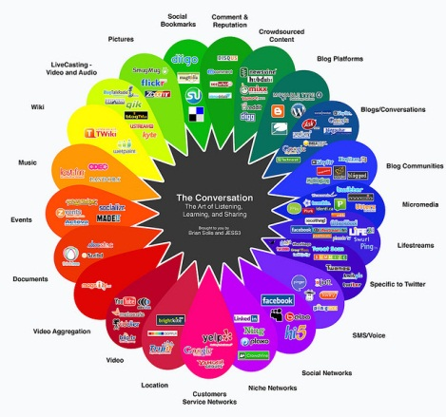
www.cycj.org.uk
developing, supporting & understanding youth justice

Slide 5
So why do we use it?
It’s free
Sky’s the limit
Everyone else is doing it
Word of mouth: the next generation
Better search engine placement
www.cycj.org.uk
developing, supporting & understanding youth justice

Slide 6
What can it do for you?
Boost your brand
Make connections
Advance your career
Be inspired
Follow the action
www.cycj.org.uk
developing, supporting & understanding youth justice

Slide 7
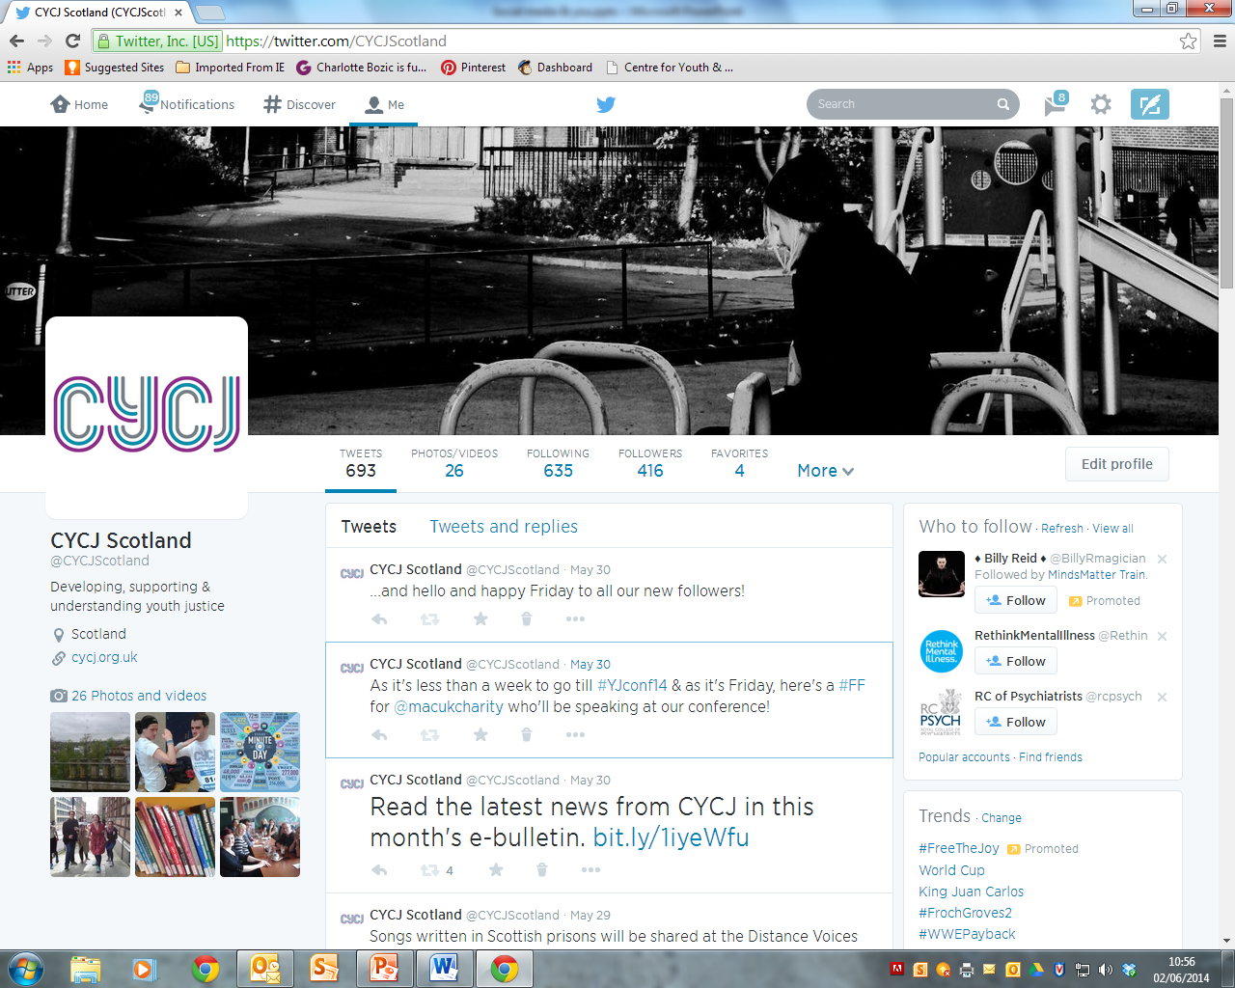
How do I use it?
www.cycj.org.uk
developing, supporting & understanding youth justice

Slide 8
What do I use it for?
Sharing your news and others
Job vacancies
Retweeting
Starting a conversation
Trending
www.cycj.org.uk
developing, supporting & understanding youth justice

Slide 9
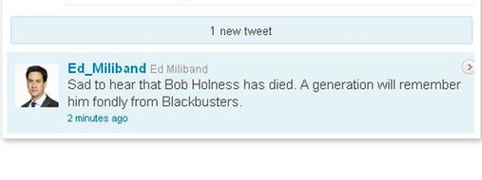
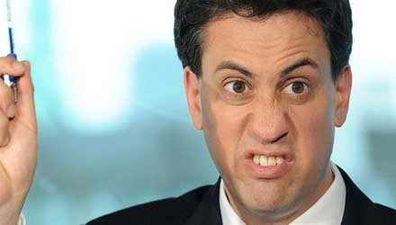
When shouldn’t I use it?
www.cycj.org.uk
developing, supporting & understanding youth justice

Slide 10
Thank you for listening. Any questions?
www.cycj.org.uk
developing, supporting & understanding youth justice

