Slide 1
Whole Systems Approach - A Partners’ Perspective
Notes:
A partnership was struck up between Includem and Police Scotland and in 2010 we began to deliver a whole systems approach to tackle the problem of violent and alcohol related behaviours.

Slide 2
Why?
Offending
Charge
Custody
Court
Measures

Slide 3
It was recognised that the revolving door of offending, charges, court and reoffending wasn’t having an impact on those young people at high risk with complex needs.
Includem’s partnership with Police Scotland, namely One Glasgow’s Reducing Offending Team, means that the streamlined referral process, planning, assessment and decision making processes ensures that young people get the right help at the right time.

Slide 4
Typical Referral = There isn’t one!
Persistent violent and alcohol related offences, causing harm to their community and creating victims. The young people risk remaining prolific offenders unless intensive supports are offered and accepted.
When Dean, 18, began working with Includem, he was a chaotic, vulnerable young man with numerous charges. Involved in gang violence. His offending behaviour was underpinned by alcohol misuse, and he was easily led and negatively influenced by his peers. Homeless and with no structure or routine to his life, Dean was not co-operating with his probation appointments or unpaid work and frequently had his benefits sanctioned.

Slide 5
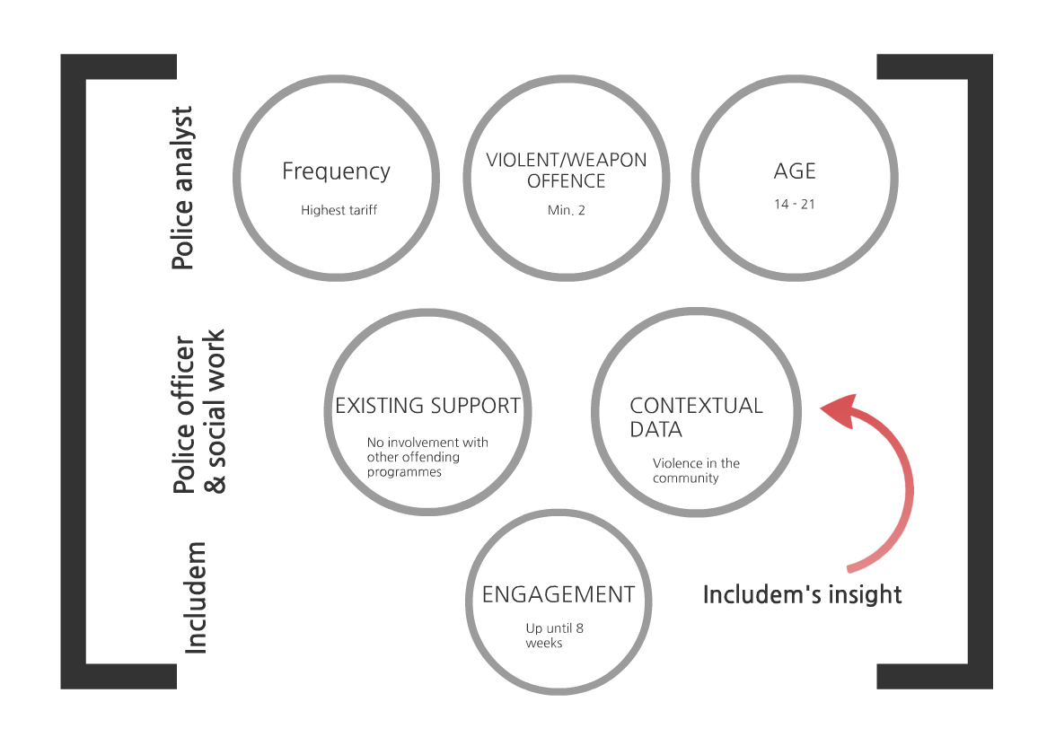
The Referral Process to identify the highest risk and persistent offenders
Notes:
This is not about nuisance antisocial behaviours or about one off serious crimes as a high percentage of first offenders don’t reoffend.
It is about meeting the needs of the prolific offenders to have an impact on the wider society and their potential to positively contribute.
Initially the police analysts identify potentially appropriate young people through their Offending Recency/ Frequency/ Gravity system -
aimed to highlight persistent offenders of serious crimes.
From there, there is discussion between Police and Social Work within the reducing offending team to provide some context to the charges, which are often numerous, as well as the young person’s history and current situation and wellbeing.
If they are already receiving support from Includem in another form, or from another agency, they may be deferred to revisit at a later time should they continue to offend.
It is common that they have been referred to several projects in the past but failed to engage with them, sometimes as they are expected to attend appointments in centres which often involve crossing territorial “gang” boundaries or turn up under the influence of drugs and alcohol
Includem and community police meet to discuss concerns about the young people based on the information gathered and confirm the appropriateness of the referral - often with Includem providing additional contextual information.
There have been instances of Self-referral , peer-referral or staff observations that have been successful referrals when supported by offending Data.
Engagement - Includem and Police Scotland usually first attend the young people’s family home or accommodation.
The joint sign ups are about transparency, to ensure the young people are fully aware of the partnership.
We explain that we hold regular meetings held with Includem and Police Scotland, and our information sharing protocols.

Slide 6
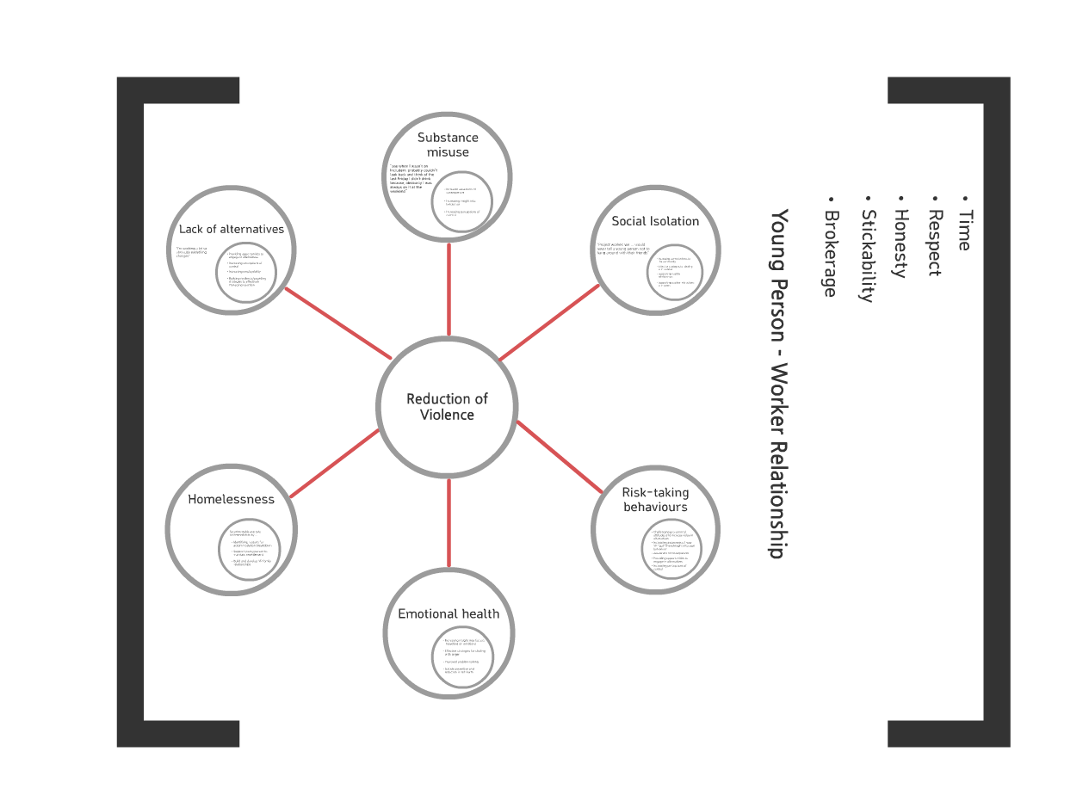
What does the Support Look Like

Slide 7
How?
Joint signups with the police so the partnership is transparent
Contacts at Target Times (evenings and weekends)
The Robust and intensive enforcement of the law by the Police is matched with robust and intensive support from Includem.
3 contacts a week initially, increased to respond to crisis and supported by Includem’s 24/7 helpline
The relationship built between Includem and the young people is fundamental to achieving positive outcomes in the long run.
Stickibility – These young people have complex needs and therefore there are episodes of poor engagement and chaotic behaviours. Missed, cancelled or refused contacts are replaced with unplanned contacts.
Brokerage - seeking specialist support to meet the identified needs and using partner agencies.
Court Support - We support young people and through the court processes, supplying reports and liaising with lawyers and court social work and where asked speaking with Sheriffs. Impact also liaises closely with the court support worker to ensure support for the young people.
Police National Computer Marker - This means that should YP be charged and held in custody, Includem’s 24 hour helpline would be notified and workers could respond at the earliest opportunity to support them to reflect on the consequences. Young people have benefited from a worker’s support at this teachable moment.

Slide 8
A Better Life
The use of Includem’s “A Better Life” cognitive toolkit allows the young people to assess their own needs and create their own support plan and goals which they are helped to work towards.
Tailored to their learning styles and to their individual needs.
A better life includes coaching conversations, motivational interviewing and focused cognitive exercises which address these areas of need.
Open discussions on offending and risk-taking identify triggers for offending behaviour, and we work with young people to manage those risks.
Confidential within parameters agreed as part of the partnership and clearly outlined and revisited with young people.

Slide 9
Information Sharing Protocols
Information is shared at the point of referral and for support and risk management purposes.
Meetings with the reducing offending team focus upon the progress made or difficulties faced not the content of the work delivered around the reasons for referral.
There is a trust within the partnership that is understood by all parties involved that there is no collusion but a robust model of challenging and problem solving founded upon GIRFEC, duty of care and change theory.
Where workers become aware of potential risk to young people, peers, family or other members of the community this information is immediately shared with One Glasgow and/or the Gangs Task Force so that resources can be appropriately deployed or information safely used.
Where possible this information sharing is transparent with the young people and where it would place them or workers at risk the information is treated confidentially but the outcomes are the same, risks are better managed and the potential for harm reduced.

Slide 10
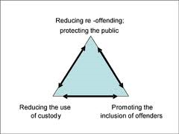
Outcomes
Support young people to reach their full potential and become successful contributors to their community and wider society.
The inter-dependence of the intended outcomes of CJSW
21st Century Social Work Reducing Re-offending Key Practice Skills
http://www.scotland.gov.uk/Resource/Doc/37432/0011296.pdf

Slide 11
Thank you
Shonagh Roy – Speirs
Impact Team Manager
Includem

