Slide 1
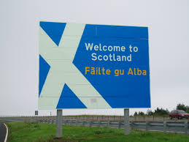
It’s complicated…
Claire Lightowler
claire.lightowler@strath.ac.uk

Slide 2
Scotland 2012-13
4.7% of children involved in offending (23,726 kids)
Charged with 43,117 crimes
Young people responsible for 16% of all crimes & offences
Scottish Government (2013) Scottish Policing Performance Framework, 2012-13.

Slide 3
Fall in detected offences between 2008/9 and 2012/13

Slide 4
Youth offending 2012/13

Slide 5
Fall in murder rate 2003/4 to 2012/13

Slide 6
What do we know about complexity in Scotland…?

Slide 7
1. Vulnerability and victimisation
Edinburgh Study of Youth Transitions & Crime
Cohort of 4,300 young people who started secondary school in Edinburgh in 1998
At age 15, 23% reported involvement in one or more episodes of violence
Those involved in violent offending were the most vulnerable and victimised

Slide 8
Violent offenders were significantly more likely than non-violent youths to be …
victims of crime and adult harassment
self-harming and para-suicidal behaviour
problematic health risk behaviours
Weak bonds (parent / school)
Personality measures (impulsivity and risk taking)
Bullying others
Family turbulence
socially deprivation
Friends involved in offending

Slide 9
Self-reported serious offending trajectories (McAra and McVie forthcoming 2014)
Trajectories estimated using semi-parametric group-based modelling (see Nagin 2005).
Serious offending = Housebreaking, vehicle theft, joyriding, fire-raising, robbery, weapon carrying and 6+ incidents of assault.

Slide 10
2. Mental Health
IVY project – young people presenting a significant risk to others
September 2014
All had input from social work services and looked after status
76% exposed to domestic violence
88% experienced some other form of maltreatment

Slide 11
Psychological/Mental Disorders
Diagnosed or Suspected Difficulty | n
Anger | 9
Anxiety | 3
Autism Spectrum Disorder | 12
Attachment Disorder | 7
Attention Deficit Hyperactivity Disorder | 10
Communication Disorder | 2
Complex Post Traumatic Stress | 12
Deliberate Self-Harm | 12
Dissociation | 3
Eating Difficulties | 3
Emotional Dysregulation | 7
Learning Disability | 3
Low Mood | 2
Oppositional Defiant/Conduct Disorder | 2
Psychosis | 2
Sleep Difficulties | 2
Substance Misuse Difficulties (Alcohol/Drugs) | 15
Suicidal Ideation/Action | 8
Thought Disorder | 1
Toileting Difficulties | 3
Tourette’s Syndrome | 1
Unusual perceptual experiences | 4
N=30
MEAN = 4

Slide 12
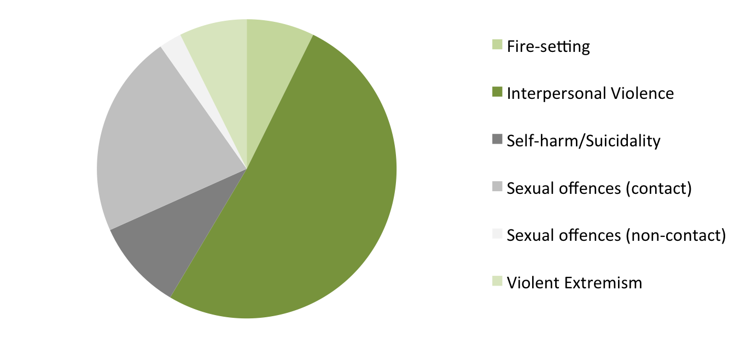
RISK PRESENTATION
*63% co-morbid risk to other presentations
*approx 30% suicide/self-harm
*approx 25 % concerns about victimisation
Notes:
N = 30

Slide 13
3. Bereavement and Loss
“How many more people do I have to see die? I’m only 19 and that’s five people died already and I keep thinking to myself ‘are the rest of them gonna die?’ And then I’ll grow up alone” (Vaswani, 2014)

Slide 14
Bereavement and loss
33 young men in Polmont YOI
91% had experienced at least one bereavement
Over three-quarters experienced traumatic bereavements (murder, suicide etc)
Two-thirds suffering from substantial bereavements (four or more)

Slide 15
Responding to complexity…

Slide 16
Whole System Approach (WSA)
The core focus of the WSA is to promote:
EEI for low-level offences
Opportunities to divert young people from prosecution
Court support
Community alternatives to secure care and custody
Changing behaviours of those in secure care and custody
Improving reintegration back into the community.

Slide 17
No. of young people referred to SCRA on offence grounds 2012/13

Slide 18
% change in prison receptions 2002-03 to 2010-11

Slide 19
Includem’s impact project
Intensive support in the community
young people identified as posing high risk to themselves and their communities
Police referral
Age 14-21
Glasgow
More than one violent crime/weapon crime

Slide 20
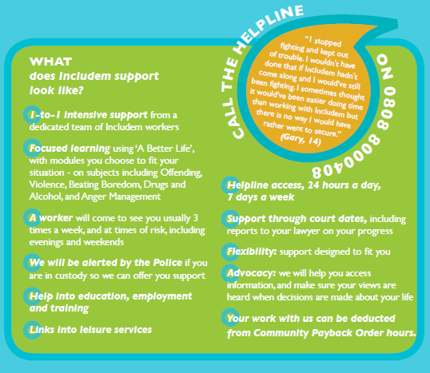

Slide 21
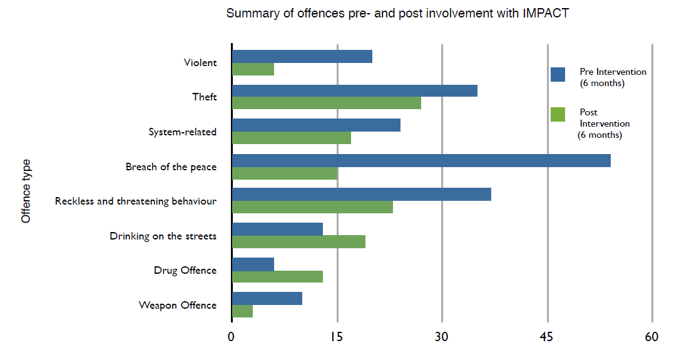
6 months post intervention
Dartington Social Research Unit

Slide 22
Interventions for vulnerable youth (IVY)
Scotland wide service
No cost for use
Forensic and clinical psychology, and social work
Level 1 - consultation clinic
Level 2 - specialist clinical forensic psychology assessment.
Level 3 - (specialist treatment)

Slide 23
Seasons for growth
Polmont YOI trying out new group work programme -Seasons for Growth.
Designed to help people deal with loss.
Weekly sessions 8 weeks
First time anyone has run Seasons for Growth in a Young Offenders Institution.

Slide 24
But…

Slide 25
Secure admissions 2002/03 to 2011/12

Slide 26
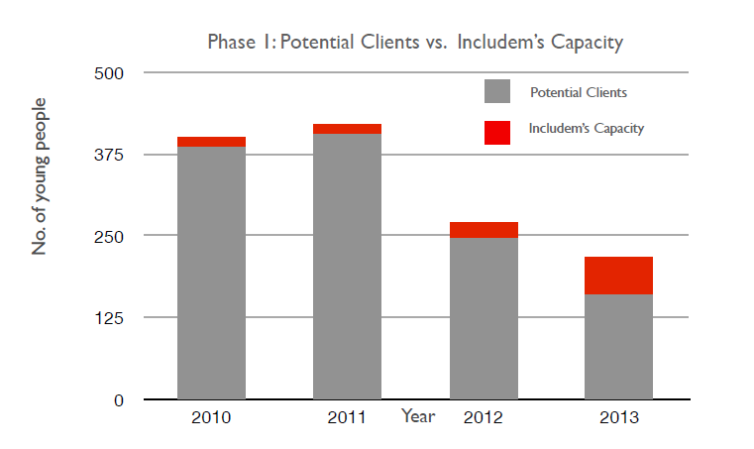
Dartington Social Research Unit

Slide 27
Speech, language & communication needs
prevalence in the youth justice population between 50% and 60% (UK wide)
Survey of Scottish local authorities (17 responses received)
35% reported that their area used tools to assess children and young people for SLCN
Only 41% reported that there were services or interventions available in their areas to support young people with SLCN

Slide 28
How do we support the workforce to better at dealing with complexity…?

Slide 29
We need a workforce that:
Learns from each other - across sectors, boundaries, geographies
Captures & shares what we do & learn
Tries out new ways of doing things (based on best available knowledge)
Evaluates
Integrates forms of knowledge
Reflects, and creates spaces for reflection
Accesses advice and support
Develops skills

Slide 30
CYCJ theory of change
Children & young people flourish
Practice and policy improvements
Practice Development
Knowledge exchange
Research
Advice, peer support, consultancy support, trying out initiatives, guidance, toolkits, training, supporting change projects
New knowledge, synthesising research evidence, evaluating initiatives, supporting evidence use
Capturing knowledge, promoting sharing, disseminating, improving access & accessibility, integrating forms of knowledge

Slide 31
Policy
Practice
Research
Experience

Slide 32
References
Lightowler, C., Orr, D. and Vaswani, N. (2014) Youth Justice in Scotland: Fixed in the past or fit for the future?, www.cycj.org.uk
Scottish Government (2013) Scottish Policing Performance Framework, 2012-13.
McAra, L. and McVie, S. (2010) Youth crime and Justice: Key Messages from the Edinburgh Study of Youth Transitions and Crime, www.research.ed.ac.uk/portal/files/8195355/Youth_crime_and_justice_Key_messages_from_the_Edinburgh_Study_of_Youth_Transitions_and_Crime_Criminology_and_Criminal_Justice.pdf
The Social Research Unit (2014) An Independent Evaluation of Includem’s IMPACT project http://www.includem.org/files/Report-Framework-May-2014_Independent-Evaluation-of-the-Glasgow-Youth-Violence-Project_05.06.pdf
Mental Health Difficulties in the Youth Justice Population: Learning from the first six months of the IVY project, www.cycj.org.uk/wp-content/uploads/2014/07/Briefing-Paper-5-final.pdf
Vaswani, N. (2014) The Ripples of Death: Exploring the Bereavement Experiences and Mental Health of Young Men in Custody, http://onlinelibrary.wiley.com/doi/10.1111/hojo.12064/full
Guidance on working with young people with speech, language & communication needs www.cycj.org.uk/resource/speech-language-and-communication-needs-in-youth-justice/
An Independent Evaluation of Includem’s IMPACT Project, www.includem.org/files/Report-Framework-May-2014_Independent-Evaluation-of-the-Glasgow-Youth-Violence-Project_05.06.pdf
CYCJ strategy, www.cycj.org.uk/resource/cycj-strategy-2014-2016/

