Slide 1
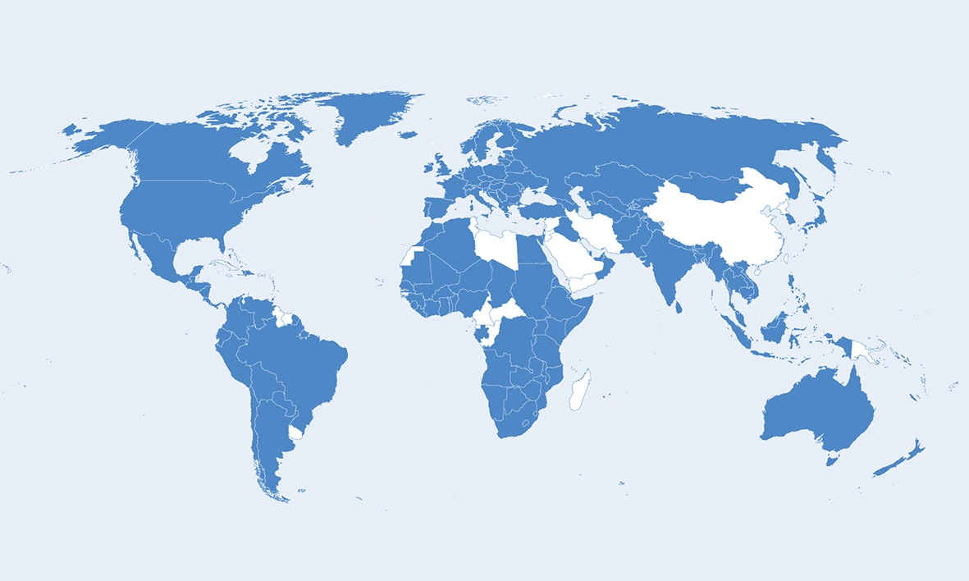
Human Trafficking
Global-National-Local
Human Trafficking is a global phenomenon.
It can happen anywhere
It’s how we respond that counts
Key Words Child Trafficking Child Protection:
child In need protecting the child
safeguarding children children and their families supporting families prevention looked after information sharing child care child welfare rapid response partnerships suitable accommodation
Philip Ishola

Slide 2
“Human Trafficking is a form of abuse. Exploitation is simply a way of making money from the misery of others”
www.chtb.org /chtbuk

Slide 3
Top Source Countries
Global-National-Local
Nigeria
Vietnam
Romania
Albania
Hungary
Slovakia
The UK
China
Czech Republic
Uganda

Slide 4
Age and type of exploitation
Traffickers do not distinguish by age
Under 10: domestic servitude and crime
11 - 17: sexual, labour and crime
18 – 30: sexual, labour, domestic servitude, labour, crime
30 +: domestic servitude, labour exploitation, crime, organs

Slide 5
Forms of exploitation
Why? Money
Sexual – prostitution, working in a brothel, passed around groups of men for money
Labour – forced labour
Domestic Servitude – can be both sexual and labour
Begging
Working in Cannabis Farms
Crime – ATM thefts, pickpocketing
Child and housing benefits
Other – eg Nigerian Baby Factories etc

Slide 6
Common Global Themes:
Exsample-International Labour Office Operational indicators
http://www.ilo.org/wcmsp5/groups/public/---ed_norm/---declaration/documents/publication/wcms_105023.pdf

Slide 8
The Day Job
Trafficking is complex? (It’s normal business)
A Child Rights and Human Rights (adults) approach makes it right (It’s what you do anyway)
No barriers

Slide 9
Multiagency Response
Child
Police
Health visitors, GPs, Accident and Emergency, schools, Youth offending teams,)
Voluntary and Community Sector
UKVI
>Point of first contact >Competent Authority
NCA- UK Human Trafficking Centre UKHTC >Competent Authority
Criminal Justice
Solicitors
Young Offenders Organisations

Slide 10
Scotland specific interactions – Interactions With Criminal Justice Service
Prison Service staff/ offender management/probation service
Crown Office – prosecutors Victim Information and Advice Service
Health Services e.g. Duty Doctor, psychiatric assessments for court/ sentencing
Independent Custody Visitors e.g. Duty Doctor, Appropriate Adult Scheme, Duty Doctor
NGOs e.g. Association of Visiting Committees, Samaritans in prisons
Police during ongoing investigations
Scottish Court Service, Judiciary
Solicitors – Immigration and defence /Legal Aid Board/Law Society (seeking solicitor)
Witness/Arrest/ Detention

Slide 11
Scotland specific interactions – Child Specific Interactions
NGOs e.g. Children 1st, Call centres- ChildLine,
Local Authority –Children’s services, Child protection Committees
Police during ongoing investigations
Interaction with the criminal Justice service as per previous slide
Adoption/Fostering Agencies
Health Providers e.g. GPs, A&E Depts, Dentists, sexual heath clinics
Local Authority educational services – teaching staff, nurses, Social Workers, care homes
Members of the public e.g. neighbours/ peer group
Child Victims

Slide 12
Make that Difference
Thank you for listening to me this morning
Questions ?

