Slide 1
Clinical Experience of NPS
Dr Richard Stevenson

Slide 2
NPS Background
Confusing terminology
“Designer Drugs”
“Bath Salts”
“Legal Highs”
“Psychoactive drugs, newly available in the UK, which are not prohibited by the United Nations Drug Conventions but which may pose a public health threat comparable to that posed by substances listed in these conventions”

Slide 3
Challenges
Unknown toxicology
Mechanism of action
Duration of action
Metabolism
Interactions (including prescription drugs)
Short term & long term harms
Identification of use
Self reporting
Post-mortem toxicology
Role of urine toxicology screens

Slide 4
Clinical Presentations
Concern over health
Extended duration of symptoms
Abnormal behaviours
Mild abnormalities
Drug induced psychoses
Acute behavioural disturbance
Acute drug toxicity
Harm associated with intoxication
Consequences of method of drug use

Slide 5
Local Demographics
Ages from 12 to 50
Equal sex distribution
Depends on the substance
Often from private dwellings
Polysubstance use is markedly prevalent
Alcohol +++
Often take it because its there
Intention to “get mad wi it”

Slide 6
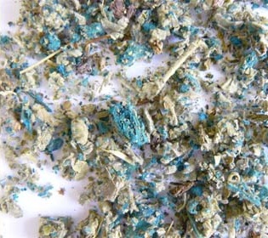
Synthetic Cannabinoids
Sold openly from head shops
Annihilation, Psy-clone, Clockwork Orange, Damnation, Exodus etc
Potent endogenous cannabinoid receptor agonists
Repeat presentations
Commonly smoked, ? “vaping”
Often present with
Nausea +++
Collapse
Catatonia, coma
Drug induced psychosis

Slide 7
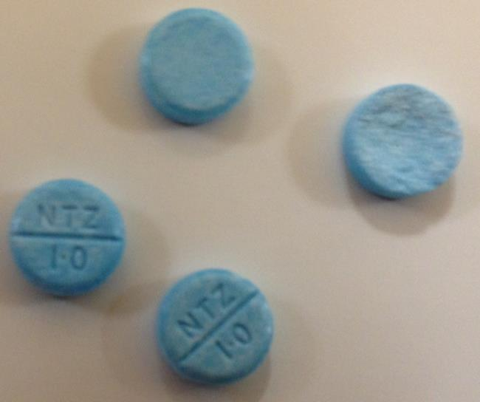
Benzodiazepines
Phenzepam, etizolam, diclazepam
1mg = 10mg diazepam
May or may not be detected on urine drug screens
Increasingly responsible for presumed opiate toxicity
Recent study from Abertay Uni & Police Scotland
“street blues” found to contain from 8mg to 48mg diazepam
Phenazepam & etizolam detected

Slide 8
Ketamine Mimics & Hallucinogens
Methoxetamine, 3-MePCP, methoxphenidine
Induce dissociation NMDA receptor antagonists
Prolonged duration of action
Cerebellar signs
N-BOMe, DOC
Sold on blotters (like LSD)
20 hour duration of action
Drug induced psychosis and threat to life behaviours

Slide 9
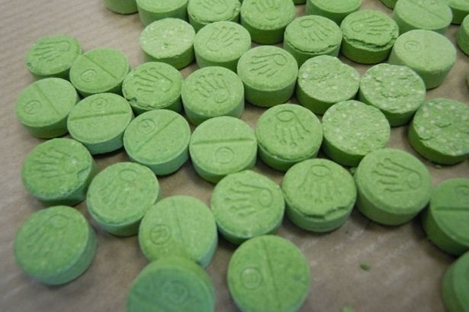
Ecstasy Mimics
BZP, PMA/PMMA, Benzo Fury, AMT, MDAI
Often sold as Ecstasy, or “legal equivalents” (most now illegal)
Mimic the empathogenic effect
Potent inducers of serotonin toxicity

Slide 10
AGITATION
MUSCLE ACTIVITY
ALTERED MENTAL STATE
HYPERTHERMIA
DEHYDRATION
RHABDOMYOLYSIS
 DEATH 
ACIDOSIS
↑ K
KIDNEY INJURY
HYPERPYREXIA 41+
DIC
↓ GLUCOSE
↓ Ca

Slide 11
Summary
NPS are here to stay
Responsible for increasing presentations
Clinically challenging
White powders – dangerous!
Mental health implications for young people
Perceptions need changed!

