Slide 1

whole system
approach
making a
difference
Framework for Risk Assessment Management and Evaluation (FRAME) for Local Authorities and partners - incorporating Care and Risk Management Guidance
Chris Wright
Children’s Hearings and Youth Justice Team
Scottish Government
Notes:
Thank you Freda for inviting me along today to give a Scottish Government overview of Whole System Approach.
Good morning everyone……. My first time in an Evangelical Church
I had a look at the church website and note from its child policy a commitment to:
Ensuring that all children and young people have the opportunity to grow up safe from harm;
Listening to, valuing and relating effectively to children and young people;
Ensuring those working with children and young people are properly supported and trained;
Encouraging and supporting parents and guardians.
I think a good ethos to be working to and fits in well with what we do!
I have been invited here today to talk about the whole system approach but first I thought it might be helpful to give you a bit of background and context to the team I work in.

Slide 2


Care and risk management
Notes:
2
In terms of the different models, it is fair to say that it has been established and accepted that unstructured clinical opinions are not an acceptable method of risk assessment. Research on the accuracy of these opinions have shown, empirically, these risk assessments performed no better than chance (Quinsey et al, 1988).

Slide 3

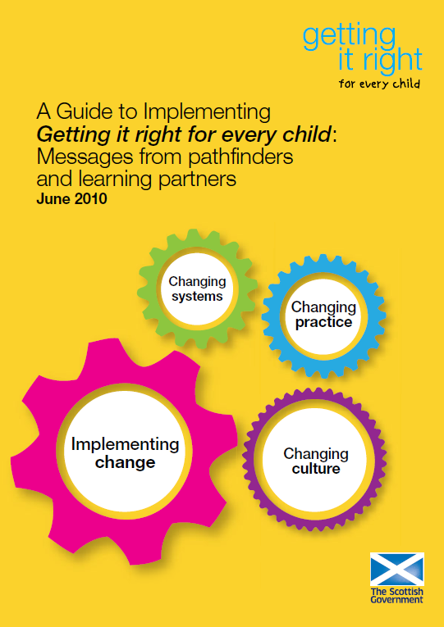
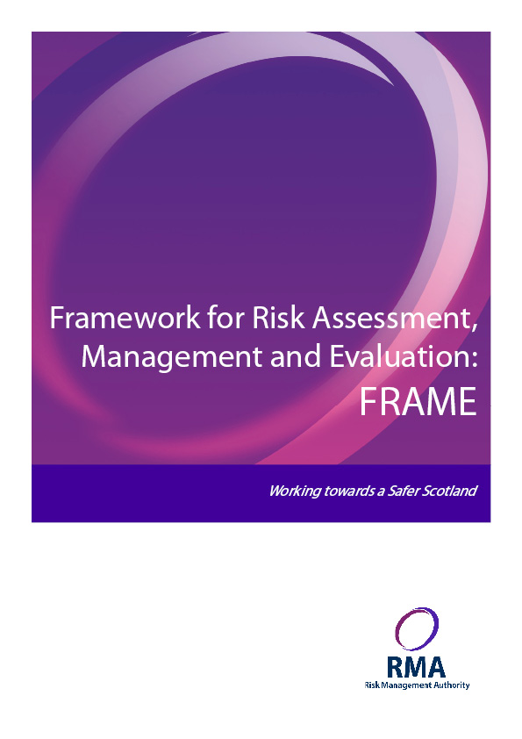
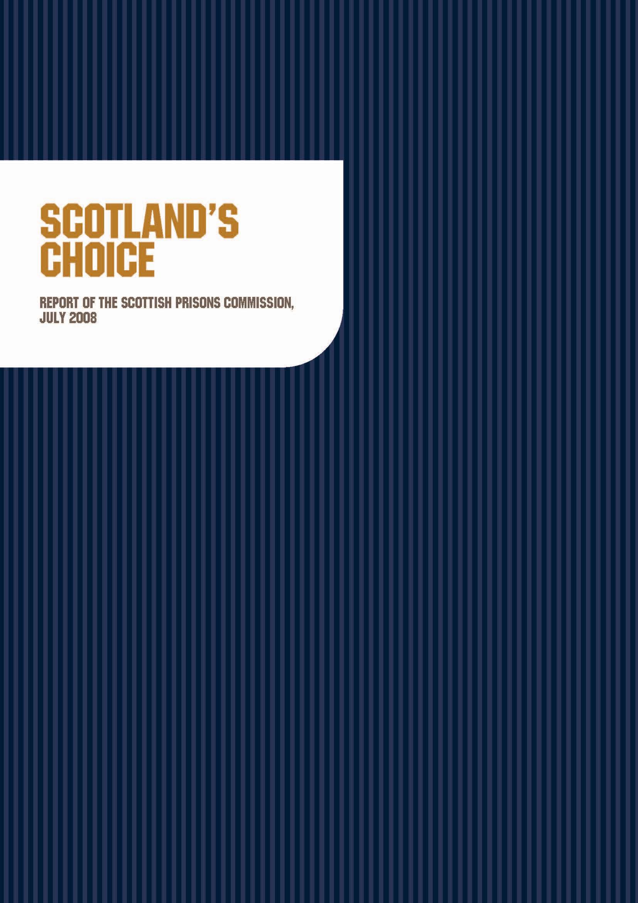
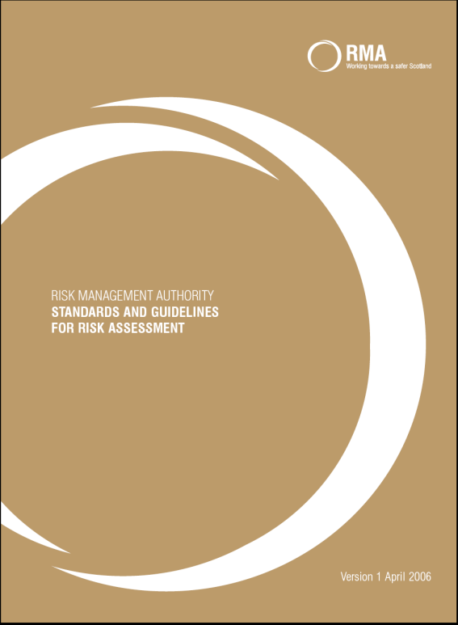
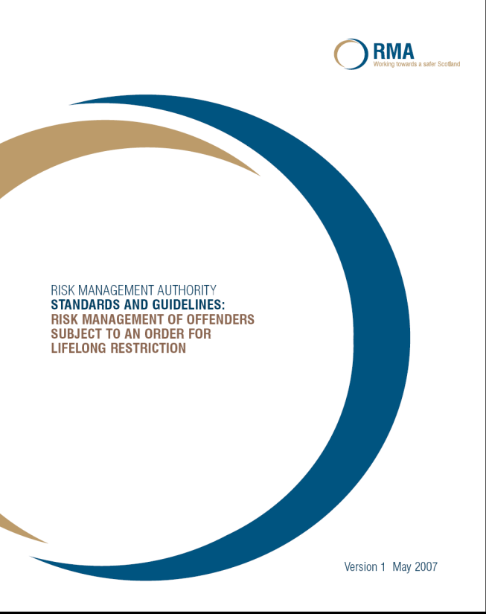




Background

Slide 4
whole system approach
making a
difference
Background
Karen Dewar - Colyn Evans
MAPPA
Risk Management by Youth Justice – Seminar Dec 2012
FRAME – CARM Guidance
Safer Lives
Notes:
So let us talk about Whole System Approach. In June 2008, the partnership framework Preventing Offending by Young People was published. It outlined a shared vision of what national and local agencies working with children and young people should do to prevent, divert, manage and change the behaviour of those who offend, or are at risk of offending.
Following on from this and as part of the work being delivered through the Young People Who Offend strand of the Scottish Government’s Reducing Reoffending Programme, there was a commitment to review the current systems, processes and practices in place for dealing with the offending behaviour of 16 and 17 year olds and those presenting a risk of serious harm.
In March 2010, a programme was set up to review the current systems and responses in place for dealing with the offending behaviour of young people under the age of 18 in Aberdeen, who were dealt with by the police, through the children’s hearings or in the courts. This programme set out to develop a ‘Whole System Approach’ and received funding from the Government.
Following the success of a whole system approach in Aberdeen, the Scottish Government prioritised work to support partners to take forward the development of a whole system approach across Scotland. This involved putting in place streamlined planning, assessment and decision making processes for young people who offend, ensuring they receive the right help at the right time.
Launched in September 2011, and aligned with GIRFEC - Getting it right for every child, the whole system approach focusses on delivering the strategic aims set out in the preventing offending by young people framework and reducing reoffending programme. The WSA outlines a shared ambition of Government and key partners to prevent, divert, manage and change offending behaviour by children and young people and reduce the number entering the adult criminal justice system, by diverting them from statutory measures, from prosecution and from custody through early intervention and through robust community alternatives.
This approach has now been adopted in 28 Local Authorities areas across Scotland.

Slide 5
whole system approach
making a
difference
Colyn Evans
Colyn Evans was sentenced to life imprisonment on 10 June 2005 for the murder of Karen Dewar, a 16 year old girl living in the same neighbourhood.
The crime was committed when Colyn Evans was aged 17. He had been subject to supervision by Fife Council Social Work Service until April 2004, under section 70(3) Children (Scotland) Act 1995 and thereafter to throughcare support under the Support and Assistance of Young People Leaving Care (Scotland) Regulations 2003
Notes:
So let us talk about Whole System Approach. In June 2008, the partnership framework Preventing Offending by Young People was published. It outlined a shared vision of what national and local agencies working with children and young people should do to prevent, divert, manage and change the behaviour of those who offend, or are at risk of offending.
Following on from this and as part of the work being delivered through the Young People Who Offend strand of the Scottish Government’s Reducing Reoffending Programme, there was a commitment to review the current systems, processes and practices in place for dealing with the offending behaviour of 16 and 17 year olds and those presenting a risk of serious harm.
In March 2010, a programme was set up to review the current systems and responses in place for dealing with the offending behaviour of young people under the age of 18 in Aberdeen, who were dealt with by the police, through the children’s hearings or in the courts. This programme set out to develop a ‘Whole System Approach’ and received funding from the Government.
Following the success of a whole system approach in Aberdeen, the Scottish Government prioritised work to support partners to take forward the development of a whole system approach across Scotland. This involved putting in place streamlined planning, assessment and decision making processes for young people who offend, ensuring they receive the right help at the right time.
Launched in September 2011, and aligned with GIRFEC - Getting it right for every child, the whole system approach focusses on delivering the strategic aims set out in the preventing offending by young people framework and reducing reoffending programme. The WSA outlines a shared ambition of Government and key partners to prevent, divert, manage and change offending behaviour by children and young people and reduce the number entering the adult criminal justice system, by diverting them from statutory measures, from prosecution and from custody through early intervention and through robust community alternatives.
This approach has now been adopted in 28 Local Authorities areas across Scotland.

Slide 6
whole system approach
making a
difference
Multi Agency Public Protection Arrangements
Multi Agency Public Protection Arrangements (MAPPA) is the framework which joins up the agencies who manage offenders. The fundamental purpose of MAPPA is public safety and the reduction of serious harm.
The introduction of MAPPA across Scotland in April 2007 gave a consistant approach to the management of offenders across all local authority and police force areas, providing a framework for assessing and managing the risk posed by some of those offenders.
This evolved from the Cosgrove report (expert panel on sex offending), Irving report (reducing the risk) and the work of the Information Sharing Steering Group which led to the Management of Offenders etc (Scotland) Act 2005.
Notes:
So let us talk about Whole System Approach. In June 2008, the partnership framework Preventing Offending by Young People was published. It outlined a shared vision of what national and local agencies working with children and young people should do to prevent, divert, manage and change the behaviour of those who offend, or are at risk of offending.
Following on from this and as part of the work being delivered through the Young People Who Offend strand of the Scottish Government’s Reducing Reoffending Programme, there was a commitment to review the current systems, processes and practices in place for dealing with the offending behaviour of 16 and 17 year olds and those presenting a risk of serious harm.
In March 2010, a programme was set up to review the current systems and responses in place for dealing with the offending behaviour of young people under the age of 18 in Aberdeen, who were dealt with by the police, through the children’s hearings or in the courts. This programme set out to develop a ‘Whole System Approach’ and received funding from the Government.
Following the success of a whole system approach in Aberdeen, the Scottish Government prioritised work to support partners to take forward the development of a whole system approach across Scotland. This involved putting in place streamlined planning, assessment and decision making processes for young people who offend, ensuring they receive the right help at the right time.
Launched in September 2011, and aligned with GIRFEC - Getting it right for every child, the whole system approach focusses on delivering the strategic aims set out in the preventing offending by young people framework and reducing reoffending programme. The WSA outlines a shared ambition of Government and key partners to prevent, divert, manage and change offending behaviour by children and young people and reduce the number entering the adult criminal justice system, by diverting them from statutory measures, from prosecution and from custody through early intervention and through robust community alternatives.
This approach has now been adopted in 28 Local Authorities areas across Scotland.

Slide 7
whole system approach
making a
difference
Risk Management Seminar
Outcomes
Better integration of Risk Management and GIRFEC, WSA and Child Protection
Development of a national protocol / guidance
Local authority accountability – link to Inspection regime.
Sharing best practice - champions group and practice development group
Training - particularly for Chairs, links with MAPPA co-ordinators and LA reviews
Notes:
So let us talk about Whole System Approach. In June 2008, the partnership framework Preventing Offending by Young People was published. It outlined a shared vision of what national and local agencies working with children and young people should do to prevent, divert, manage and change the behaviour of those who offend, or are at risk of offending.
Following on from this and as part of the work being delivered through the Young People Who Offend strand of the Scottish Government’s Reducing Reoffending Programme, there was a commitment to review the current systems, processes and practices in place for dealing with the offending behaviour of 16 and 17 year olds and those presenting a risk of serious harm.
In March 2010, a programme was set up to review the current systems and responses in place for dealing with the offending behaviour of young people under the age of 18 in Aberdeen, who were dealt with by the police, through the children’s hearings or in the courts. This programme set out to develop a ‘Whole System Approach’ and received funding from the Government.
Following the success of a whole system approach in Aberdeen, the Scottish Government prioritised work to support partners to take forward the development of a whole system approach across Scotland. This involved putting in place streamlined planning, assessment and decision making processes for young people who offend, ensuring they receive the right help at the right time.
Launched in September 2011, and aligned with GIRFEC - Getting it right for every child, the whole system approach focusses on delivering the strategic aims set out in the preventing offending by young people framework and reducing reoffending programme. The WSA outlines a shared ambition of Government and key partners to prevent, divert, manage and change offending behaviour by children and young people and reduce the number entering the adult criminal justice system, by diverting them from statutory measures, from prosecution and from custody through early intervention and through robust community alternatives.
This approach has now been adopted in 28 Local Authorities areas across Scotland.

Slide 8
whole system approach
making a
difference
National Standards April 2013 Objective 1
Provide quality youth justice processes and practice
If a sustainable reduction in offending and reduced use of secure accommodation and detention is to be achieved, the assessment of young people who offend and the quality of reports provided to children's reporters, children's hearings, procurators fiscal and criminal courts, must be consistent across Scotland.
Comprehensive assessments and multi-disciplinary Single Plans for children and young people involved in offending behaviour should be guided by the principles of GIRFEC. This is applicable to all reports and effective planned interventions for young people up to the age of 18 years involved in children's hearings and/or criminal courts. The Single Plan should directly address assessed needs and risks including criminogenic needs, and provide immediate and longer term objectives, tasks and timescales, and the views of the child or young person.
http://www.scotland.gov.uk/Publications/2013/04/8899/55
Notes:
WSA has been a collaboration of working together to change how we can deliver without a need for legislation or major investment.
Within this, there has been system and process change. And WSA is now embedded into practice. As we move away from the set up funding we need to ensure that WSA is sustainable. Some LA areas have not been receiving funding for a little while, but I think the jury may be still out.
What I have become aware of is a recognition by a number of LA areas moving towards the expansion of WSA to 21 year olds. I can fully understand this move, it cuts through boundaries between services and I am sure it will improve outcomes. We in the government need to recognise this move and consider our position on this move in direction. I know that one of CYCJ’s ambitions is to expand the age group and will be lobbying us on this.
Finally, there will be a big challenge when the duties of the Children & Young People (Scotland) Act 2014 GIRFEC provisions are commenced in August 2016. I understand that public consultation on draft statutory guidance and provisions will happen this coming spring, and practice guidance will be developed in the summer. Those working within WSA will need to understand the implications for this, how this work will interact especially around the named person and child’s plan.
Hope you have found this useful and thank you for listening.

Slide 9
whole system approach
making a
difference
CARM Guidance
To promote consistency across Scotland's local authorities, this document encourages collective adoption of the term Care and Risk Management (CARM) Meetings. The risk management structure should involve professionals meeting on a regular case-by-case basis to manage, evaluate and monitor risk assessments and.
It is imperative that children and young people who pose a risk of serious harm have the support and opportunities to grow, develop and reach their full potential. This must be aided by proportionate and effective risk management strategies which include interventions that minimise the risk presented by the child or young person and reduce the likelihood of further harm.
Notes:
So let us talk about Whole System Approach. In June 2008, the partnership framework Preventing Offending by Young People was published. It outlined a shared vision of what national and local agencies working with children and young people should do to prevent, divert, manage and change the behaviour of those who offend, or are at risk of offending.
Following on from this and as part of the work being delivered through the Young People Who Offend strand of the Scottish Government’s Reducing Reoffending Programme, there was a commitment to review the current systems, processes and practices in place for dealing with the offending behaviour of 16 and 17 year olds and those presenting a risk of serious harm.
In March 2010, a programme was set up to review the current systems and responses in place for dealing with the offending behaviour of young people under the age of 18 in Aberdeen, who were dealt with by the police, through the children’s hearings or in the courts. This programme set out to develop a ‘Whole System Approach’ and received funding from the Government.
Following the success of a whole system approach in Aberdeen, the Scottish Government prioritised work to support partners to take forward the development of a whole system approach across Scotland. This involved putting in place streamlined planning, assessment and decision making processes for young people who offend, ensuring they receive the right help at the right time.
Launched in September 2011, and aligned with GIRFEC - Getting it right for every child, the whole system approach focusses on delivering the strategic aims set out in the preventing offending by young people framework and reducing reoffending programme. The WSA outlines a shared ambition of Government and key partners to prevent, divert, manage and change offending behaviour by children and young people and reduce the number entering the adult criminal justice system, by diverting them from statutory measures, from prosecution and from custody through early intervention and through robust community alternatives.
This approach has now been adopted in 28 Local Authorities areas across Scotland.

Slide 10
whole system approach
making a
difference
CARM Guidance
To highlight to appropriate agencies individual children or young person who present a risk of serious harm to others;
To ensure that a relevant risk assessment is undertaken in relation to a child or young person considered to present a serious risk of harm to others;
To share information in a multi-agency forum about the level of risk of harm presented by a child or young person;
To clarify the nature of the harm and the individuals who may be at risk from a child or young person's behaviour;
To undertake scenario planning which considers the nature of risk in particular settings;
Notes:
So let us talk about Whole System Approach. In June 2008, the partnership framework Preventing Offending by Young People was published. It outlined a shared vision of what national and local agencies working with children and young people should do to prevent, divert, manage and change the behaviour of those who offend, or are at risk of offending.
Following on from this and as part of the work being delivered through the Young People Who Offend strand of the Scottish Government’s Reducing Reoffending Programme, there was a commitment to review the current systems, processes and practices in place for dealing with the offending behaviour of 16 and 17 year olds and those presenting a risk of serious harm.
In March 2010, a programme was set up to review the current systems and responses in place for dealing with the offending behaviour of young people under the age of 18 in Aberdeen, who were dealt with by the police, through the children’s hearings or in the courts. This programme set out to develop a ‘Whole System Approach’ and received funding from the Government.
Following the success of a whole system approach in Aberdeen, the Scottish Government prioritised work to support partners to take forward the development of a whole system approach across Scotland. This involved putting in place streamlined planning, assessment and decision making processes for young people who offend, ensuring they receive the right help at the right time.
Launched in September 2011, and aligned with GIRFEC - Getting it right for every child, the whole system approach focusses on delivering the strategic aims set out in the preventing offending by young people framework and reducing reoffending programme. The WSA outlines a shared ambition of Government and key partners to prevent, divert, manage and change offending behaviour by children and young people and reduce the number entering the adult criminal justice system, by diverting them from statutory measures, from prosecution and from custody through early intervention and through robust community alternatives.
This approach has now been adopted in 28 Local Authorities areas across Scotland.

Slide 11
whole system approach
making a
difference
CARM Guidance
To identify safety factors which can reduce risk;
To implement risk management measures that are constructive and individualised, bearing in mind the principle of proportionality, the best interests of the individual as well as his/her age, physical and mental well-being and development and circumstances of the case;
To ensure that the young person's social, developmental and psychological needs should be addressed within the context of decisions about risk management strategies; and,
To ensure that, through the completion of risk assessment(s) and the linked development of risk management strategies, there is an appropriate multi-agency response to the child or young person's behaviour.
Notes:
So let us talk about Whole System Approach. In June 2008, the partnership framework Preventing Offending by Young People was published. It outlined a shared vision of what national and local agencies working with children and young people should do to prevent, divert, manage and change the behaviour of those who offend, or are at risk of offending.
Following on from this and as part of the work being delivered through the Young People Who Offend strand of the Scottish Government’s Reducing Reoffending Programme, there was a commitment to review the current systems, processes and practices in place for dealing with the offending behaviour of 16 and 17 year olds and those presenting a risk of serious harm.
In March 2010, a programme was set up to review the current systems and responses in place for dealing with the offending behaviour of young people under the age of 18 in Aberdeen, who were dealt with by the police, through the children’s hearings or in the courts. This programme set out to develop a ‘Whole System Approach’ and received funding from the Government.
Following the success of a whole system approach in Aberdeen, the Scottish Government prioritised work to support partners to take forward the development of a whole system approach across Scotland. This involved putting in place streamlined planning, assessment and decision making processes for young people who offend, ensuring they receive the right help at the right time.
Launched in September 2011, and aligned with GIRFEC - Getting it right for every child, the whole system approach focusses on delivering the strategic aims set out in the preventing offending by young people framework and reducing reoffending programme. The WSA outlines a shared ambition of Government and key partners to prevent, divert, manage and change offending behaviour by children and young people and reduce the number entering the adult criminal justice system, by diverting them from statutory measures, from prosecution and from custody through early intervention and through robust community alternatives.
This approach has now been adopted in 28 Local Authorities areas across Scotland.

Slide 12
whole system approach
making a
difference
CARM Guidance
Care and risk management processes need to be supplemented and strengthened by local or inter-authority training for practitioners that addresses:
awareness of local care and risk management processes and how universal services can work with children and young people in a risk management context;
assessment of young people who present a risk of serious harm; and,
intervention work with young people who present a risk of serious harm.
Notes:
So let us talk about Whole System Approach. In June 2008, the partnership framework Preventing Offending by Young People was published. It outlined a shared vision of what national and local agencies working with children and young people should do to prevent, divert, manage and change the behaviour of those who offend, or are at risk of offending.
Following on from this and as part of the work being delivered through the Young People Who Offend strand of the Scottish Government’s Reducing Reoffending Programme, there was a commitment to review the current systems, processes and practices in place for dealing with the offending behaviour of 16 and 17 year olds and those presenting a risk of serious harm.
In March 2010, a programme was set up to review the current systems and responses in place for dealing with the offending behaviour of young people under the age of 18 in Aberdeen, who were dealt with by the police, through the children’s hearings or in the courts. This programme set out to develop a ‘Whole System Approach’ and received funding from the Government.
Following the success of a whole system approach in Aberdeen, the Scottish Government prioritised work to support partners to take forward the development of a whole system approach across Scotland. This involved putting in place streamlined planning, assessment and decision making processes for young people who offend, ensuring they receive the right help at the right time.
Launched in September 2011, and aligned with GIRFEC - Getting it right for every child, the whole system approach focusses on delivering the strategic aims set out in the preventing offending by young people framework and reducing reoffending programme. The WSA outlines a shared ambition of Government and key partners to prevent, divert, manage and change offending behaviour by children and young people and reduce the number entering the adult criminal justice system, by diverting them from statutory measures, from prosecution and from custody through early intervention and through robust community alternatives.
This approach has now been adopted in 28 Local Authorities areas across Scotland.

Slide 13

whole system
approach
making a
difference
In 2012-13,
4% of 8-17 year olds or 1 in 25 were found to have committed a crime or offence
Notes:
13
Other stats:
Number of young people 16/17 year olds serving a sentence on 13 November – SPS stats 2011 – 76 2012 - 58 2013 - 40 ↓ 47%
Number of young people 16/17 year olds on remand on 13 November – SPS stats 2011 – 50 2012 - 27 2013 – 20 ↓ 60%

Slide 14
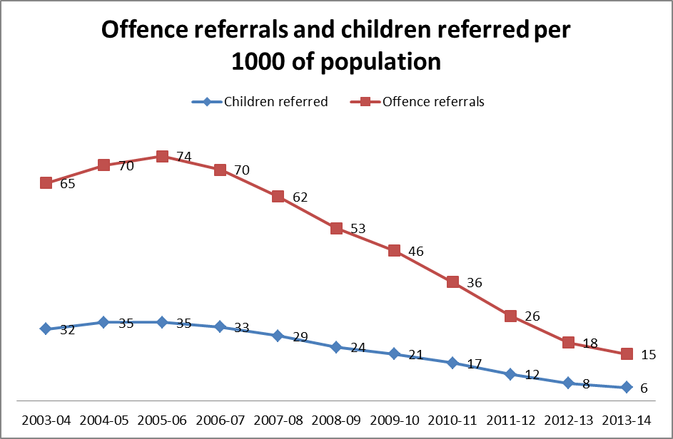
whole system
approach
making a
difference
Notes:
14
Other stats:
Number of young people 16/17 year olds serving a sentence on 13 November – SPS stats 2011 – 76 2012 - 58 2013 - 40 ↓ 47%
Number of young people 16/17 year olds on remand on 13 November – SPS stats 2011 – 50 2012 - 27 2013 – 20 ↓ 60%

Slide 15
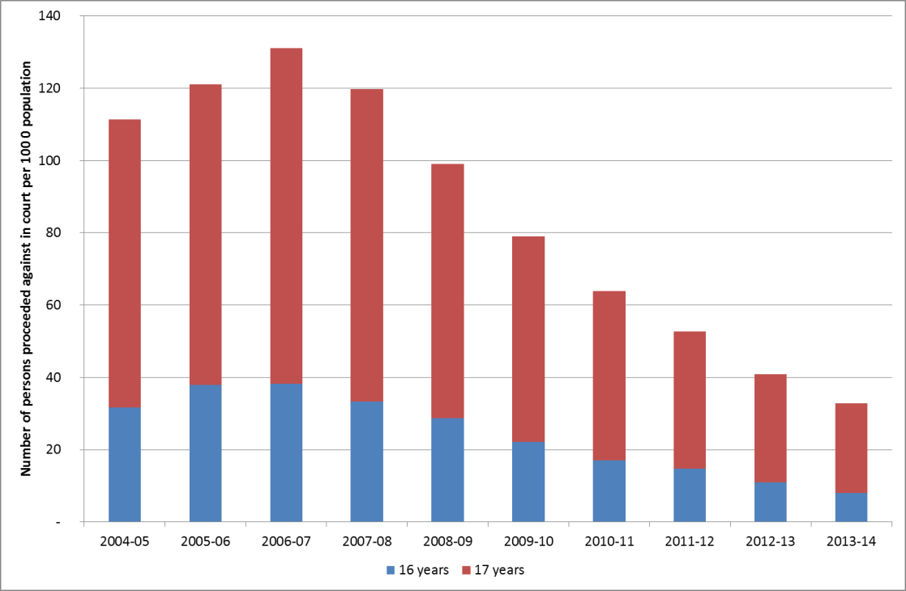
whole system
approach
making a
difference
Notes:
15
Other stats:
Number of young people 16/17 year olds serving a sentence on 13 November – SPS stats 2011 – 76 2012 - 58 2013 - 40 ↓ 47%
Number of young people 16/17 year olds on remand on 13 November – SPS stats 2011 – 50 2012 - 27 2013 – 20 ↓ 60%

Slide 16


whole system
approach
making a
difference
Notes:
16
This is a real good demonstration that fewer young people are ending up with convictions, therefore less will end up with a criminal records leading to better chances of education and employment opportunities.

Slide 17
whole system
approach
making a
difference
Notes:
Other stats:
Number of young people 16/17 year olds serving a sentence on 13 November – SPS stats 2011 – 76 2012 - 58 2013 - 40 ↓ 47%
Number of young people 16/17 year olds on remand on 13 November – SPS stats 2011 – 50 2012 - 27 2013 – 20 ↓ 60%
One of the most striking results to me are that this week there are only 49 16/17 year olds in YOI custody – this figure includes sentenced and remand males and females. This is from a 200+ figure in 2007/08. What a success and something as a nation we should be proud of and promoting.
Currently only 9 sentenced young people are in secure units.

Slide 18
Analysis of crime reduction: age
whole system
approach
making a
difference
8-17 year olds - contribution to fall in cleared-up crime
TOTAL CRIME | 51%
TOTAL CRIME + MISC OFFENCES | 60%
Notes:
We have been looking at what data tells us about who was committing the crime and whether this is relevant to the crime reduction story. It is.
In particular, what’s been happening to youth crime is particularly important. This chart shows “cleared-up” crime in Scotland – i.e. where we essentially know who committed the crime – for crime committed by young people (aged 8-17, quite a narrow definition).
It has a narrow range of years (08/09 to 11/12) – as these are the only data we currently have available to us. But even in this narrower period, the changes are dramatic – again showing across the board falls in the major crime types with the exception of sexual offences. We have got concerns about the increase in number of jointly reported cases and offences with sexual component and that we want to take a closer look at this.
We are also able to look at the contribution of these falls in youth crime to the overall reduction in “cleared-up” crime in Scotland. We find that youth crime (8-17) accounts for over half of the total reduction. (It accounted for much more significant falls in certain crime types, such as vandalism).
East Dunbartonshire
Statistical information collated to date indicates that there has continued to be a reduction in offending behaviour in East Dunbartonshire between 2013 and 2014. The reduction in offending behaviour has been considerable for young people under the age of 16 years. The reduction in offending behaviour has not been as significant for young people under the age of 18 years.
There has been a considerable increase in the use of Diversion from Prosecution for under 18s. Between April 2014 and October 2014 EDC has received 10 Diversion referrals. There were no diversion referrals in the same period in 2013.
Since June 2014 EEI has extended referrals to young people under the age of 18 years.
In terms of alternatives to secure, EDC has used one Movement Restriction Condition in an effort to reintegrate a young person from secure accommodation back into the community.

Slide 19
whole system
approach
making a
difference
Aims and themes
Aim:
Reduce
Re-offending by young people (under 18) through appropriate interventions
Themes:
Early and Effective Intervention
Diversion from prosecution
Alternatives to secure care and custody
Effective court case management
Reintegration and transitions
Framework for risk assessment, management and evaluation
Develop integrated processes & services across children & adult systems
Increase opportunities for diversion from formal measures
Increase opportunities for community alternatives to secure care & custody
Develop a consistent approach to risk assessment and risk management
Better support young people who attend Court/Court processes
Improve services for young people in custody and reintegration to the community
Notes:
Before I get into some of the detail I really wanted to mention how impressed I have been with the commitment given by all partners in driving the development of the approach, the commitment I have seen is really remarkable. Ok, we know there has been the odd hiccup along the way but there has always been solutions found, that cut through the red tape and keep the young people and their best interests at the centre of the work. I know that East Dunbartonshire joined in a little later than some authorities but the effort put in has ensured you are quickly catching up, and you are starting to see results. So to all those involved Freda, Jim, Diane, Angela, we are indebted to your drive and dedication.
Our overall aim is about reducing re-offending by young people. We do this through appropriate interventions covered within the listed themes. I will talk a little bit about each.
EEI – Where young people come to the attention of the police there is an opportunity to take a flexible approach to offending behaviour. The objective is to prevent future offending or antisocial behaviour by providing interventions which are timely and proportionate whilst at the same time alerting other agencies to concerns which exist about the child or young person’s behaviour and well-being. The police and other agencies including social work, health, education and others, share information in relation to their own contact with the young person and jointly decide on the best response to support the person and their family to address any needs or risks. By working together, it is possible to provide support tailored to individual needs, thus helping to turn lives around quickly.
Diversion - Bringing young people into the criminal justice system early for low level offences often results in increased offending. Providing opportunities to divert them from formal prosecution can change the behaviour of young people. Local authorities, police, the Crown Office and Prosecutor Fiscal Service are working together to identify young people reported for low level offences and divert them into a tailored support package that address the behavioural issues behind the referral. Stats on latest diversion numbers are still to be published but anecdotal information suggests this will spike dramatically. There are still challenges around diversion and success across the country is varied. We are currently working with all the parties to bring consistency so that we have a strong focus and confidence in the use of diversion.
alternatives to secure care and custody - Research has shown that placing sentenced young people in secure care or prison for low level offences is also more likely to increase their likelihood to re-offend. Robust community alternatives can be more effective. When a young person is kept in their community, it is important that appropriate risk assessment and management procedures are in place, alongside intensive support and supervision including, in some cases, electronic monitoring to ensure community safety. I mentioned earlier that we had published guidance which will hopefully clear up lots of concerns in the use of alternatives. In should be noted that Children’s Hearings panel should not sanction the use of secure care if alternatives have not been considered and the alternatives deemed in appropriate.
Court support and management- We are improving the information for courts which deal with young people and improving support for the young person through the court process. The use of court workers have provided a useful support link for young people in what is a very stressful situation. We do still have concerns about the time cases for young people are taking to get to court and we know of cases that have taken 4-5 years before prosecution. Issues here include that this is not good for the offender or the victim to have to wait so long. And in several cases the child as defined when the offence first occurred has become an adult and sentencing is dealt differently.
Improving reintegration back into the community - Supporting reintegration from secure care and custody back into society is vitally important to reduce reoffending. Children and young people leaving secure care and custody should have a package of support detailed in their Child’s Plan to help them re-integrate successfully. We are working with the Scottish Prison Service, Secure Care providers, local authorities, charities and Skills Development Scotland to ensure young people are given the best opportunities to turn their lives around.
I would like to mention secure and the role it has. It is about Changing behaviours of those in secure care and custody- A small number of young people are require to be placed in secure care or custody. The secure care providers work with these young people to improve their outcomes. This is done by encouraging behavioural changes, increasing their engagement with learning, education and health care.
Secure care numbers have remained steady over the last while, numbers being masked by young people who have been placed from England due to pressures on their units and that 7 beds at Rossie and St Mary’s are unavailable at present. We are working with units to ensure places are protected for Scotland’s young people.
I know that authorities are working very hard to reduce the numbers within secure and only those that are either sentenced or cause a high risk to themselves or others are the young people in secure. I do have concern that a reasonable number of those in secure have mental health issues and whether secure is the right place for them. We are working on health colleagues on this at the moment and take on board concerns raised with us about the lack of appropriate facilities. I also think there is a need to develop stronger consistency across the secure units in terms of the services and outcomes, it should not be a case of you get a better services if you are in a certain unit.

Slide 20
whole system approach
making a
difference
Youth Justice Strategy Refresh
A review not a new direction
Developing Priority themes –
Advancing the Whole System Approach
Improving Life Chances
Developing Capacity
Notes:
WSA has been a collaboration of working together to change how we can deliver without a need for legislation or major investment.
Within this, there has been system and process change. And WSA is now embedded into practice. As we move away from the set up funding we need to ensure that WSA is sustainable. Some LA areas have not been receiving funding for a little while, but I think the jury may be still out.
What I have become aware of is a recognition by a number of LA areas moving towards the expansion of WSA to 21 year olds. I can fully understand this move, it cuts through boundaries between services and I am sure it will improve outcomes. We in the government need to recognise this move and consider our position on this move in direction. I know that one of CYCJ’s ambitions is to expand the age group and will be lobbying us on this.
Finally, there will be a big challenge when the duties of the Children & Young People (Scotland) Act 2014 GIRFEC provisions are commenced in August 2016. I understand that public consultation on draft statutory guidance and provisions will happen this coming spring, and practice guidance will be developed in the summer. Those working within WSA will need to understand the implications for this, how this work will interact especially around the named person and child’s plan.
Hope you have found this useful and thank you for listening.

Slide 21
whole system approach
making a
difference
WSA Evaluation
Early Indications:
WSA has been a galvanising factor in driving improvements in partnership working, information-sharing and shared learning across agencies and in turn improving outcomes for children and young people.
Flexibility in implementing WSA across local authority areas may be necessary to adapt to different conditions and local demands, including variations in local authority size, scale and structure.
Notes:
WSA has been a collaboration of working together to change how we can deliver without a need for legislation or major investment.
Within this, there has been system and process change. And WSA is now embedded into practice. As we move away from the set up funding we need to ensure that WSA is sustainable. Some LA areas have not been receiving funding for a little while, but I think the jury may be still out.
What I have become aware of is a recognition by a number of LA areas moving towards the expansion of WSA to 21 year olds. I can fully understand this move, it cuts through boundaries between services and I am sure it will improve outcomes. We in the government need to recognise this move and consider our position on this move in direction. I know that one of CYCJ’s ambitions is to expand the age group and will be lobbying us on this.
Finally, there will be a big challenge when the duties of the Children & Young People (Scotland) Act 2014 GIRFEC provisions are commenced in August 2016. I understand that public consultation on draft statutory guidance and provisions will happen this coming spring, and practice guidance will be developed in the summer. Those working within WSA will need to understand the implications for this, how this work will interact especially around the named person and child’s plan.
Hope you have found this useful and thank you for listening.

Slide 22
whole system
approach
making a
difference
Intensive Support and Monitoring System - Guidance on the use of Movement Restriction Conditions (MRC's) in the Children's Hearing System
The purpose of this guidance document is to provide an overview of the key factors that ought to be taken into account when consideration is being given to the use of a Movement Restriction Condition (MRC) in the Children's Hearing System (CHS).
The document is intended primarily for Lead Professionals (generally social workers) who have a statutory responsibility to present information to Children's Panel Members in respect of young people involved in offending behaviour of a serious nature or behaviours which places themselves and/or others at risk of serious harm
Notes:
22
This is a real good demonstration that fewer young people are ending up with convictions, therefore less will end up with a criminal records leading to better chances of education and employment opportunities.

Slide 23
whole system
approach
making a
difference
Intensive Support and Monitoring System - Guidance on the use of Movement Restriction Conditions (MRC's) in the Children's Hearing System
While the focus of the guidance is upon the mechanics and practicalities of MRCs it is imperative that implementation authorities do not lose sight of the importance of providing vulnerable young people and their families with a broad and varied range of support and assistance irrespective of whether concerns are predominantly wellbeing oriented or related to offending behaviour or concerns stem from an interplay
of the two
Notes:
23
This is a real good demonstration that fewer young people are ending up with convictions, therefore less will end up with a criminal records leading to better chances of education and employment opportunities.

Slide 24


GIRFEC is coming are you ready ..or not?
Communication and Change plan developed and agreed
Right messages shared at the right time with the right people
Partners/colleagues/staff are fully and engaged and involved
New processes and procedures developed
Our management structure and network support the named person
New processes and procedures agreed and documented
Have organised workshops to review processes and procedures with out key partners / colleagues
Senior managers fully support and endorse new ways of working
Policies / guidance updated to reflect GIRFEC compliance
MA training agreed / developed
Have identified Key partners / colleagues we need to communicate with
Stakeholders kept informed of changes and on-board with new ways of working
MA training delivered
Policies and guidance do not reflect GIRFEC compliance
New processes/ procedures implemented
Have not considered / reviewed our EEI processes and procedures to support the named person
Staff on-board with new processes/
procedures
Little / no engagement with our key partners
/colleagues / staff
We have implemented our new processes
Procedures and working practices
Not ready
Making progress
Making good progress
Ready to go
Aug 2016

Slide 25
whole system
approach
making a
difference
More detail on preventing offending by
young people and the whole system approach:
www.scotland.gov.uk
Chris Wright – Professional Advisor, Scottish Government
Chris.wright@scotland.gsi.gov.uk

