Slide 1
Adjusting your lens: Thinking about extremist risk
Dr Leanne Gregory, Senior Clinical Psychologist, CYCJ Associate
IVY Conference, Glasgow, December 3rd and 4th 2015

Slide 2
Conceptualisation
Context
Challenges
Lessons from the Literature
Risk Assessment
Learning Points
Notes:
Risk assessment implications/challenges
How overcome
Help yourself to think
VERA
Literature
Join working
Case by case
Other protocols hcr20, MLG

Slide 3
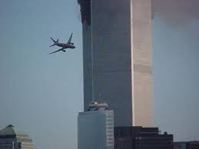
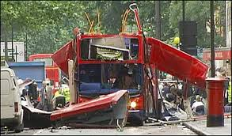
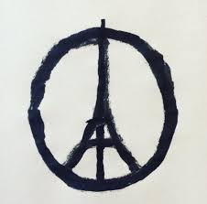
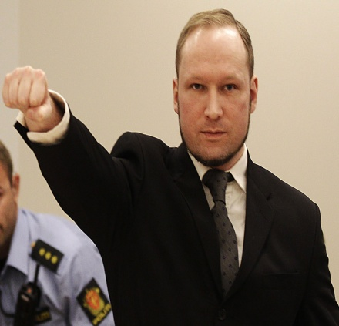
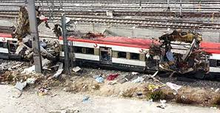
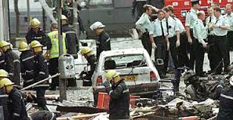
….use or threat of action designed to influence the government or its agencies; or to intimidate the public; and is driven by political, religious or ideological agendas. The nature of the threat or action involves serious violence against a person, serious damage to property, endangers a person's life, other than that of the person committing the action, creates a serious risk to the health or safety of the public or a section of the public, or is designed seriously to interfere with or seriously to disrupt an electronic system… (Terrorism Act).

Slide 6
Type | Objective | Example
Criminal Terrorism | Further Criminal Goals | Narcoterrorists assassinate legal officials
Political Terrorism – State – State turns on own | Further political agenda, change | Argentina “bloody wars”; Sadam Hussain’s regime; Libya
Political Terrorism – Sub state – Social revolution | Overthrow prevailing, usually capitalist, order | Red Army; Weather Underground; extreme environmentalists
Political Terrorism – Substrate – National Separatist | Response to social injustice | IRA; ETA
Religious Terrorism | Further religious ends | Al-Queda; ISIS
1998 - 929
2009 - 4715
2013 - 11952

Slide 7
Contest (Home Office, 2011)
Protect:
strengthen national protection against terrorist attacks in the UK or against UK interests overseas
Prevent:
prevent people from being drawn into terrorism and to work across sectors and institutions where there are risks of radicalisation
Pursue:
detect threats at earliest stage, disrupt activity before it can endanger the public, prosecute those responsible
Prepare:
seeks to mitigate the impact of a terrorist attack in the event that it cannot be stopped
ROBUST RISK ASSESSMENT IS NEEDED TO SUCCESSFULLY FULFIL PREVENT’S BRIEF
Notes:
The UK Government, like other jurisdictions, has an explicit CVE strategy, known as CONTEST, which outlines the ways in which the Home Office intends to work to prevent terrorism across the UK. The CONTEST strategy (Home Office, 2011) outlines four differing areas of work, each of having its own brief: Protect aims to strengthen national protection against terrorist attacks in the UK or against UK interests overseas; Prevent aims to respond in order to prevent people from being drawn into terrorism and to work across sectors and institutions where there are risks of radicalisation; Pursue aims to stop terrorist attacks by detecting and investigating threats at the earliest possible stage, disrupting terrorist activity before it can endanger the public and, wherever possible, prosecuting those responsible; Protect seeks to mitigate the impact of a terrorist attack in the event that it cannot be stopped. Akin to other public protection policies, CONTEST applies to a host of public agencies, including criminal justice, health, and social and its implementation requires collaborative working across sectors, agencies, teams and individuals. The primary focus of the present paper is on the Prevent agenda. Indeed, it has been suggested that prevention, or efforts to diminish the number of new extremists, is the next necessary wave of global CVE measures (Borum, 2011). Nonetheless, if we or our agency are tasked with responding in some way to offending behaviour in our role. This risk becomes ours to respond to.
It is argued that robust risk assessment is needed to successfully fulfil Prevent’s brief

Slide 8
CHALLENGES
Risk Assessment, especially of CYP
Infant nature of literature
Complex nature of VE phenomena
THIS IS WHERE WE ARE OPERATING

Slide 9
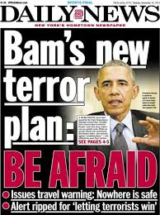
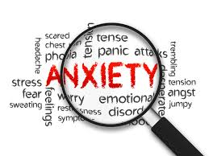
SERIOUSNESS +
GROWING FREQUENCY +
CHALLENGES TO RISK ASSESSMENT +
OUR OWN FEELINGS & BIASES +
INFANT LITERATURE +
+
=
What am I supposed to do about this?!?

Slide 10
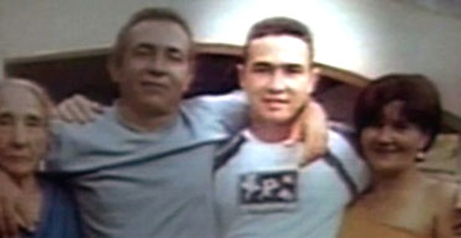
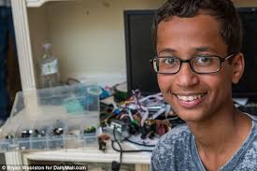
THINKING SKILLS
ANXIETY
Notes:
Managing our anxiety is key, as anxiety hampers our thinking, and limits to our thinking may translate to false positive.
Jean Charles da Silva e de Menezes (pronounced [ʒeˈɐ̃ ˈʃahlis dʒi meˈnezis] in Brazilian Portuguese; 7 January 1978 – 22 July 2005) was a Brazilian man killed by officers of the London Metropolitan Police Service at Stockwell Station on the London Underground after he was wrongly deemed to be one of the fugitives involved in the previous day's failed bombing attempts.^{[1]} These events took place two weeks after the London bombings of 7 July 2005, in which 52 people were murdered.
The Muslim teenager who was arrested when his teacher mistook his homemade clock for a bomb has met President Barack Obama.
Fourteen-year-old Ahmed Mohamed was catapulted to fame after his case in Texas went viral on social media, winning sympathy from the White House to Silicon Valley.
So what we need to practice at our best, I feel, is help to think.

Slide 11
Notes:
What we need to manage our anxiety is help to think
Even when we’re not anxious, I would argue that what we need to overcome the challenges of the task, is help to think.
There are several things that might help us to achieve our best thinking and judgement.
Consulting the literature, supervision and liaison with colleagues, emprically derived, hopefully evidence based risk assesment tools.

Slide 12
“…many terrorisms exist, and their character has changed over time and from country to country. The endeavour to find a “general theory” of terrorism, one overall explanation of its roots, is a futile and misguided enterprise…” Lacquer (2003)

Slide 13
LESSONS FROM THE LITERATURE
Mental illness is not a critical factor explaining VE behaviour.
Most terrorists are not psychopaths.
There is no such things as a terrorist personality.
“…most serious researchers in the field at least nominally agree with the position that terrorists are essentially normal individuals” (Silke, 1998).
Childhood maltreatment is common in the biographies of terrorist.
Perceived injustice/humiliation are important themes.
Need for identity and belonging are common vulnerabilities.
Motives are hugely varied and not stable over time.
Individual risk cannot be divorced from the context of the in-group, and the political context of the time.
Becoming a terrorist is rarely a conscious decision – social process.
Opportunity is an important factor.
Know little about recruitment. Seems geared towards deprived and dissatisfied.
Role of culture is poorly understood, as are operations, and behaviour in the group.
Terrorists have different roles and become terrorists via differing pathways and for different reasons. In understanding risk, it might be helpful to distinguish between the reasons for joining, remaining in, and leaving group.

Slide 14
Risk Factors
Formulation
Scenarios
Management
Background
Communication
RISK ASSESSMENT
STRUCTURED PROFESSIONAL JUDGEMENT
Notes:
This method allows for the capturing of heterogeneity.

Slide 15
Capability
Affiliations
Political and Social Environment
Disengagement Factors
Ideology
Emotional Factors
EXTREMIST RISK ASSESSMENT Silke (2014)

Slide 16
Extremism Risk Guidance 22 + (ERG22+) (Rehabilitation Services Group, 2011)
Violent Extremist Risk Assessment (VERA-2) (Pressman & Flockton, 2010, 2012a)
Risk Factors

Slide 17
Adam is a 17-year-old Caucasian male. Concerns were raised within two weeks of first term as he had taken-up position at the entrance where he stood each morning, lunchtime and evening distributing home-made leaflets promoting right wing politics. He was also reported to occasionally make statements in class about “blowing the place up”. As a result of his behaviour, he had been charged with dissemination of terrorist materials, and asked to leave college. However, he persisted and returned each day but stood outside the campus grounds where he continually espoused his views. He was highly aggrieved with the college and further education establishments for promoting multi-cultural society and for, what he termed, giving supremacy to foreign nationals. He distributed leaflets to this effect whilst dressed in a military-type uniform. Through his activities, he managed to recruit supporters and very quickly, he progressed from being something of a lone voice to having several supporters stand alongside him. His mother disclosed to police that he had told her that, alongside peers, he had been planning and incident he referred to as a “the most amazing one yet”. There were many email interchanges to this effect and, when his computer was analysed, a detailed and specific plan was found. He had also been attempting to source materials for making firebombs and computer record analysis indicated historical searches regarding bomb-making. Adam has two known incidents of interpersonal violence at school earlier in his adolescence, which reportedly involved him pushing and hitting peers in response to misunderstandings.

Slide 18
Capability
Affiliations
Political and Social Environment
Disengagement Factors
Ideology
Emotional Factors
EXTREMIST RISK ASSESSMENT

Slide 19
Emotional Factors
STRUCTURED ASSESSMENT VIOLENCE RISK IN YOUTH (SAVRY)
Disengagement Factors

Slide 20
Affiliations
Ideology
Capability
Emotional Factors
VIOLENT EXTREMISM RISK ASSESSMENT (VERA)
Ideology
Capability
Disengagement Factors
Notes:
At face value we see that the VERA is qualitatively quite different from the SAVRY, with very little overlap in terms of risk items. The VERA is informed by what the burgeoning empirical evidence tells us are the correlates of VE. It considers individual (ideological/emotional), contextual, capability factors, and potential deradicalisation factors.

Slide 21
LEARNING POINTS
Terrorists are a highly, highly idiosyncratic group.
There is no single pathway into terrorism.
The empirical evidence regarding risk assessment of violent extremism is in its infancy, with no validated tools available. As such, methods are limited but there is promise.
Case by base highly individualised risk assessment is required.
Cognisance of in-group is important, as is acknowledgement of socio-political context.
We need to look to the literature, teach ourselves.
SPJ paradigm can tolerate the demands of the assessment.
VERA, and other VE sensitive tools are a welcome addition to risk assessment methodologies.
We need to consult with experts in a particular terrorist movement.
Given the breadth of information needed to capture the risk domains, multiagency working and information sharing is key.
This is anxiety provoking. Help yourself to think, liaise with your colleagues, get supervision, work jointly.

