Slide 1

Secure Care in Scotland, Looking Ahead
Thursday 21 April 2016
Welcome

Slide 2
Welcome and Opening Remarks
Chair
Beth Smith, Director, WithScotland

Slide 3
What Does Getting It Right Look Like? Achievements, Challenges and Opportunities
Secure Care Services Joint Presentation.
This presentation was prepared jointly by all five Secure Care Centres
Jim Crawford, St Mary’s Kenmure
David Mitchell, Rossie
Dan Johnson, Kibble
Audrey Baird, Good Shepherd

Slide 4
Secure Care Sector Lead event
Karen Dyball
Service Manager Intensive Services
Glasgow City Health and Social Care Partnership
21/04/2016

Slide 5
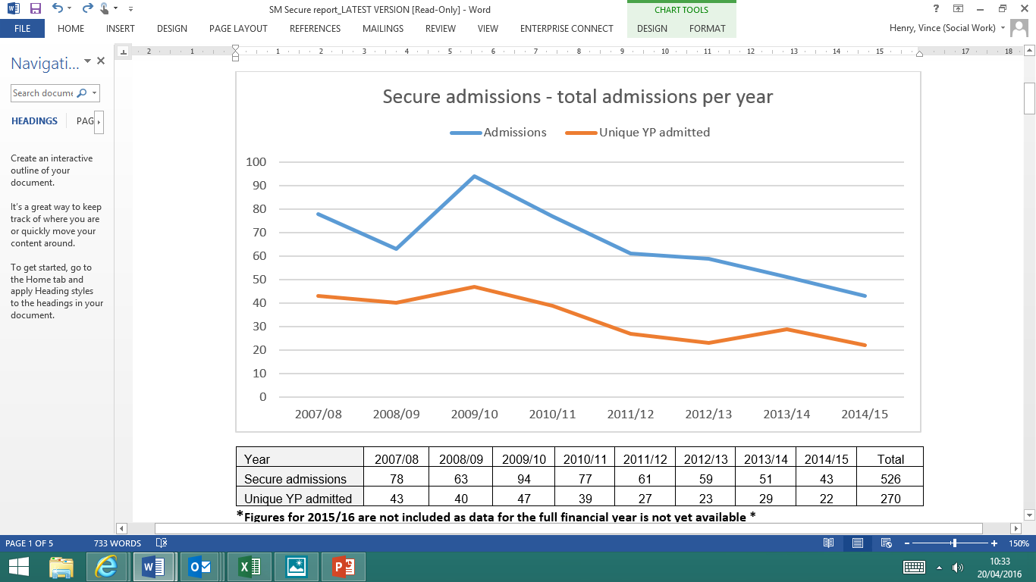
Trends in the use of secure
Notes:
Over 7 consecutive years (2007/08 to 2014/15) there has been a total of 526 admissions in respect of 270 young people.
There has been a 45% reduction in the use of secure care over a 7 year period (further reductions are likely be witnessed in 2015/16 – full data not yet available)

Slide 6
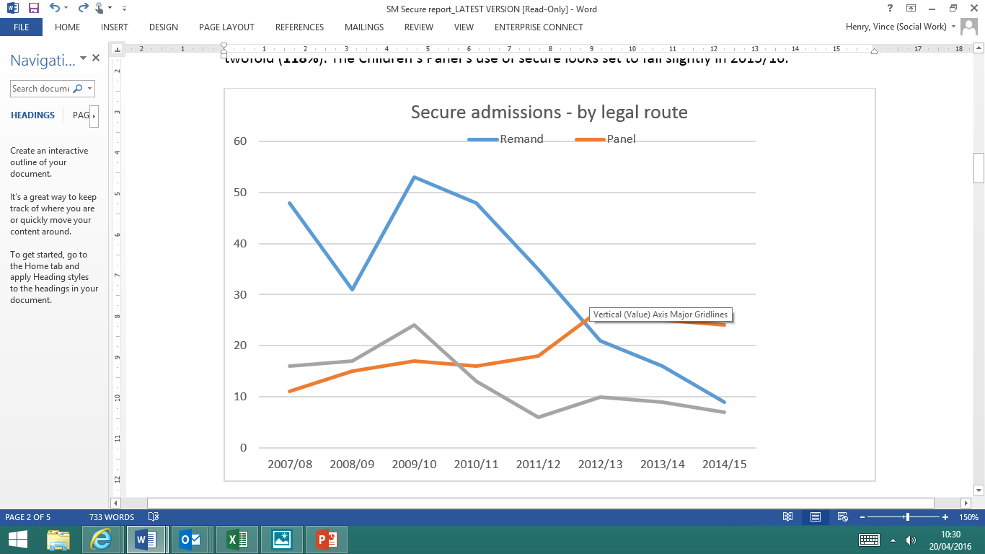
Secure Trends/Reduction in costs
Costs reduced from £3.5 Million to £1.75 Million
Notes:
Trends show an 81% reduction in the use of secure for remands over 7 years and a 56% reduction in the use of secure for sentences. Conversely the Children’s Panel’s use of secure has increased twofold (118%). The Children’s Panel’s use of secure looks set to fall slightly in 2015/16.
The average age on admission is 16 years, and the majority of admissions were for males with 443 (79%). There was no significant difference between males and females on the age of admission. Interestingly 50% of all female admissions to Secure Care go through the Children’s Hearings Panel.
Costs reduces from 3.5 m to 1.75m

Slide 7
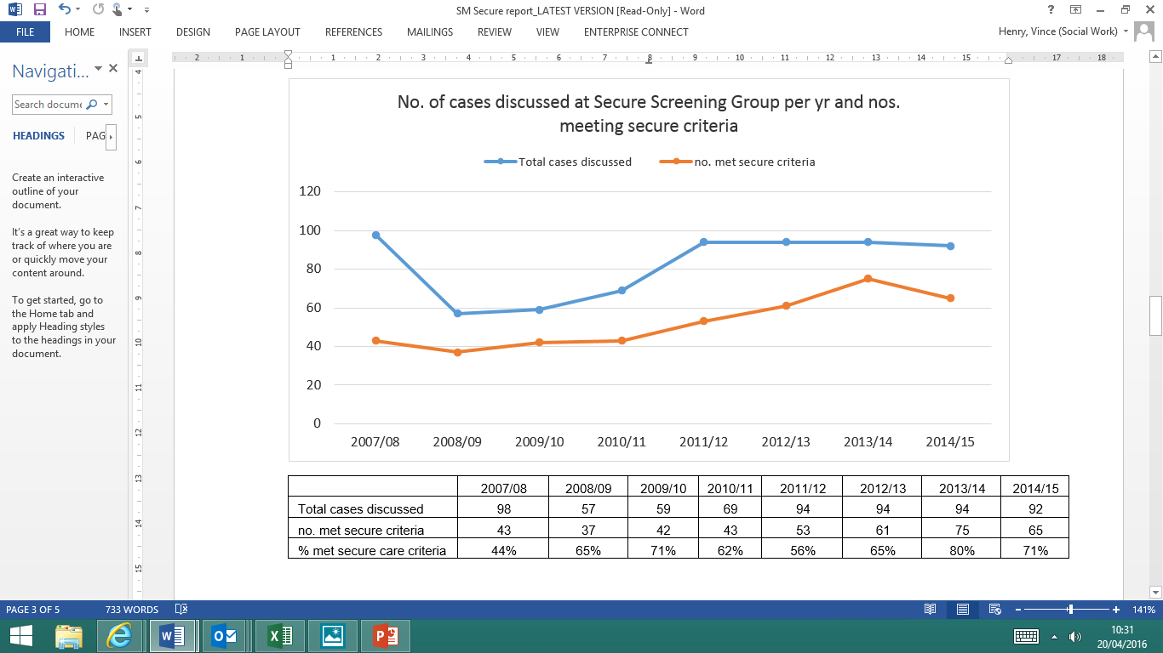
Secure screening
Notes:
Around 40% of admissions to secure have been picked up and discussed at the Secure Screening Group over a 7 year period.
Overall the number of cases discussed at the secure screening forum has remained consistently high over 7 years. The number of cases discussed who meet the criteria for secure care has increased over the years.

Slide 8
Reasons (s) for referral to SSG (n=741) | no. of young people | % of males | % of females
offending | 524 | 76% | 24%
Substance misuse | 403 | 71% | 29%
Sexual exploitation/ vulnerability | 205 | 40% | 60%
Absconding | 54 | 57% | 43%
Self harm | 46 | 63% | 37%
Mental health | 80 | 54% | 46%

Slide 9
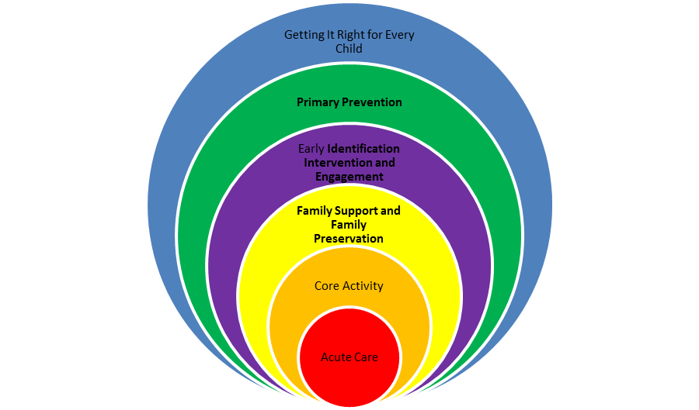

Slide 10
Glasgow response :
Evidence based Programmes/ Intensive services
ISMS
ATR
SNAP
FFT
DBT
Notes:
The ISMS service was established in April 2005 to provide a direct alternative to secure care for high risk, vulnerable and chaotic young people. An intensive, multi-agency service package is co-ordinated around each young person according to their individual needs and risks.
The service has demonstrated high levels of effectiveness and efficiency, and has improved outcomes for a hard to reach and vulnerable client group while also ensuring community safety.
Analysis of offending between 18 months and 2 years since leaving ISMS suggests a reduction in offending of 56.7%.
The reduction in the use of secure (admissions during 2008/2009 were 20% lower than in the year prior to ISMS commencing)

Slide 11
Why DBT
Increasing focus on evidence based interventions service wide
Analysis of needs indicates a profile of complex trauma
A small but growing body of evidence indicating that DBT has the potential to be an effective intervention with young females presenting with emerging borderline personality traits and symptoms of complex trauma
DBT provides a pathway of care for young people impacted by symptoms of complex trauma and can be delivered responsively dependent on the nature and severity of difficulties experienced by individual young people
Notes:
Following needs analysis we recognised that we had a profile of young women in particular where we felt DBT would be effective

Slide 12
Reflections
To achieve change and meet young people’s needs.
New partnership and a new culture.
Develop role of the third sector
Promoting parenting – Utilising mums…dads … community assets.
Influencing and co-ordinating beyond the Partnership.
Strengthening and promoting early engagement – the Universal Pathways.
A Spectrum of family support, realigning and transfer resource transfer.
Critical role of Social Work, solution but not the answer
Transforming the balance of care

Slide 13
Secure Care in Scotland:
What does Getting It Right look like?

Slide 14
a brief history…
7 secure facilities opened between 1962 – 2007:
1962 - Rossie Farm
1976 - St Mary’s Kenmure
1983 - Kerelaw (closed 2006)
1984 - Howdenhall, Edinburgh
2005 - St Philips (closed 2011)
2006 - Good Shepherd Centre
2007 - Kibble Safe Centre

Slide 15
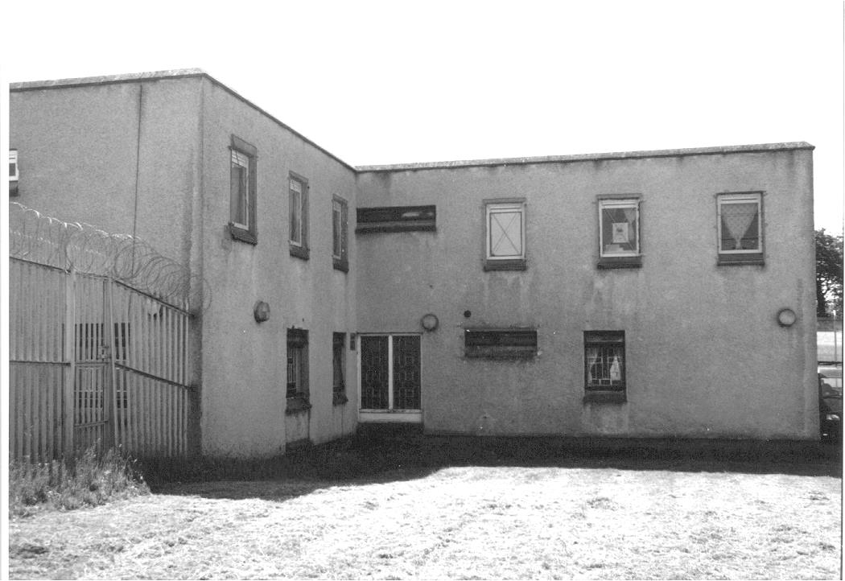
this was then…

Slide 16
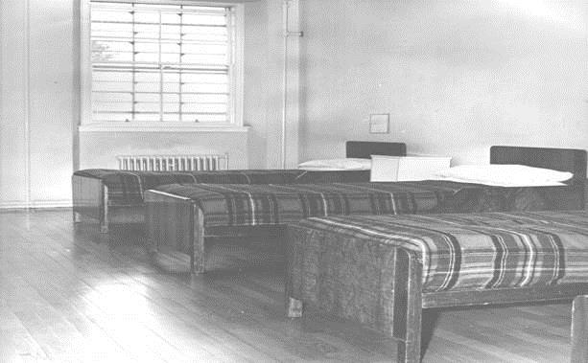
this was then…

Slide 17
this was then…

Slide 18

this was then…

Slide 19
current position…
Today 4 independent charities (Rossie, St Marys, Good Shepherd, Kibble) offer state of the art secure facilities with a total of 78 secure beds. 1 Local Authority Service (Edinburgh) offers 12 secure beds. The 4 charities are part of the Secure Care National Contract which is managed by Scotland Excel
Purchasers
Local Authorities (Scotland/UK)
Scottish Government
Referrals
Children's Hearing System
Courts (sentence/remand)
Administrative/Emergency Process
Current legislation is The Secure Accommodation (Scotland) Regulations 2013. Referrals are based on set criteria within the Children’s Hearings (Scotland) Act 2011. Criminal Procedure legislation is covered by both. Decisions made on implementing secure authorisations are covered in The Children’s Hearings (Scotland) Act 2011 (Implementation of Secure Accommodation Authorisation) (Scotland) Regulations 2013

Slide 20
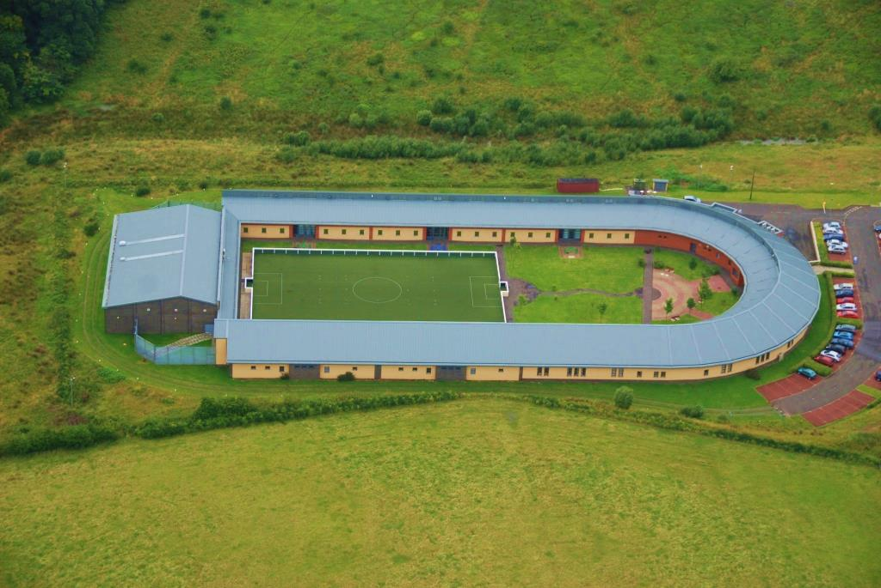
this is now…

Slide 21
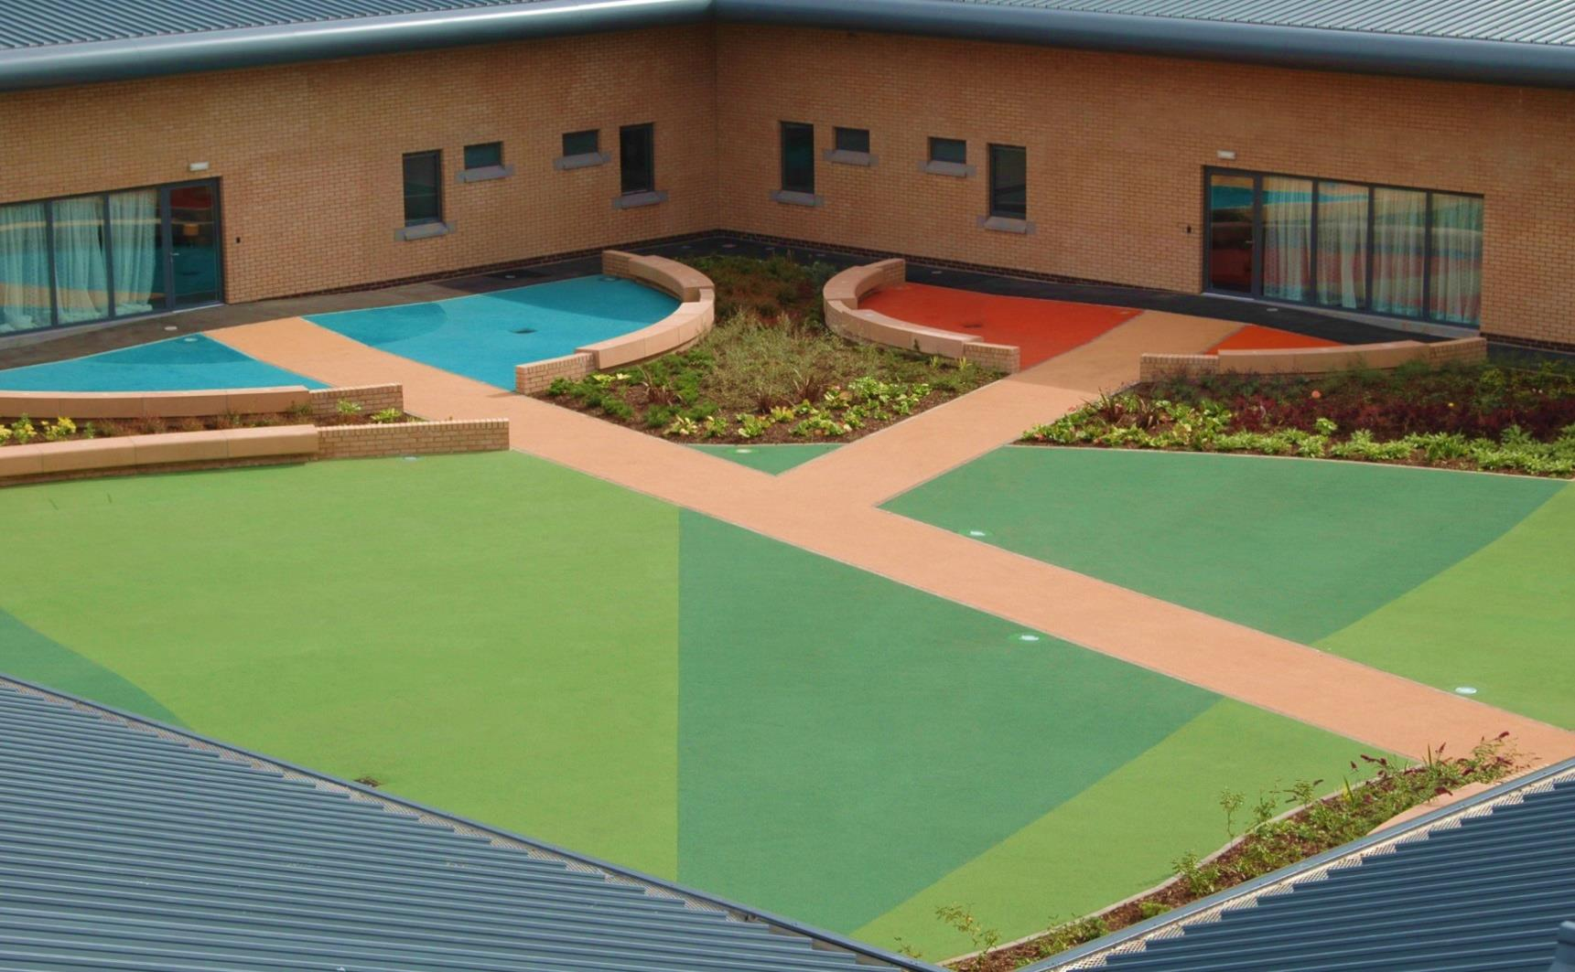
this is now…

Slide 22

this is now…

Slide 23
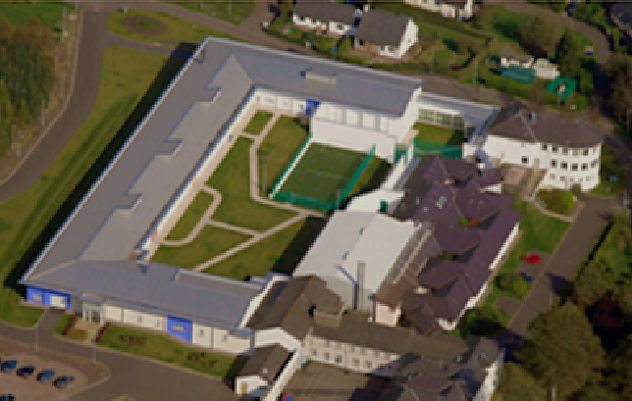
this is now…

Slide 24
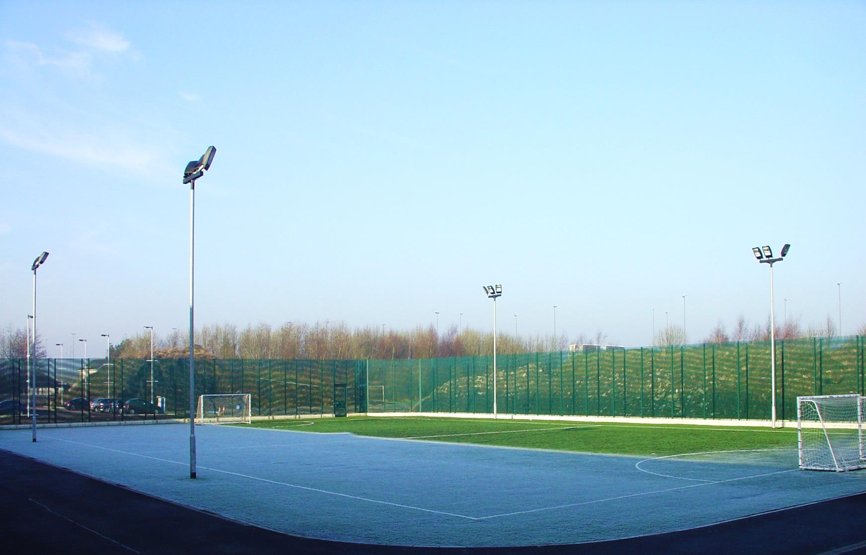
this is now…

Slide 25
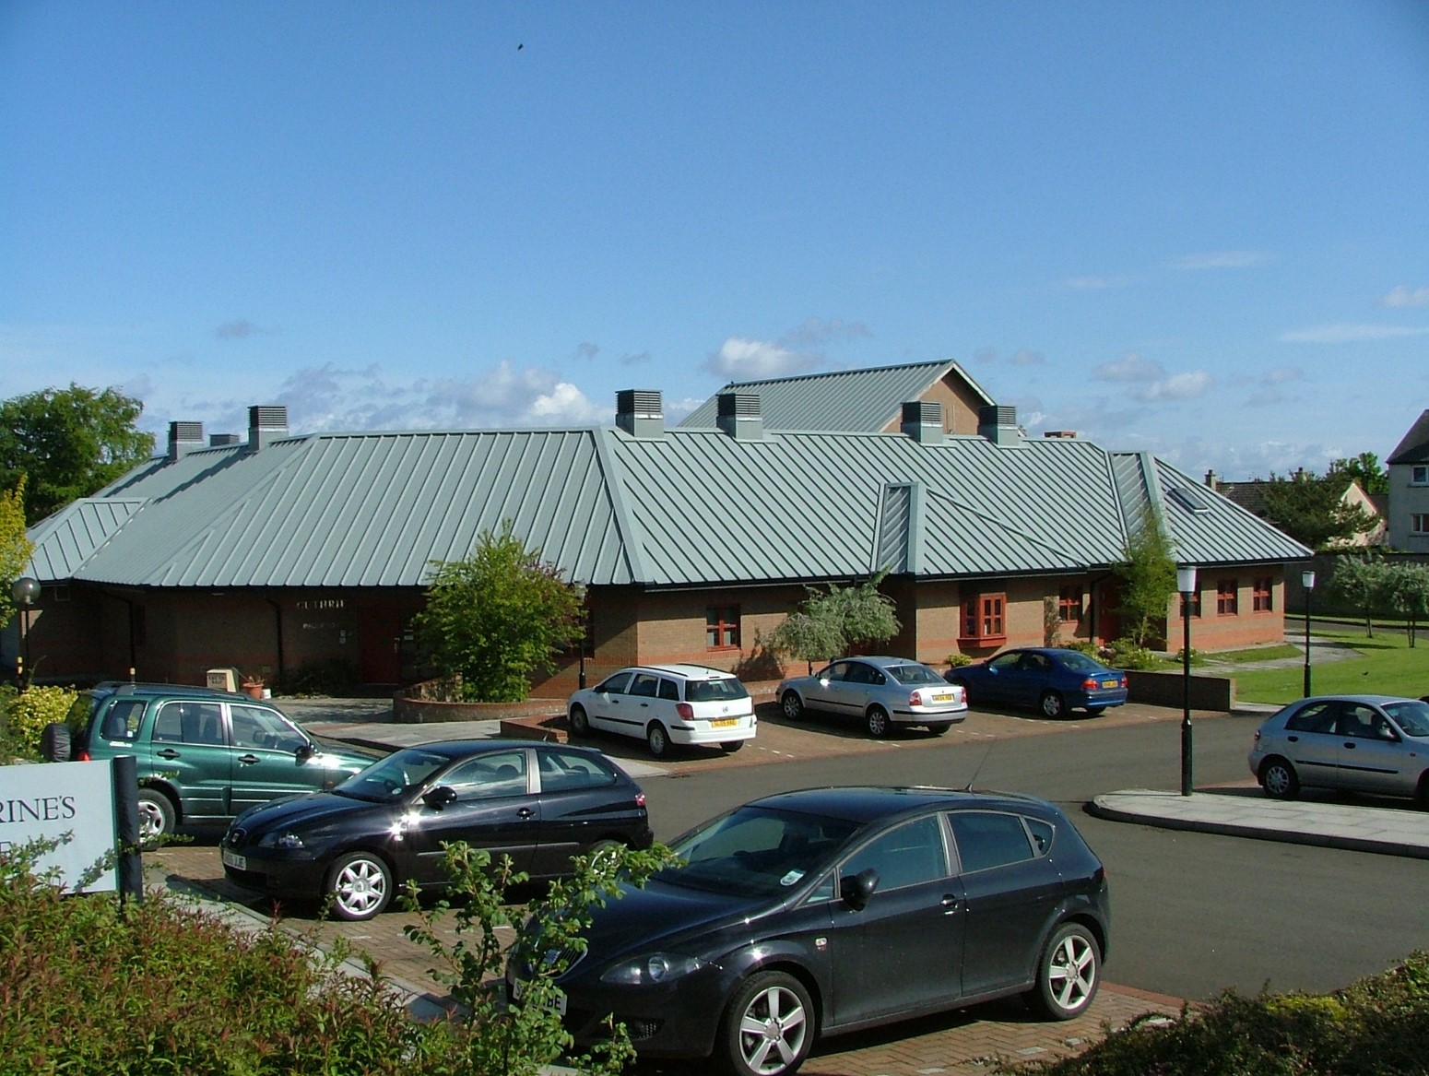
this is now…

Slide 26
services offered…
Full assessment on admission (Care, Health, Education)
Health needs met onsite (GP surgery, Dentist, Immunisations, Optical Care, Sexual Health in-reach, Podiatrist, referral to NHS Outpatient Services as required)
Psychological Services offered (clinical / forensic)
Liaison with Child Mental Health Services (CAMHS / FCAMHS)
Full range of tailored intervention programmes and bespoke packages
Child-centred care plans in line with GIRFEC principles
Individual Crisis Management Plan for every child (ICMP)
Individualised Education Plan for every child (IEP)
Broad General / Senior Phase Education offered in line with CfE
National Qualifications and Wider Achievement Awards offered
Liaison with external agencies / colleges / training providers for transitions
Youth Employment and Training services
Outcome Frameworks in place based on SHANARRI wellbeing indicators
Various Risk Assessment processes
The above list is not exhaustive and the above approaches are common across Scotland’s secure care provision

Slide 27
our aims…
To respond appropriately and effectively to the challenges of emergency placements.
To continue to ensure we provide high quality services which meet the Physical, Mental, Emotional and Educational needs of the young people we care for
To continue to offer life enhancing & life enriching experiences for young people
To continue to ensure young people mark their achievements and successes whilst developing their hopes and aspirations for the future
To continue to develop highly skilled, experienced and specialised staff

Slide 28
Management, Leadership and Governance
SECURE CARE SCOTLAND

Slide 29
how and why secure care embraced management, changing patterns of leadership and the impact on service cultures and improvement …
then…
Historically, many residential and secure organisations had strong authoritarian and regimented regimes and hierarchical structures
Management and Leadership was influenced and impacted on by local authority structures and the intensification of managerialist approaches (1980’s - 1990’s) predicated on ‘Economy, Efficiency and Effectiveness’, as well as regulatory apparatus and agendas (Smith, 2015)

Slide 30
management, leadership and governance…
now…
Centrality and importance of Leadership and Management embedded in statutory and regulatory frameworks…and more recently policy
“It would be hard to overstate how significant the quality of leadership is in narrowing the gap for children within a context of improving outcomes for all, and that means leadership across all services and at all levels within services. It is the single most important critical success factor”
(UK Local Government Association, 2008)

Slide 31
management, leadership and governance…
Secure Care organisations ‘consciously and carefully’ led to reinforce values of high quality care that permeate top to bottom and end to end
Balancing of the business and statutory dimensions with the relationship based, ethical and human dimensions
“when we obscure the essential human and moral aspects of care behind more rules and regulations we make the daily practice of social work ever more distant from its original ethical impulse”
(Smith, 2015)
Importance of establishing healing cultures of predictability, reliability and stability for young people…but equally important to create sufficient financial and relational stability to enable staff to undertake such work within their relationships with young people

Slide 32
management, leadership and governance…
Well developed vision and mission statements provide directional paths and are translated into clear, aligned, agreed and challenging objectives
Cultures that facilitate learning, growth and development of staff groups and young people
Leadership less about ‘positional power’ – more about distributed leadership and ‘outcomes belong to everyone’
Investment in Leadership and Management and development of leadership capacity
Greater integration of our services at strategic, service delivery and individual user levels
Value given to intra and inter agency collaboration – more than the ‘sum of our parts’

Slide 33
PROFILE of young person
SECURE CARE SCOTLAND

Slide 34
https://prezi.com/ix4ojkakken8/secure-care-in-scotland-looking-ahead-21-04-16/?utm_campaign=share&utm_medium=copy

Slide 35
improved
OUTCOMES
SECURE CARE SCOTLAND

Slide 36
background…
2012 saw the Scottish Government signal their intention to progress with outcomes focused work in secure care by hosting a ‘Measuring Secure Care Outcomes and Impact’ seminar in Edinburgh in May 2012
Following the seminar a ‘Measuring Outcomes and Impact’ working group was set up to progress the work
2013/14 saw each secure care provider devise their own bespoke outcomes framework that enables them to measure and evidence the outcomes of young people placed in their care

Slide 37
girfec…
The eight wellbeing indicators identified in Scotland’s national practice model as areas young people need in order to do well are incorporated in each of the secure care provider’s outcome frameworks
The eight indicators Safe, Healthy, Active, Nurtured, Achieving, Respected, Responsible and Included are used as domains to provide evidence of the progress young people make during their placement in secure care

Slide 38
comparisons…

Slide 39
improved outcomes…
safe | Improved consequential thinking, decision making and empathy skills Improved strategies for minimizing risks in social situations Improved resilience to cope with adverse circumstances (bereavement, parental abuse) Reduced exposure to anti-social and criminal activity Reduced involvement in harmful, risk-taking behaviours
healthy | Improved coping skills to deal with everyday stressors without undue anxiety and aggression Improved knowledge of the risks and effects of alcohol and drug use / misuse Reduced anxiety and paranoia Improved levels of self- worth, self-image and self-respect Increased sense of identity and belonging

Slide 40
improved outcomes…
active | Increased engagement in sport activities Improved ability to develop personal interests Improved engagement in community based physical activities
nurtured | Increased understanding of significant life events and their effect on the present Increased contact with significant, supportive adults who provide trust, love and support Improved ability to talk to others about feelings Improved confidence to deal with problems and new challenges

Slide 41
improved outcomes…
achieving | Re-engagement in education / training / employment Increased confidence in educational ability Improved educational achievement Increased skills and awareness of how to apply them to new opportunities Improved employability skills Improved self-care and life skills
respected | Improved ability to show respect for others Increased confidence of being listened to and taken seriously by others Increased levels of hope and happiness Improved ability to express opinions and views in a positive way

Slide 42
improved outcomes…
responsible | Increased participation in decisions about future plans Improved ability to take responsibility for personal choices Improved ability to understand consequences for actions and be empathic Increased ability to exercise self control over emotions and behaviour Improved ability to use positive strategies for minimizing risk to self and others
included | Improved awareness of life circumstances that may have resulted in social exclusion Improved social skills and participation in group and community initiatives Increased ability to express wishes and make decisions in relation to personal health and wellbeing

Slide 43
Young People’s Voices
Who Cares? Scotland
Cheryl-Ann Cruickshank & Laura Beveridge

Slide 44

Cheryl-Ann Cruickshank
Director of Innovation and Development
[LISTEN] [ACT] [UNITE]

Slide 45
(2006) Consultation Project designed to achieve better outcomes for young people in Secure Services (BOSS)
[LISTEN] [ACT] [UNITE]

Slide 46


The report maps young people’s journey from admission to discharge, including the transition from secure care and what they feel assists them in that transition.
It outlines their advice to other young people coming into secure care and changes they would like to see.
[LISTEN] [ACT] [UNITE]

Slide 47
76 individual young people over a 2 year period from 2006 to 2008
[LISTEN] [ACT] [UNITE]

Slide 48
“Do what they ask you to do and you’ll get out faster” (Female 15)
[LISTEN] [ACT] [UNITE]

Slide 49

Key Messages
Importance of loving, stable relationships
Importance of support to overcome Trauma, instead of being labelled the bad kid
Importance of appropriate care placements and moving on support inc. continuing care and return to care
[LISTEN] [ACT] [UNITE]

Slide 50
Laura Beveridge
Development Officer
&
Care Leaver
[LISTEN] [ACT] [UNITE]

Slide 51
Reflections;
Importance of Relationships, Attachments, Love & Hope
Importance of support to overcome Trauma
Importance of appropriate placements and moving on support
[LISTEN] [ACT] [UNITE]

Slide 52
Secure Care National Project: Early Reflections
Alison Gough, Secure Care National Adviser, CYCJ

Slide 53

In the next 15 minutes…
brief overview of the remit and approach of the secure care national project
Reflections on stakeholders’ perspectives about the current
achievements
risks and challenges
opportunities
in relation to secure care and young people with high risk, high vulnerability
Looking ahead - Where next?
www.cycj.org.uk
developing, supporting & understanding youth justice

Slide 54
Secure care national project
Scottish Government website says:
‘’ This is an independent, analytical, practice focused and strategic role which will give the opportunity to work with sector leads and other partners to ensure the effective delivery of service to children in secure care, to review current trends, achievements and risks and to make recommendations to partners about future configuration of the secure estate.’’
http://www.gov.scot/Topics/Justice/policies/young-offending/secure-care
www.cycj.org.uk
developing, supporting & understanding youth justice
Notes:
Scottish Government commissioned CYCJ to deliver ‘strategic and transitions advisory function’ for secure care – time frame August 2015 to March 2017
Secure care national adviser based at CYCJ, University of Strathclyde, reporting via the EGG (Executive Governance Group)
Also accountable to the Secure Care National Steering Group (jointly chaired by Scottish Government and CoSLA)
Key dates:
Focus sessions with secure care workforce and young people with secure care experience October 2015 to April 2016
Developed and signed off project vision, outcomes and key deliverables – secure care national steering group November 2015
Local Authority and key stakeholders gathering held 2 December 2015
Initial reflections fed back to Secure Care National Steering Group February 2016
National sector lead engagement event April 2016
Interim report due June 2016
Draft recommendations/report due December 2016
Final report to be published by end March 2017
Information available on CYCJ website and in briefing note

Slide 55
Secure care national project
Project vision:
For those children and young people in Scotland for whom placement in secure care is necessary to keep them and/or their communities safe, they experience secure, nurturing, high quality care, where their needs and rights are recognised, understood and met and there is a positive impact on their immediate and longer term safety and wellbeing.
Six Outcomes
Key Deliverables
Project approach: Inquiry (listening to and understanding the lived experience and practice evidence)
= HIGHLIGHTING STRENGTHS
+ IDENTIFYING GAPS AND FLAWS
+ EXPLORING SOLUTIONS
= Outputs – Project as Inquiry and Intervention towards realising some of outcomes
www.cycj.org.uk
developing, supporting & understanding youth justice
Notes:
Scottish Government remit wide ranging - took the SG remit and combined this with initial stakeholder fact finding to establish project vision statement, outcome areas and key deliverables – see role as analytical and facilitative – importance of creating space for difficult conversations – secure care extreme care – high cost, high value (life saving for some young people) - need for shared language and understanding – even if there is not a consensus on future vision at this stage

Slide 56
Secure care national project outcomes
There is a shared vision for and understanding of what is meant by high quality secure care and that this may be the best option to keep some children and young people and/or their communities safe.
There is a clear strategy in place nationally and locally across Scotland ensuring access to the right kind and timing of needs led support and intervention focused on prevention, early intervention and enablement. Young people are diverted from secure care and custody wherever this is appropriate and possible.
There are clear pathways for children and young people in secure care, ensuring effective transition support and experiences before, during and after their placement in secure care.
Young people in secure care, including those with mental and emotional health problems, receive the appropriate universal and specialist health services wherever they may be placed and there is continuum of care.
There is a national sustainability programme in place, including a fair system for capital projects in relation to the secure care ‘’estate’’, enabling Scottish Government, secure care providers, local authorities, Scotland Excel and other responsible partners to effectively maintain, develop and improve quality across the physical environments.
Wherever secure care services are delivered, staff are highly skilled and trained and are valued and well supported to effectively care for young people who have experienced significant trauma and loss.
www.cycj.org.uk
developing, supporting & understanding youth justice

Slide 57
Gathering stakeholder perspectives
The Scottish Government remit, combined with initial stakeholder fact finding, informed the development of the working vision, outcome areas and linked key deliverables. Conversations and focus sessions have been held across three ‘themes’ taken from the six outcomes:
Transitions High risk and vulnerability – supporting young people effectively and complementary services - Routes into secure care, admission process and experience, planning with and for young people, transitions through secure care, moving on and aftercare
Mental and emotional health and wellbeing Reflecting on the impact of trauma and loss, meeting emotional and mental wellbeing needs in the secure setting, the role of universal and specialist services, in-reach and continuity of care, support and training for staff and carers
Strategy for Sustainability Thinking about the future, planning for the future , key challenges and issues, the business models, national contract framework, the physical estate, ensuring effective skills and knowledge exchange
www.cycj.
developing, supporting & understanding youth justice
Notes:
Importance of hearing from secure care experienced young people and the sector itself as well as all key partners
Meetings and focus sessions were held in 2015 with a range of key partners including:
Social Work Scotland (SWS) Executive Committee
Child Protection Committee (CPC) Chairs/leads
Children’s Hearings Scotland (CHS)
Scottish Children’s Reporter Administration (SCRA) Locality Reporter meetings
Community Care and Support Providers Scotland (CPPS) Criminal Justice Voluntary Sector Forum and member organisations, including children and family services
Consortium of Scottish Local Authorities (CoSLA)
Centre for Excellence Looked After Children in Scotland (CELCIS)
Secure care focus sessions with YP and workforce
Discrete work has emerged:
A survey of consideration and decision making at children’s hearings (through the CHS/SCRA Hearings Management Group)
A survey of Chief Social Work Officers and Local Authority approaches to secure care/high risk/high vulnerability
National stakeholder sector leads event (21 April 2016)
Follow up re outcomes and findings from above – will talk later about:
Supporting development of national standards for secure care
Supporting next steps re Commissioning

Slide 58
Looking Forward: Achievements
‘’ I wasn’t in school for 3 years before coming here – I didn’t have a clue what to do – came into education and thought what can I do? But they’ve (education staff) been good – I’m managing to learn’’
‘’it’s really been the best thing for me. I came in here a dafty but I’ve changed in here. I’ll think twice and do things differently out there.’’
(programmes) ‘’have helped. Like you do get to think about things that happened before and how you’d do things different. Like consequential thinking and reflecting on stuff – I’ll use that my whole life’’
‘’If I hadn’t come in here I wouldn’t be here.’’ (alive) ‘’I’d be dead or in jail.’’
www.cycj.
developing, supporting & understanding youth justice
Notes:
Early and effective intervention – decrease in referrals to SCRA since 2007 – impact of EEI and WSA – GIRFEC and complementary approaches – SOFI and reduction in placement capacity and numbers of YP in secure care - There are examples of highly effective multi-agency integrated approaches to youth justice and to identifying high risk and vulnerabilities, not all Local Authority areas have the infrastructure, capacity or need to replicate models such as One Glasgow - Range of third sector providers with substantial experience, knowledge and capacity in delivering complementary services which may prevent the need for young people to be secured, for example Includem services, Up-2-Us and Stepdown. Services which can offer gender specific interventions and a range of specialist supports.
The secure care centres have all invested in developing effective outcomes and evidence based approaches to care planning, including transitions. Transitions within the secure care services themselves are generally well managed, for example young people moving into a longer stay facility on campus. Where funding and geography allows, secure care centres are able to offer effective transition support to young people, families/the receiving carers or support team. - ESS has wraparound through care and aftercare support which is highly rated by those young adults whom it supports. Whilst there is varying capacity among the four not for profit secure care centres in relation to close support/transition support, those who do deliver transition supports offer high quality options.
The Scotland Excel framework has brought some clarity and focus around expectations of secure care placements, (and of placing authorities) around transition planning. – how we map and monitor spend and usage of secure care has improved
The Mental Welfare Commission and Care Inspectorate are confident that secure care centres are meeting the mental and emotional wellbeing needs of young people with diagnosed mental health problems well. Evidence that the secure care sector is developing (and in some cases embedding) trauma informed thinking across service planning, staff training and day to day practice. Services have adopted an integrated team approach with clinical, wellbeing, education and care staff working closely together. Messages from the current review of youth custody secure provision in England, and recent case studies from other European countries, suggest that we could be doing more to broadcast the high quality of care and education delivered in Scotland in comparison. People have looked elsewhere but there is no panacea.

Slide 59
Looking Forward: Challenges and Risks
‘’ I didn’t know I was going to be locked away from my pals and family - I had no idea – all I was told was to come down stairs…they hand cuffed me and put me in a motor and then said you are now going in secure’’
‘’secure care is still seen as being for young people who are in trouble – I haven’t done anything wrong but I was in with someone who had set fire to another person – but then I guess that young person might have had bad things happen to them – we’re blaming young people instead of the adults who’ve hurt them and let them down’’
‘’It’s really sad that for some young people they don’t feel safe anywhere cos of what happened to them and they’ll do anything to get back into jail or secure – there should be more routine and safety in the open residential units…. having the staff here has been brilliant – they’re like family – I trust them more than my own family, they give you a boost, you can drop in or call them up and ask daft questions and just get advice and reassurance’’
www.cycj.
developing, supporting & understanding youth justice
Notes:
Lack of national coverage and availability of quality, affordable, intensive, effective community based services which can respond to the care and protection needs of the most vulnerable/high risk young people and prevent the need to secure. Arrangements for secure screening vary across the country – as does understanding and expectations of the nature and purpose of secure care as part of the continuum to meet the needs of the most vulnerable young people.
Young people, some Children’s Reporters, and the majority of secure care staff (140) who took part in focus sessions around transitions believe that the CHS timescales require review. YP consistently describe a lack of information and preparation for them and their families prior to becoming secured, with a high proportion of young people stating that they did not feel well prepared and/or informed by social workers, children’s panel members and other carers. The interface between the CHS, adult justice system and secure care requires to be revisited. Inequity of treatment for 16 to 18 year olds. Some 12% of young people experiencing secure care between 2013 and 2015 were in secure care on three or more occasions. Further analysis of repeat placements and the reasons for them is required.
Current funding pressures can only increase – some Chief Social Work Officers voiced a view that community based safe care arrangements should eventually replace the traditional model of secure care centres, they acknowledged that the capacity to redirect funding/bridge fund this transformation is unlikely to be available for the foreseeable future. Secure care providers seeking to develop their remit and broaden the transition services they deliver find themselves without the financial capacity to do so. Longer term planning in terms of the current physical estate. A debate is needed to explore the current governance and funding arrangements as to who holds and shares responsibility for managing the physical estate and associated risks.
The limited number of centres and geographical spread means considerable practical challenges/logistics in relation to family contact, social work contact with placement, planning and Through care. It also limits the possibilities for single gender or other specific secure care centres. The interface with Education Authorities, Health (and CAMHS), housing and Throughcare services can be problematic i.e. significant difficulties in ensuring effective continuity of support and relationships and ensuring that young people transitioning from children to adult services are supported with these transitions. There has been little consistent focus on secure care in the past few years; there’s now a need for some form of strategic partnership to provide that national overview of secure care and ensure everyone with a role to play is engaged and involved.
We still know very little about what works and longitudinal research is required to explore outcomes around intervention and high risk/vulnerability and secure care.

Slide 60
Looking Forward: Opportunities
What Next?
‘’They should bottle Alison House and how things work here – every young person who gets secured should have the same kind of through care support to make sure they get help and support to move on and make something of their life – look at what we’ve all achieved despite everything we’ve been through – they should listen to young people who’ve been through it and step in our shoes’’.
‘’It’s up to you isn’t it? I mean they (staff and social workers) can tell you how it is and you can do all these programmes and stuff but at the end of the day, I can tell them what they want to hear or I can decide how things are going to be when I get out of here’’
‘’at the end of the day some of these staff have genuinely changed my life and changed me for good in different ways….they really have’’
www.cycj.
developing, supporting & understanding youth justice
Notes:
Transitions
research with Chief Social Work Officers and Local Authorities, is planned to start in April and will report within the life time of the secure care project. April to September 2016 - The secure care project will engage with CHIP and YJIB, (Claire L and AG forthcoming inputs) and key partners to explore local authority and other partners’ responsibilities in relation to transition planning, and the interface between preventative and complementary services and secure. A survey of SCRA and CHS Area Support Teams to explore the quality of consideration of secure care and options within children’s hearings will be completed. - started February 2016, Stakeholders have welcomed the review of National Care Standards as an opportunity for the development of National Standards for secure care. Such standards could enable consistency of experience and approaches, for example in relation to transition planning and approaches to separation and restraint/safe holding across the centres. – discussions started with care Inspectorate
Mental and emotional health and wellbeing
Within the secure care sector there is an appetite for exploring both the possibility of a specialist mental health secure care centre, and the extension of the IVY model in relation to creating a national service or resource which could deliver trauma and distress response services. (in-reach) – the project has shared stakeholder feedback with relevant Scottish Government colleagues in relation to the current development of the Mental Health Strategy. Keen to develop this work.
Strategy for Sustainability
Dr Emma Miller, a project group based at University of Strathclyde - developing a longitudinal research project to explore outcomes for young people. Stakeholders have expressed support for this and a priority for the secure care project in 2016/17 should be to ensure sector engagement and involvement with this research. - There is an appetite to address this, and to continue the conversations about the purpose and place of secure care within children’s services, to review the remit and membership of the secure care national steering group and connectivity with CHIP and the YJIB. These conversations will be essential to inform the review of the commissioning and funding arrangements over 2016/7. The development of a vision and strategy for secure care services and our response to high risk and vulnerability is regarded as necessary by all stakeholder groups and the secure care project will focus on facilitating discussion towards the underpinning principles for this.

Slide 61
Table Discussion and Feedback
12-20 to 13-00
“What is your future vision for the purpose and function of secure care, within the continuum of services for children and young people?”

Slide 62
Secure Care in Scotland – Looking Ahead
Mike Callaghan,
Children and Young People Team
COSLA

Slide 63
Introduction
Consider future for secure care
Secure Care – What are we talking about?

Slide 64
Background and Context – Before 2010 and Post 2010
Secure Care estate not sustainable
Over capacity
Need for better outcomes
Securing Our Future Initiative (SOFI) – 2009
Post SOFI (2010 onwards) – contract arrangements
Opportunity now to refocus policy

Slide 65
A Secure Care Sector for the Future
Needs to influence outcomes
A major task has to be done
Great deal of expertise can be harnessed
Need to pull together rather than fracture
Move secure care policy forward

Slide 66
A Shared Vision
A shared vision for the future
Ownership and commitment
Realistic and achievable
Positive intervention at right time
Part of a bigger system for children’s services

Slide 67
Key Issues and Opportunities for Future Planning
Who should secure care be for?
Better clarity for roles of partners
Better shared understanding and agreement
Identify what we need to develop and sustain
Young people have mental health difficulties
Difficult life circumstances
Psychiatric and forensic support

Slide 68
Key Issues and Opportunities for Future Planning
Good practice and achievements
Good at building relationships and trust
Improve transitions
Secure Care as part of policy for LAC
We can all assist in shaping agenda to move policy forward
Future contract arrangements flow from it.

Slide 69
Scotland Excel Perspectives
Julie Welsh, Director, Scotland Excel

Slide 70
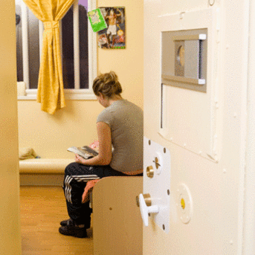
Notes:
Key Themes
Positive outcomes for children
The contract
Financial constraints
The way forward
Positive outcomes for children
We are all here because we care about the children in need of secure care.
No matter what our role in the process, or the challenges we face, what we develop needs to deliver positive outcomes for the child.
Recognise the need for early and effective intervention.
What helps looked after children succeed:
Having people who care
Stability
Given high expectations
Encouragement & support
Participation and achievement
70

Slide 71

Notes:
71
My role and the role of Scotland Excel
• Procurement 20 + years
• Public Sector 9 years
• Toshiba, Japan
• Semi Conductors, Motorola
• Research Agreements (GU)
Care is the most complex, challenging and rewarding area.
Do I control the money? No!
My organisation is a shared service across 32 Local Authorities.
We deliver collaborative contracts for councils across Construction, Education , IT, Corporate - £700 million.
• Care is our fastest growing area
• But we do not set the strategic agenda
• Contracts and their content is agreed with Stakeholders across SG/SWS/Scottish Care/CCPS/Councils and IJBs
National arrangements which allow local commissioning.
The first Secure Care framework was set up in 2011. 4/5 Independent Units were successful
(St Philips reconfigured) Followed by negotiation not tender (July 2013 – June 2017).
Imminent expiry is one of the problems we face –
• Providers seeking a longer term commitment
• No agreed strategy at a National Local level

Slide 72

Notes:
Financial constraints
We are faced with a perfect storm – increasing demand for all care services, with decreasing budgets
16/17 – 3.5% cuts, with 10% expected over the next few years
72

Slide 73

Notes:
Financial constraints
Doing more with less
Difficult choices – what does a CE spend his £5671 on?
986 hot 2 course meals delivered
10 weeks of residential care can be provided to an older person OR
61 alarm units to allow people to stay safely at home OR
534 hours of an agency care assistant could be purchased to supplement council resources
We cannot afford to be complacent in terms of costs...
However we know that if we don’t intervene early enough for some, the outcomes are bad, and potentially even more costly – social care services, prison, housing, employment, health (mental health), early death
And... the need for all care services is increasing... Secure is no exception occupancy
97% for the last 3 months of 2015, compared with 86% one year earlier (average now c. 90%)
73

Slide 74
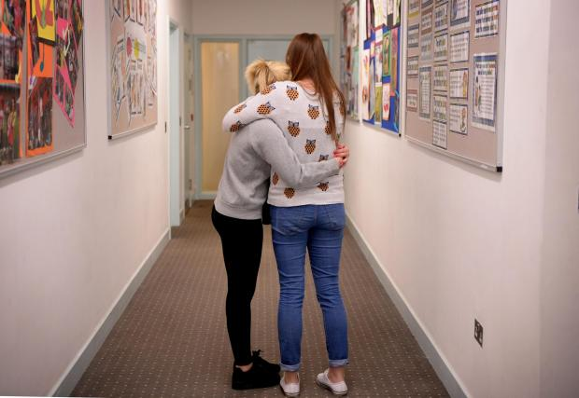
Notes:
The Way forward
Clear strategy at national and local level – how does secure fit in to policy direction for both children’s and justice portfolios?
We know that individual councils are coming up with alternative commissioning solutions
This is not solely a problem for the children, the families, the providers or the commissioners – we all must own this jointly!
We – jointly- must find ways to become more innovative and commercial in our thinking, because local authorities are unlikely to be able to fund ongoing increases in this area, or in any other care related area
We – jointly- must be able to demonstrate the value delivered in these services each and every day, through clear and consistent monitoring of outcomes. Share the successes.
I don’t have the answers!
How do we contain costs whilst improving the quality of outcomes?
How do providers plan for the future?
Future of contract – should we replicate what we have? What should the length of the contract be? How will services be paid for and commissioned in future?
74

Slide 75
Commissioning for the future – round table discussion 14-10 to 14-40
“How do we better integrate service planning and commissioning arrangements for secure care within our responses to young people with very high vulnerability and risk?”
How do we contain costs whilst improving the quality of outcomes?
How do providers plan for the future?
Future of contract – should we replicate what we have? Or is there another way?

Slide 76
Visual Feedback
Facilitated by Beth Smith and Graham Ogilvie

Slide 77
Closing Remarks
Claire Lightowler, Director, CYCJ

