Slide 1
The New Model for Community Justice
Youth Justice Conference
Dundee
16 June 2016

Slide 2
Outline
Context;
Overview and building blocks to the new model;
Expectations, transition & timescales.

Slide 3
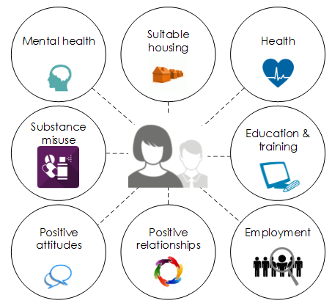
WHY?
Every Intervention is an opportunity to aid Prevention

Slide 4
Drivers for reform
Critical reports in 2012 on current community justice structures, set in background of the Christie Commission and a high imprisonment rate in Scotland;
The understanding of the underlying causes of offending and what works to reduce re-offending;
  Evidence around effectiveness of short custodial sentences versus community sentences;
Opportunities to think differently about community justice and penal policy:
Prevent and reduce further offending

Slide 5
Community Justice and Penal Policy Reforms
Include:
New model for Community Justice;
Presumption Against Short Sentences;
Electronic Monitoring in Scotland;
Custodial Estate for Women;
Reintegration – taking forward recommendations from MGOR;
Improvement project to reduce remand/short sentences;
Broader work with SPS on their transformation agenda.
Prevent and reduce further offending

Slide 6
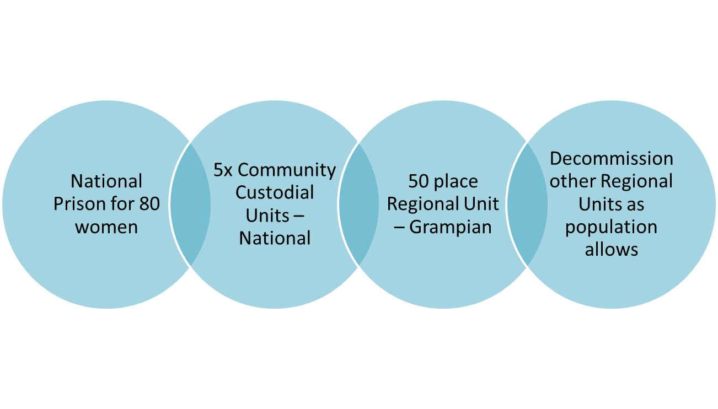
Custodial Estate for Women
Now until March 2017 Site identification & Concept Design
Oct 2016 to End Sept 2017 Purchase & Planning
April 2017 to Sept 2018 Detailed Design & Procurement
April 2018 to End June 2019 Phased construction & commissioning
Sept 2019 to End Dec 2020 Phased Occupation

Slide 7
Electronic Monitoring
National rollout started 2002;
Current uses:
Consultation and EM in Scotland Working Group
Restriction of Liberty Order
Parole Licence
Movement Restriction Condition
Restricted Movement Requirement
Home Detention Curfew
Drug Treatment and Testing Order

Slide 8
The EM in Scotland Working Group
EM as a rehabilitation and reintegration tool
Integrated approach with mentoring and support
EM as a presumption against short term sentences
Extending the future uses of EM to bail, short term sentences; home leave etc.
The role EM could play in the women’s custodial estate
Effectively Communicating the benefit of EM to stakeholders and the public
Non-compliance guidelines and consistency
Technologies – GPS, alcohol monitoring

Slide 9

The New Model for Community Justice

Slide 10
New Model for Community Justice
Local strategic planning and delivery of community justice services - collectively;
Duties on a defined set of community justice partners to engage in this local strategic planning and delivery with accountability for planning and performance residing at this level;
The creation of Community Justice Scotland to provide leadership for the sector, opportunities for innovation, learning and development and independent professional assurance to Scottish Ministers on the collective achievement of community justice outcomes across Scotland and to provide improvement support where required; and
A focus on collaboration, including the opportunity to commission, manage or deliver services nationally where appropriate.

Slide 11

Statutory
Community Justice Partners

Slide 12

A Broader Partnership

Slide 13
New Model - Building Blocks
Successful transition
Community Justice (Scotland) Act 2016
Establishment of Community Justice Scotland
Community Justice Partners
Collaboration through partnership
Collective Responsibility
Quality
Improvement
Person-centred
Strategic Approach to Commissioning
Standards
Innovation, Learning and Development
National Strategy for Community Justice
Outcomes, Performance and Improvement Framework
New Funding Model

Slide 14






Expectations

Slide 15
The National Strategy and the
Outcomes, Performance and Improvement Framework

Slide 16
How it all hangs together…

Slide 17
The National Strategy

Slide 18
The Strategic Vision
Scotland is a safer, fairer and more inclusive nation where we:-
prevent and reduce further offending by addressing its underlying causes; and
safely and effectively manage and support those who have committed offences to help them reintegrate into the community and realise their potential for the benefit of all citizens

Slide 19
The 4 Priority Areas for Action
Improved Community Understanding and Participation - so that stronger engagement with communities informs effective policy and services and addresses stigma
Strategic Planning and Partnership Working - so that partners work together to improve community justice outcomes
Equal Access to Services - so that people get the help they need, when they need it, to make a real difference to their lives
Effective Use of Evidence-Based Interventions - so that fewer people go to prison and fewer people return to prison

Slide 20

The OPI Framework

Slide 21





Outcomes, Performance and Improvement Framework

Slide 22
DRAFT OUTCOMES

Slide 23
WHY?
Every Intervention is an opportunity to aid Prevention

Slide 24
Timescales and Forward Look
1 April 2016 - partners took on responsibilities under their duties in new model in a transition year, working collectively through local arrangements;
Now – March 2017 - Awareness raising, the delivery of information from CJAs to their respective CPPs and partners and support on the transition process;
Now – 2017/18 – Support from the Redesign Team on the transition process;
June 2016 – publication of the national strategy for community justice, the national outcomes, performance and improvement framework and guidance;
Autumn 2016 - launch of the national strategy for community justice, the national outcomes, performance and improvement framework and guidance;
During second half of 2016/17 – Community Justice Scotland shadow arrangements;
31/03/2017 – provisional date for first CJOIPS;
31/03/2017 – CJAs are formally dis-established;
1 April 2017 – Community Justice Scotland formally established and the new model for community justice in Scotland comes fully into effect.

Slide 25

I’m in!
How Can I Find
Out More?
How can I
get involved?
Redesign Knowledge Hub
redesignofcommunityjustice@gov.scot

Slide 26


