Slide 1
www.t2a.org.uk
@T2AAlliance

Slide 2
I would there were no age between sixteen and three-and-twenty, or that youth would sleep out the rest; for there is nothing in the between but getting wenches with child, wronging the ancientry, stealing, and fighting .
[There should be] a special concentration of public effort upon this group of young adults, who are in danger of going on to long and costly criminal careers, is a sensible investment by society at a time when resources, both human and material, are too scarce to allow a similar degree of attention to be paid to all age groups.
Notes:
The idea that young adults are distinct and challenging to work with is not a new idea, but the evidence base is stronger than ever

Slide 3
Shakespeare (1623), The Winter’s Tale, Act 3 Scene 3
Shepherd: I would there were no age between sixteen and three-and-twenty, or that youth would sleep out the rest; for there is nothing in the between but getting wenches with child, wronging the ancientry, stealing, and fighting .
Advisory Council on the Penal System (1974), recommended there should be:
A special concentration of public effort upon this group of young adults, who are in danger of going on to long and costly criminal careers, is a sensible investment by society at a time when resources, both human and material, are too scarce to allow a similar degree of attention to be paid to all age groups.
Notes:
The idea that young adults are distinct and challenging to work with is not a new idea, but the evidence base is stronger than ever

Slide 4
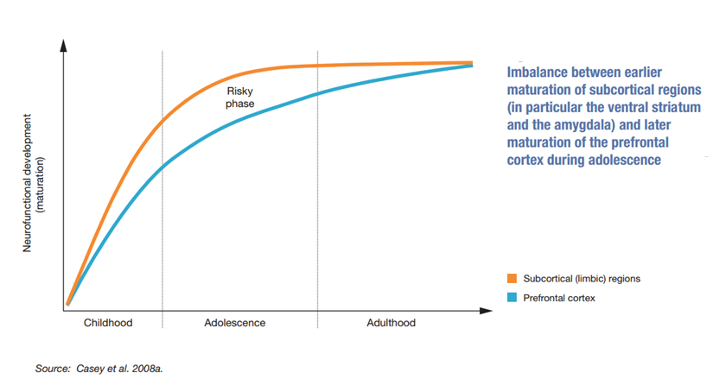
T2A: Why young adults?
Brain not fully developed until at least mid-20s;
Impulse control; empathy; planning ahead final elements of brain development;
Multiple transition points (e.g. education, care leavers, health, employment, family);
Markers of adulthood 5-7 years later than 1970s (parenthood, marriage, independent living).

Slide 5
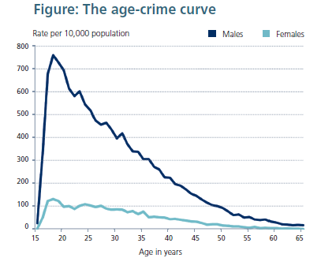
T2A: Why young adults?
18-25s are 10% of UK population; 1/3 of CJ caseload in E&W; Worst outcomes (reconviction and breach);
Peak age of offending internationally; But...peak age for desistance;
Most responsive to interventions; Successes of youth justice can be applied.

Slide 7
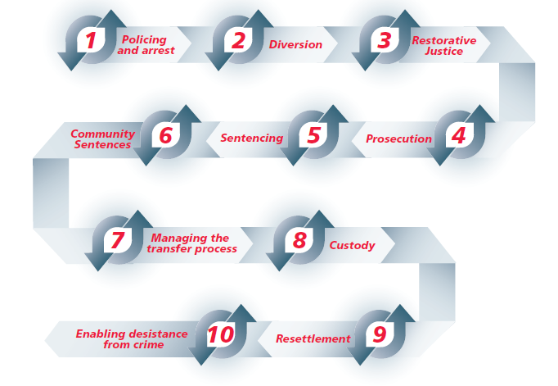
The T2A Pathway

Slide 8
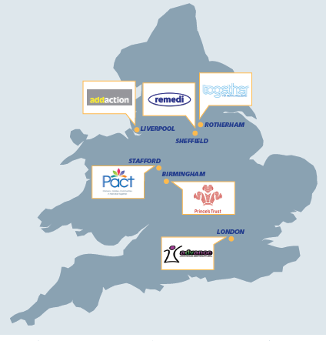
Demonstrating good practice
2008-2012 – Three pilots based at probation stage of pathway - voluntary, relationship-based, integrated support to young adults aligned to statutory interventions;
Reconviction down from 3/4 to 1/4; breach rates halved; employment rates trebled;
2014-17 - Six projects across the whole pathway (police, courts, probation and custody).

Slide 9
T2A Pathway Film

Slide 10
Lessons from the evidence – responding to a lack of maturity
No one becomes a fully mature adult on their 18th birthday
Every contact counts
Young adults may assume the worst
Quick progress matters
Niche issues are actually mainstream
Notes:
Recognise that no-one becomes a fully developed adult on their 18th birthday. Give young adults flexibility and support to meet the requirements of their Order and complete statutory demands.
Every contact counts – treat every contact, however short, as an opportunity to help them move towards desistance from crime. Your manner during every interaction makes a difference.
Show them you want them to complete their Order, and that you are not there to trip them up but to enforce the law fairly. It is very important for young adults to know that you have an interest in their compliance. You may be the only consistent, supportive person in their lives.
Be aware of the impact of trauma and attachment issues on young adults, and how these affect their behaviour.

Slide 11
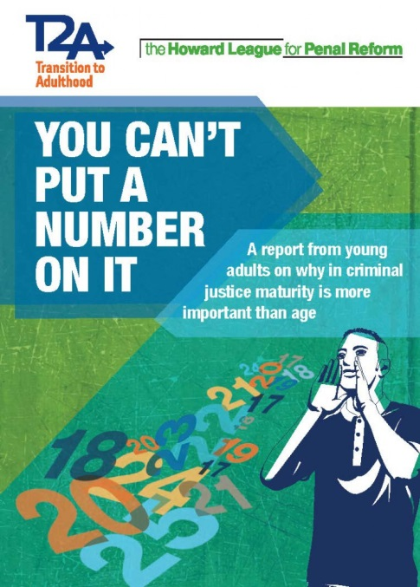
What young adults say they want

Slide 12
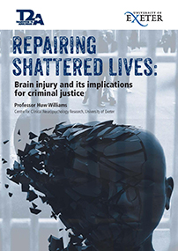
Niche issues are mainsteam
Neurodevelopment
Brain injury
Gender
Ethnicity
Notes:
Neurodevelopment: Adult male brain not fully developed until the mid-20s. These ‘neurocognitive abilities’, particularly when coupled with emotion processing systems, are critical in social behaviour. The ‘frontal’ (executive) systems along with parts of the limbic system (amygdala, hippocampus and insula) are involved in responses to situations which require such important capabilities as impulse control, empathic responding and consideration of consequences of action. Young adults have an adult range of emotions, but a teenager’s ability to regulate them.
Brain injury: Up to 70% prevalence – impact on memory, executive function and attention, socio-communication, mood and behaviour, depression, anxiety, anger
Solutions: Staff awareness training, screening (CHAT), BISI, basic coping techniques, support across and into services, neurorehabilitation.
Gender: Smaller group of the caseload, but higher intensity of complexity and need. Different to young adult men in terms of maturity and brain development, but also different from older women. Trauma more recent, likely to be a mother of young children, offence types more likely to involve violence.
Ethnicity: Huge over-representation of BAME people among young adult caseload. Average of around 30-40%, compared to around 15% of general population. Young Muslim men fastest growing group in prisons. Stop and search, gang construct, joint enterprise, dangerousness, underrepresented on CRC and overrepresented on NPS?; Islamophobia. Race/ethnicity as strength factor? Gender implications?

Slide 13
Implementation in practice
Transition framework (Probation/YOT secondments)
Intensive Offender Management for young adults
Intensive Alternative to Custody/Intensive Community Order
Adult Attendance Centres
Police triage to voluntary sector

Slide 14
Future developments
Justice Select Committee Inquiry on Young Adult Offenders
Charlie Taylor Review
Dame Sally Coates Review
David Lammy Review
Sentencing Council consultations
Young adult problem-solving courts
NPS: Implementing mandatory maturity assessments

Slide 15
Contact details
Please get in touch by email:
m.rutherford@barrowcadbury.org.uk
Websites
www.t2a.org.uk
www.barrowcadbury.org.uk
Twitter
@T2AAlliance
@BarrowCadbury

